Slide 1
SRv6
Technology and Deployment Update
Mounir Mohamed
Systems Architect – Global SP Team

Slide 2


Thank you
Lead operators
EcoSystem Partners
Academic and Open-Source Partners
IETF Partners
Cisco SR Team

Slide 3
segment-routing.net
SRv6 uSID: CKN, MPLS WC, DKNOG, Training
SRv6 Ultra-Scale SR Policy: 26 uSID push at linerate: demo
BGP PIC Edge with SRv6 Summarization: ISIS UPA: demo
Path Tracing: NANOG, Tutorial

Slide 4
Introduction

Slide 5
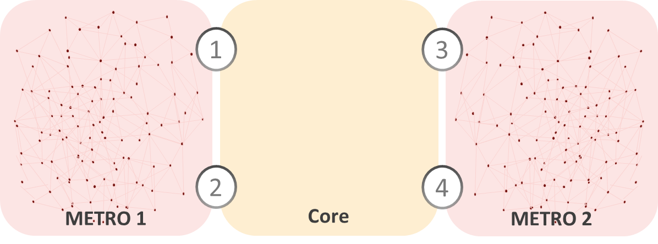
Transparent Services
SR DOMAIN
I
E
10.2/16
IPv6 Outer Header, potential SRH, NH=IPv4
IPv4 DA 10.2.0.2
IPv4 DA 10.2.0.2
IPv4 DA 10.2.0.2
{Mac, IPv4, IPv6}
{Mac, IPv4, IPv6}
Customer packet is encapsulated from
ingress to egress of the SR Domain
SRv6 is applied to the OUTER header
The inner packet is untouched
Unified control-plane data-plane E2E
Native inter-domain routing with
optimal ECMP
Native core and DC integration

Slide 6
SRv6 Network Programming - RFC8986
The End-to-End Policy is encoded as a Network Program
  The first instruction is in the outer DA
  The remaining instructions are in the SRH
An instruction (a SID) may be bound to any behavior
  TILFA FRR and uLoop Avoidance
  Traffic Engineering: internal to the domain and across peering links
  L2/L3 VPN’s
  NFV
  Any HW custom behavior: P4 on Silicon1
  Any SW custom behavior: Container orchestrated by Kubernetes
Powerful Service Creation
  Any service can be encoded as an ordered list of instructions (Low-latency Slice, VPN, NFV)
Stateless-Fabric
  The state (Network program) is in the header

Slide 7


SR Extension Header
TAG
SRv6 is a native extension of IPv6
  RFC 8754
  As foreseen 25 years ago by RFC2460
SRH contains an ordered list of SID’s
Segments Left
Locator 1
Function 1
Locator 2
Function 2
Locator 3
Function 3
Metadata TLV

Slide 8
Unified Data Plane And Seamless Deployment
A unified data plane spanning from Application socket to Internet peering though Datacenter, Access, Metro, Core, Peering
A single data plane natively supported by all nodes – just IP!
Seamless forwarding through IPv6 transit nodes
Most use-cases do not need an SRH
  DA SID contains up to 6 micro-instructions (uSID’s)
Host
User Equipment
Container
Cell Site
Peering
Access
Metro
Datacenter

Slide 9
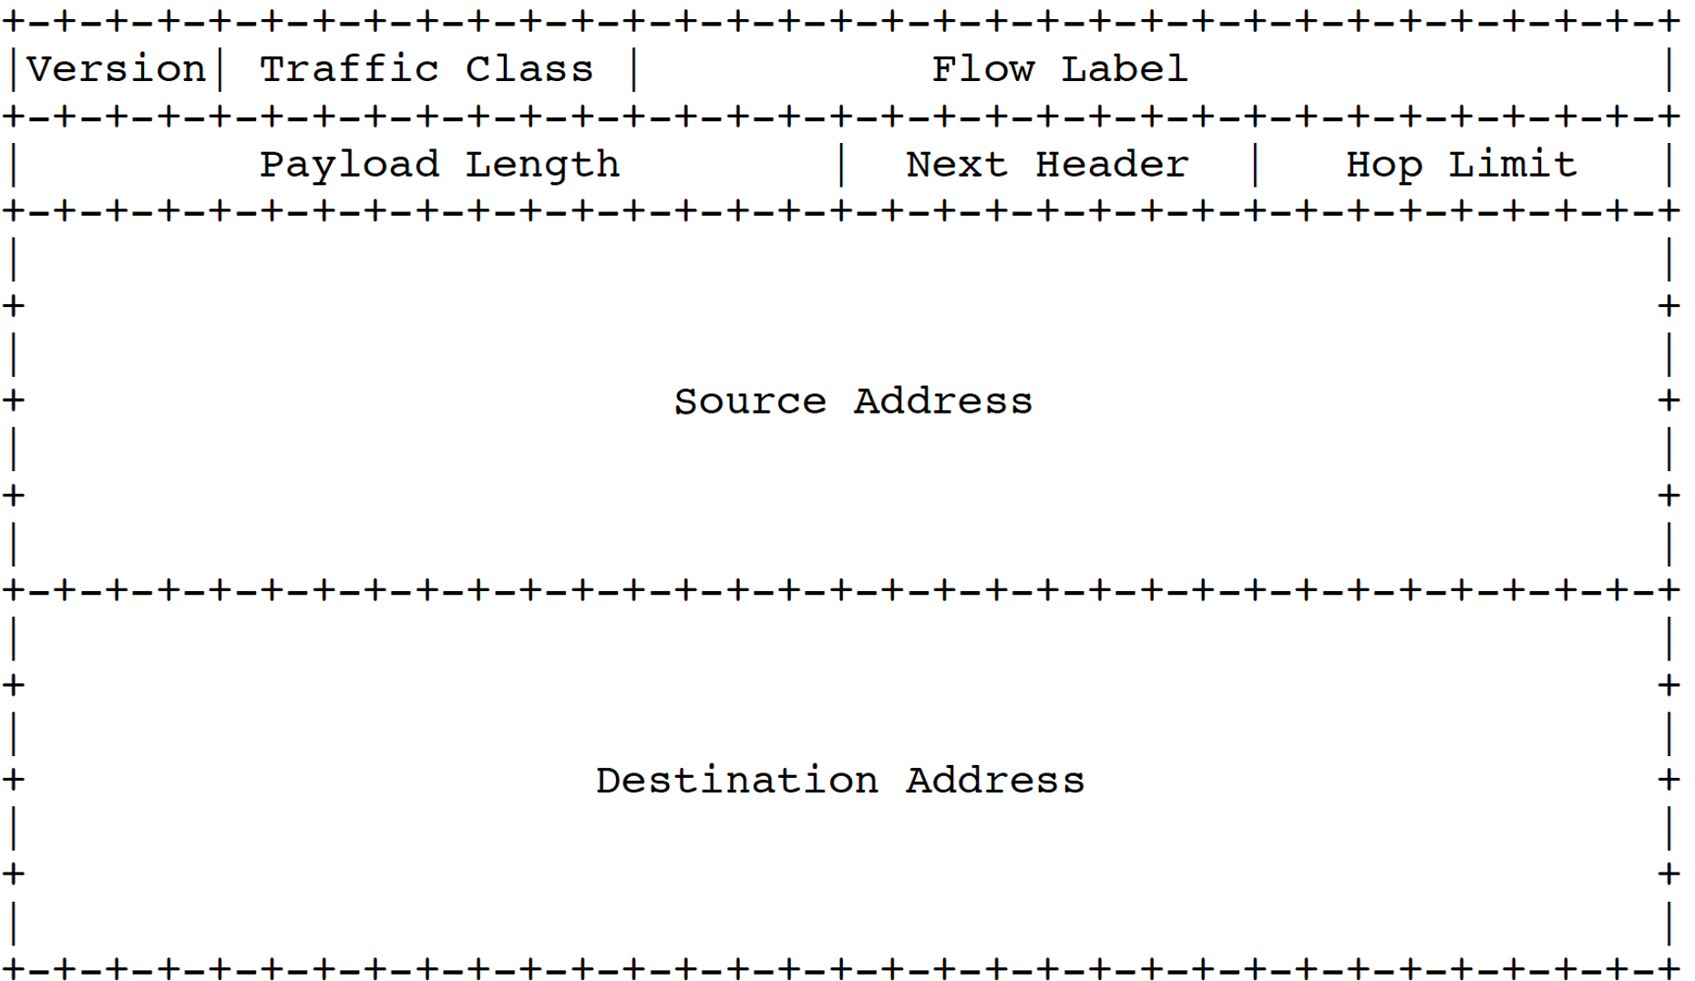
SRv6 Solves Many Challenges
ISIS
Summary1/40 Low-Cost
Summary2/40 Low-Delay
1000 times less IGP routes than with MPLS
No BGP inter-AS Option A/B/C
End-to-End Flex Algo Continuity

Slide 10
More on SRv6
Cisco Knowledge Network "SRv6 Standardization Deployed at Scale”
  https://www.segment-routing.net/tutorials/2021-11-18-CKN-SRv6/

Slide 11
Deployment Status

Slide 12
Record-Speed Deployment
3 years of commercial deployment (2019-2022)
~100M SRv6 subscribers
~100 deployments, with ~14 public reports
Across markets (Web, SP, Enterprise) and geographies (Asia, EU, US)
SoftBank | Rakuten | Indosat | MTN Uganda | Noia
Iliad | Alibaba | China Telecom | China Bank | Cernet2
Free | Bell Canada | China Unicom | Line
NEW

Slide 13

Commitment to SR Lead-Operators
Standard-Based Technology
Vendor eco-system
Open-Source eco-system

Slide 14
Mature Standardization
Much faster standardization than usual
Sign of the SRv6 Industry Endorsement
Proposed Standard
  RFC 8402 SR Architecture
  RFC 8754 SRv6 DataPlane
  RFC 8986 SRv6 Network Programming
  RFC 9252 SRv6 BGP Extension
  RFC 9256 SR Policy
  RFC 9259 SRv6 OAM

Slide 15














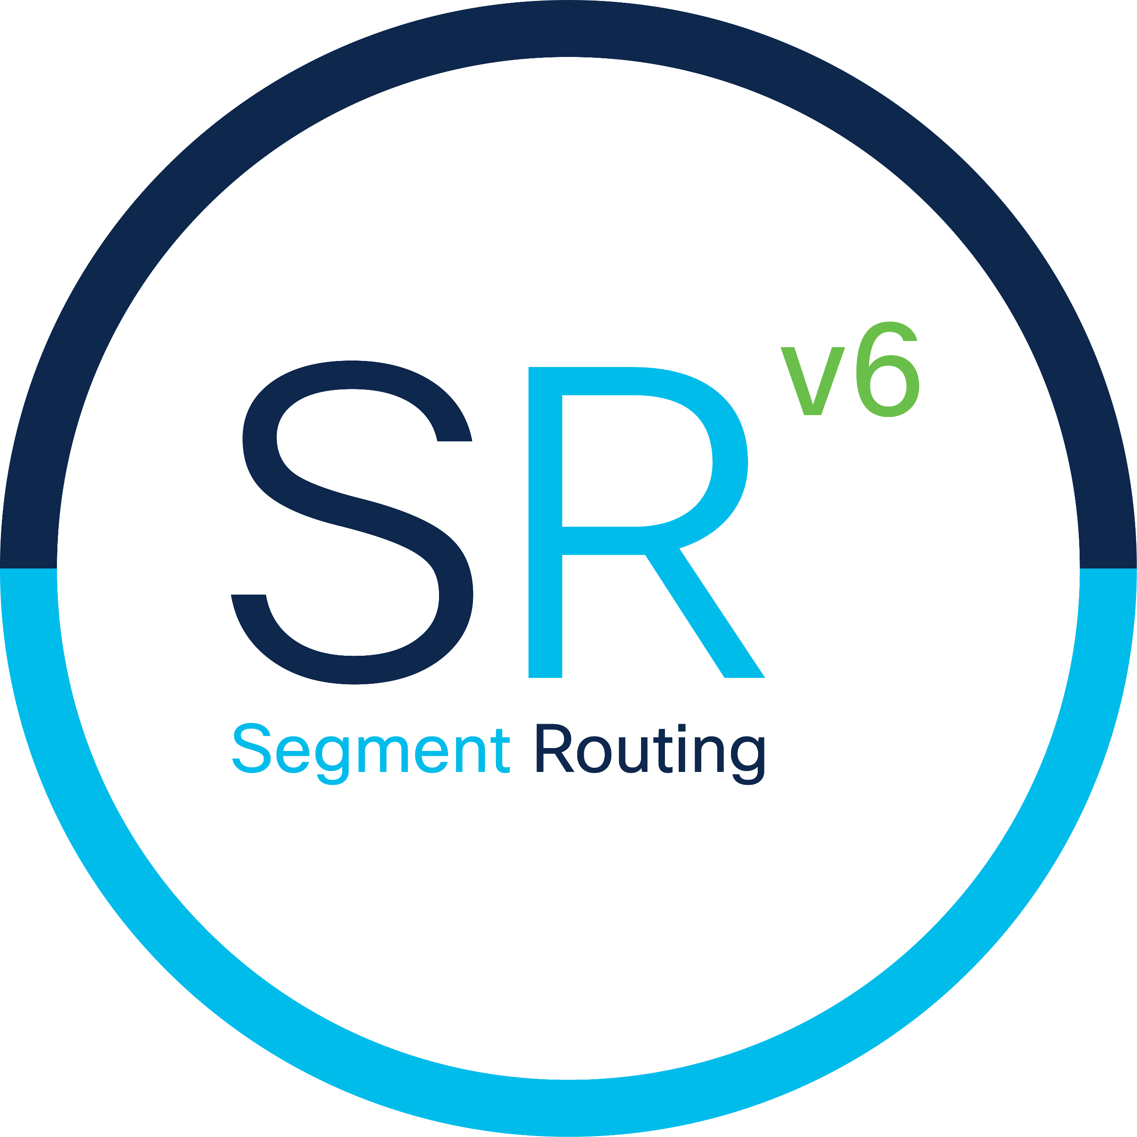
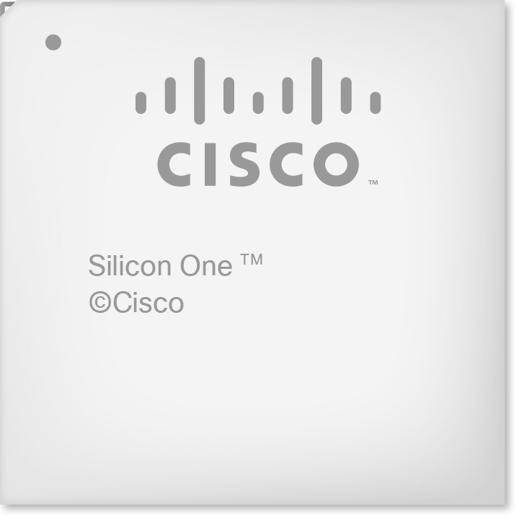






















Rich SRv6 Ecosystem
Open-Source Networking Stacks
Network Equipment Manufacturers
Merchant Silicon
Smart NIC
Open-Source Applications
Partners
BGP
Pyroute2
SERA

Slide 16
Many Successful Interops
2020/04: EANTC: SRv6 interop between Cisco, Huawei, Juniper, Arrcus, Ixia (link)
  Classic IPv6 nodes as SRv6 transit nodes
  SRv6-L3VPN for IPv4 and IPv6 services
  SRv6 TI-LFA FRR link protection with SRH insert
  SRv6 EVPN for E-Line and EVPN L3VPN services
  SRv6 TE SR Policy
2021/02: NetOne Systems (link)
  Cisco XR, Cisco NX, Juniper
2021/09: EANTC: SRv6 interop between Cisco, Huawei, Juniper, Nokia, Spirent (link)
  SRv6-Based Global IPv4 and IPv6 services
  SRv6-L3VPN for IPv4 and IPv6 services
  SRv6 TI-LFA FRR local SRLG protection with SRH insert
  SRv6 EVPN for E-Line and EVPN L3VPN services
  IGP Flex-Algo using TWAMP-measured link delays

Slide 17
SRv6 uSIDs

Slide 18
SRv6 uSID Terminology
Industry:
  SRv6 Micro Segment
  SRv6 uSID
  Briefly: uSID
IETF: NEXT-C-SID
  Briefly: Next
  IETF document: draft-ietf-spring-srv6-srh-compression-01
  Training: link

Slide 19
Container of 6 uSID’s
SRv6 Network Programming (RFC8986)
  The source encodes any end-to-end program as an ordered list of instructions
  The first instruction is in the outer DA
  The remaining instructions are in the SRH
An instruction is called a SID
A Container SID may contain up to 6 micro-instructions called uSID’s
FC00:0000:1111:2222:3333:4444:5555:6666
uSID Block
uSID1
uSID2
uSID3
uSID4
uSID5
uSID6

Slide 20
Perfect SRv6 Integration
uSID reuses SRH (RFC8754) without any change
uSID strictly applies the SRv6 Network Programming (RFC8986)
uSID can be bound to any Network Programming Instruction

Slide 21
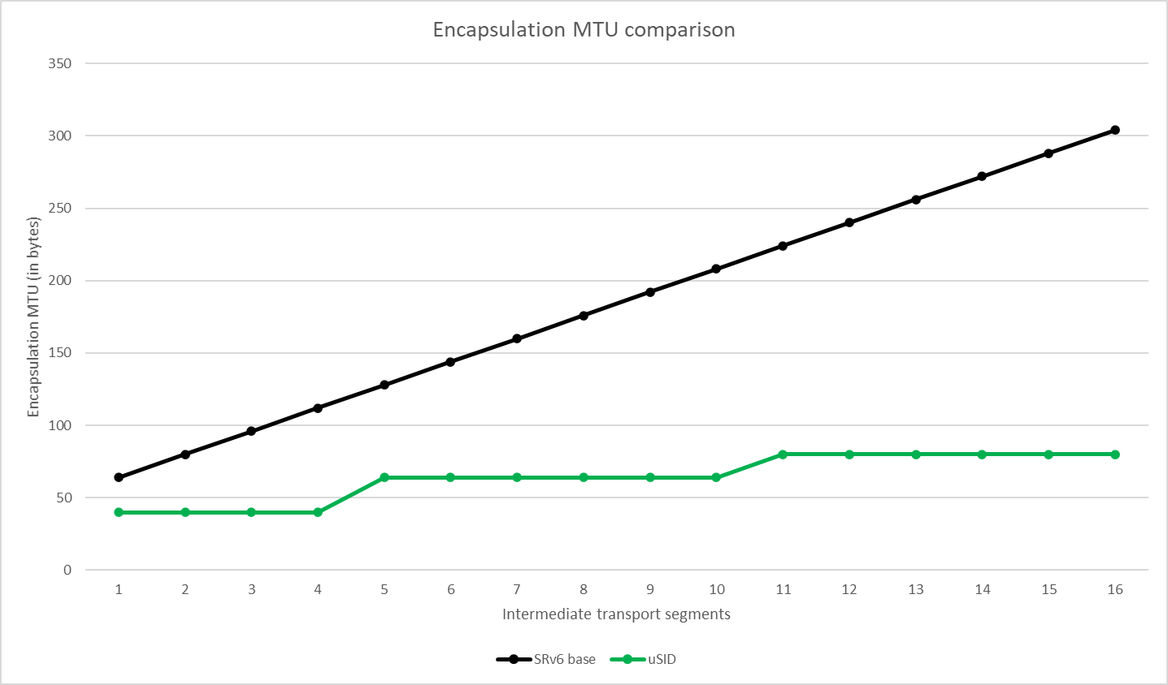
SRv6 uSID offers the best SRv6 Compression
SRv6: 208 bytes
SRv6 uSID: 64 bytes

Slide 22
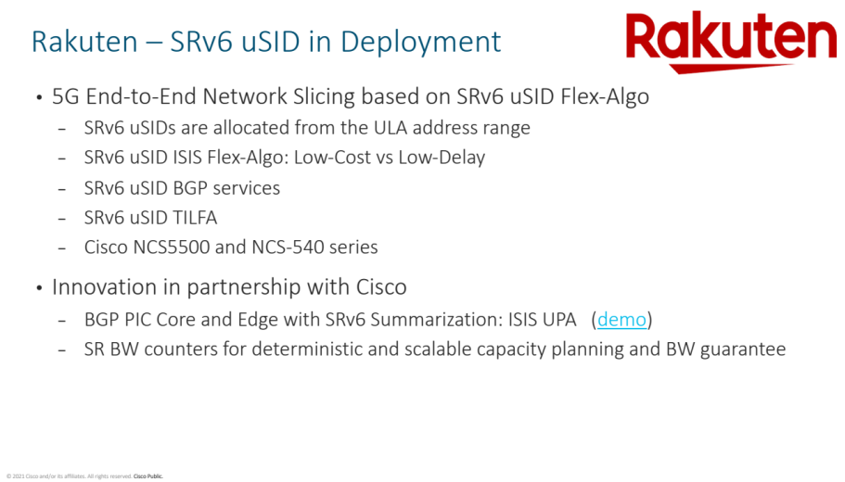
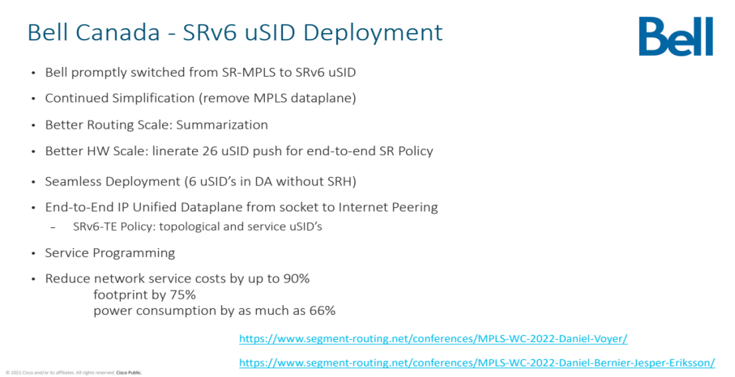
SRv6 uSID in Deployments
https://www.segment-routing.net/conferences/MPLS-WC-2022-Amit-Dhamija/
https://www.segment-routing.net/conferences/MPLS-WC-2022-Daniel-Voyer/
https://www.segment-routing.net/conferences/MPLS-WC-2022-Daniel-Bernier-Jesper-Eriksson/

Slide 23















SRv6 uSID - Rich Eco-System
Cisco, NoviFlow, Arrcus, Nokia, Ciena
Merchant: Silicon One, Broadcom, Marvell, Barefoot
Open Source: Linux, FD.io, P4, eBPF, Cillium, SAI, SONIC, FRR

Slide 24
More on uSID
SRv6 Technology Status and Deployment Update
  https://www.segment-routing.net/conferences/MPLS-WC-2022-Clarence-Filsfils/

Slide 25
Path Tracing

Slide 26
The exact path from A to M is not known
7 possible “valid” ECMP path
  ABFM, ABGM, ACFM, ACGM, ACHM, ADGM, ADHM …
E
B
F
J
A
C
G
M
D
H

Slide 27

The exact path from A to M is not known
7 possible “valid” ECMP path
  ABFM, ABGM, ACFM, ACGM, ACHM, ADGM, ADHM …
What exact path was taken by one specific packet?
  40-year-old unsolved IP problem
  Packet may have also taken an invalid path (Routing or FIB corruptions)
Timestamp at each hop
Interface Load at each hop
E
B
F
J
A
C
G
M
D
H

Slide 28


The Path Tracing Idea
Stamping in the packet header
Implemented at linerate in the most basic HW pipeline
  Reports true packet experience
  No punting to CPU, no offload to co-processors
Ultra-MTU-efficient
  Highly compressed for low MTU overhead
  Only 3 bytes per hop (12bit interface, 8bit TS, 4bit load)
Each transit router records:
  Outgoing interface ID
  Timestamp
  Outgoing interface Load
Native interworking with legacy nodes
  Seamless deployment
IPv6 header: A to M
BE
PT header: (AB, Time, Load)
Payload
B
D
A
F
C
E

Slide 29

Stamping Trajectory in PT Header
IPv6 header: A to M
AB,
PT header:
Payload
B
A
C
G
M
D
H

Slide 30
Stamping Trajectory in PT Header
IPv6 header: A to M
BG,
PT header: (AB, Time, Load)
Payload
B
A
C
G
M
D
H

Slide 31
Stamping Trajectory in PT Header
IPv6 header: A to M
GM,
PT header: (AB, Time, Load) (BG, Time, Load)
Payload
B
A
C
G
M
D
H

Slide 32

Minimize HW complexity by leveraging SDN analytics
Exact path validation (interface by interface)
  detect blackholes
  detect unexpected paths
  detect missing paths
Propagation latency & Optical stability
Per node jitter measurement
SDN App
B
A
C
G
M
D
H

Slide 33



Ecosystem
Cisco Shipping in CY22
  C8000 (Q200), NCS5700 (J2), ASR9000 (LS)
Rich Eco-System
  Cisco, Broadcom, Marvell, +others
Rich Open-Source
  Linux, FD.io VPP, P4, Wireshark, TCPDUMP
Path Tracing is being standardized at IETF
  Path Tracing in SRv6 networks (ietf.org)

Slide 34






Stay up-to-date
SRv6 Part III
CY2023
amzn.com/B01I58LSUO
amazon.com/dp/B07N13RDM9
twitter.com/SegmentRouting
segment-routing.net
facebook.com/SegmentRouting/
linkedin.com/groups/8266623
ask-segment-routing@cisco.com

