Slide 1
Too Much Data is no Information
Manuj Marwaha
Sr. Sales Consultant

Slide 2
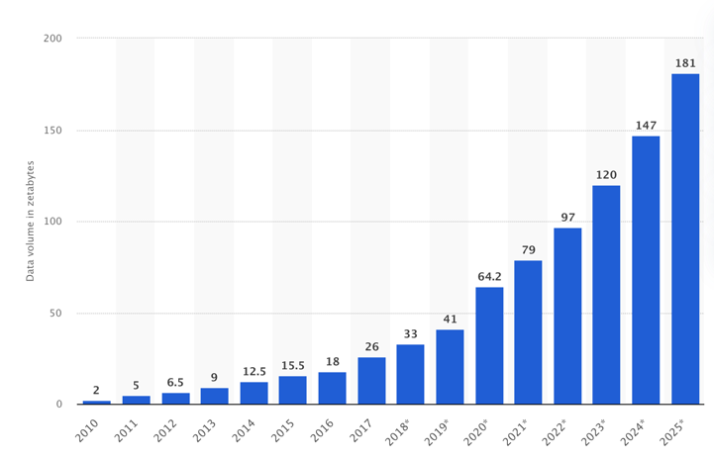


Data Tsunami++
Zetabytes: how many billion bytes ?
Post Covid Era
Annual Volume in Zetabytes
Information Credit: statista.com
Data Forecast

Slide 3


New Paradigms, New Edges
Visibility challanges
Apps

Slide 4
……more new Age Challenges
Cloud Native
Encryption
East/West Visibility
Vendor Independence
Complex Network Plumbing

Slide 5
Cloud Native
Barrier
Paradigm Shift
  Containerization, K8s
  Vendor supplied cloud vs CSP supplied cloud
  Edge Computing
  Complex Network Plumbing
    Load balancers
    NAT’ing
    IPV4/IPV6
    IP Flows - Duplicate IP addresses
K8s
Containers
Pods
NGC
Services
IPV6
Load
Balancers
Elasticity
Edge
Edge
Edge

Slide 6
Cloud Native
Barrier
K8s Cluster
Pod4
Pod2
Host 1
K8s Cluster(s)
CNF
Microservice Based
Elasticity
Automation
Pod3
Pod3
Host 2
AMF-1
Pod4
Pod1
Pod2
Host 3
T
PCF-2
Pod2
Pod2
UDM-1
CHF-7
Host 4
Pod1
SMF-3
Pod3
Pod1
Host 5
AMF
T
Pod2
Pod1
Host 6
T
PCF
CHF
Pod1
T
Pod1
Host 7
SMF
UDM
East/West

Slide 7
TLS Encryption
Barrier
Pod
Pod
AMF
TLS
TLS
SMF
1
Built In
Encrypted
91.3.1.1
91.3.1.12
Pod
Pod
AMF
SMF
2
Service Mesh
127.x.x.x
Sidecar
(TLS Encryption)
Sidecar
(TLS Encryption)
91.3.1.1
Encrypted
91.3.1.2
Additional
Container

Slide 8
East/West Visibility
Barrier
Packet Acquisition
  Non-standard
  Vendor proprietary
  Timestamps
  Out-of-Order packets
  Packet fragmentation at multiple levels
CNF#1
vTap
CNF#2
Real time Packet Decoder
Physical or Virtual
Load Balancing
Out-of-order
Fragmentation
Re-assembly
Timestamps

Slide 9
Solution should be Vendor Independent
Barrier
5G SA Vendors
Visibility Without Borders
Ericsson
T
Nokia
P
T
Analytics Engine
Packet decoder
Physical or Virtual
P
Mavenir
T
Smart Data
P
Secure Communication
P
Oracle SCP
T
P
Aspen Mesh
T
packet plugins
Vendor specific vTAP
Notes:
Easy to intergrate with any 3PP system or application
Generic and secure interface across NF types
Industry proof
Output adjustable to different formats
Integrated with ENM/CNOM and EEA

Slide 10
Complex Network Plumbing
Barrier
IP Flows
  IP Addresses do not uniquely identify a Cloud Native Function
  In Cloud Native a network function is identified by it’s NF Instance Id (128 bit)
  IP Addresses are transient and change for many reasons
  Complexity inherited with cloud native architecture (NAT’ing)
Request
Consumer
Consumer
Network
Function
Network
Function
nat
nat
Producer
Producer
Response
T
AMF
SMF
Consumer get’s NAT’d, only the Producer is known !
Result: Incomplete Visibility

Slide 11
Solution : Standards Updated
New HTTP2 Header
  3gpp-Sbi-NF-Peer-Info
    3GPP R17 TS 29.500
    Consumer NF and Producer NF uniquely identified by nfInstanceId IE’s
    128 or 64 bit universally unique number (UUID), described in IETF RFC 4122
  Configuration Flexibility
    Included or excluded in all messages (request/response, subscribe/notify)
    Providing the consumer NF, producer NF or both NFs
New Standards

Slide 12
Simple Name Table
“Like DNS”
nfInstanceId | Name
0c765082-9cc5-49c6-9876-ae2f5fa2a63f | BOSTMA-NRF-201
8fc32042-6dbf-4c4e-8daa-055cf5504df4 | BOSTMA-AUSF-201
13a1de32-ec45-4cd6-a842-ce5bb3cba3d8 | DLLSTX-NSSF-201
d67766f2-210f-4ecf-858f-cc42a60fc00e | DLLSTX-SMF-201
8b85f3f2-2f66-4698-b07e-06a07010632e | DLLSTX-AMF-201
f8b58652-49e8-463e-8f16-4dd6a15d3f14 | DLLSTX-UDR-201
2c765012-3cc5-49c6-9876-ae2f5fa2a63f | DLLSTX-UDM-201
Consumer/Producer ID
“User Friendly Name”

Slide 13
Barriers to be Removed !
Cloud Native
Encryption
East/West Visibility
Vendor Independence
Complex Network Plumbing

Slide 14
Smart Data
Ultra-HD Insights
  Derived from the Source of Truth
  - Packets, Universally Available
  Multi Generational Network Intelligence
  - 5G, 4G, 3G, 2G, WiFi, Fixed
Consumer, HVA, IoT
Subscriber
  Per Subscriber
  - Per session insights
Smart
Video, OTT, URLLC
Mobile, Fixed, WIFI
  Multi Dimensional
  - Service, handset, device, cell, location, network,...
SERVICES
Technology
Data
  Rich App/Network Metrics
  - Errors, latency, throughput, audio gaps, video quality,...
NETWORK
  Full Visibility
  - Physical and virtual, Open APIs
Physical, Virtual, Hybrid

Slide 15


New Approach: Advanced Analytics
Analytics (AI/ML)
Smart Data
Packet
Data
Automated Intelligence
Ultra HD Visibility in a Hybrid World
Ultimate Source of Truth

Slide 16
How we can have Visibility Without Borders
This gives the Confidence To Innovate
Any network
5G
Open RAN
3G/4G
WiFi
Cable
Fixed
...
Any Vendor
Ericsson
Mavinir
Nokia
Cisco
Huawei
AltioStar
F5
...
ANY NETWORK
ANY VENDOR
Any CLOUD
Kubernetes
Edge/MEC
OpenStack
VMware
Public
...
Any Service
Enterprise 5G
EPS Fallback / VoNR
VoLTE/VoIP
OTT
Video
IoT
...
ANY CLOUD
ANY SERVICE

Slide 17
Use-Case: Correlated Information is beautiful
(Radio and Core correlation)

Slide 18
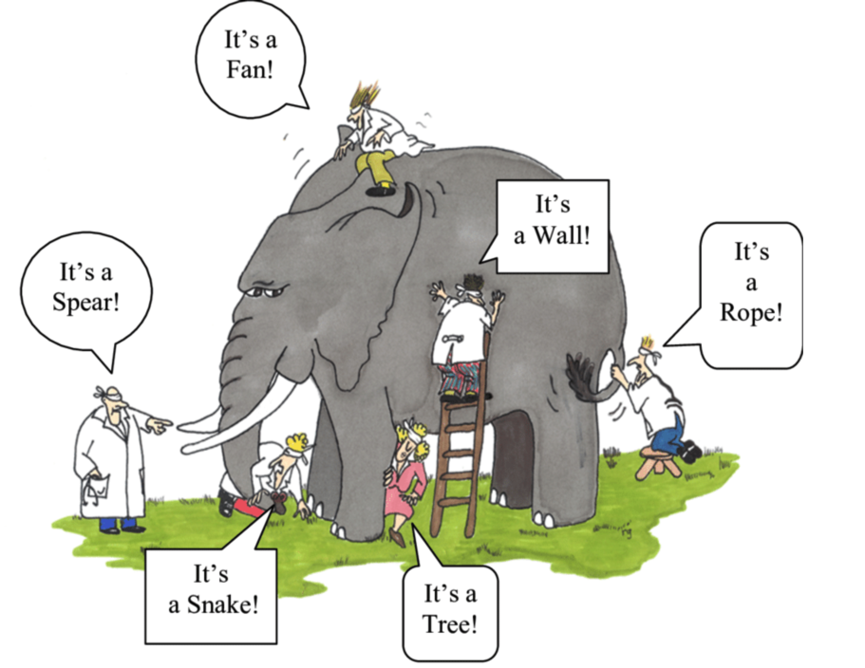
Uncorrelated Data-Elephant in the dark

Slide 19
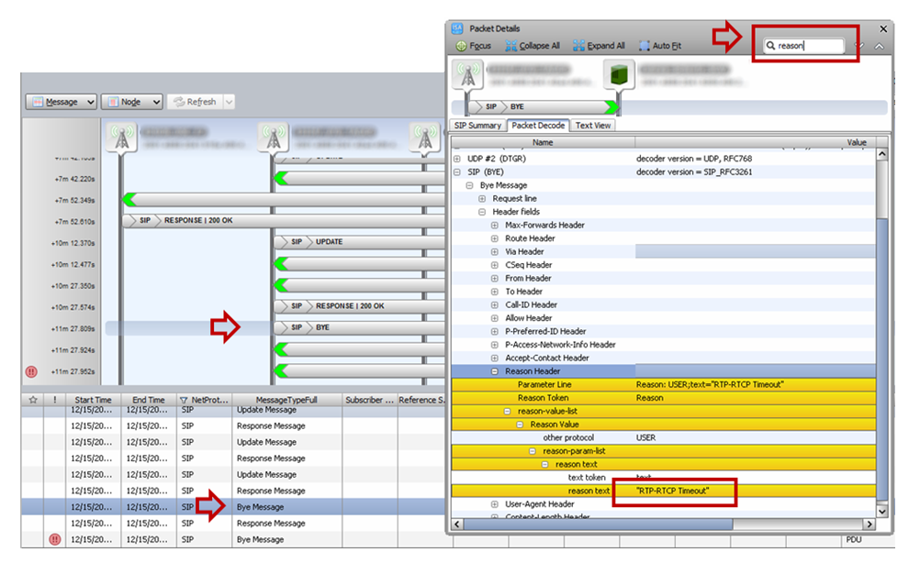
Dropped VoLTE Call Analysis
The importance of end-to-end visibility
Packet Details
Session Trace
A service technical team investigating a stream of errors in one region of the network kept pointing the errors to the SIP BYE message.
When they looked at the Reason Header in the SIP Bye message they found generic timeouts to be the cause.
Investigations lasted days, with finger-pointing and ping pong tickets rising the cost to the carrier.
SIP BYE
SIP Reason: “RTP/RTCP Timeout”

Slide 20
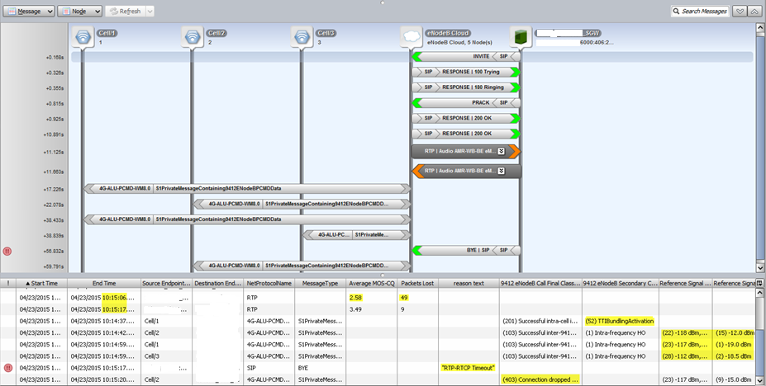
Dropped VoLTE Call
Radio Network
Core Network
2. Low signal power reported on the radio link in the access
1. Low MOS reported in the media flow uplink in the core
3. Call dropped due to the poor radio connection

Slide 21
Why Automation?
KPI Analysis
AI/ML
Automate the mundane
Discover what humans can’t
Tedious and time-consuming tasks
Complexity Increasing Exponentially
Use highly skilled resources
more efficiently
Deep domain knowledge in multiple
disciplines is needed
Smart Outcomes
Actionable Business Intelligence

Slide 22
Automating the Workflows
Audio Gaps, who is responsible?

Slide 23



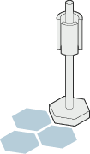


Multi-dimensional correlation to determine point of failure
4G
IMS/Fixed
3G
MME
HSS
PCRF
S6a
MAP
HSS
TAS
Sh
S1-MME
S6b
Gx
S11
Softswitch
Rx
Cx
Softswitch
S5/S8
P-CSCF
ISC
BGCF
PSTN
S1-U
S-CSCF
eNodeB
N26
Gm
Mw
Mj
Mk
SGW
PGW
Gm
Peering SBC
Mg
Peering SBC
AUSF
UDM
NSSF
PCF
Mr
Mx
Peering
5G
…
iBCF
MGCF
MRFC
Ici
Mb
NNI
(To Wireless)
NNI
(To Wireless)
N11
Mp
Ix
NNI
(To Wireline,
3G, …)
N1/N2
N4
Mn
AMF
SMF
Izi
N3
Mb
Mb
Mb
UPF
MGW
MRFP
TrGW
gNodeB
Are audio gaps coming from: device, RAN, MGW, combination of multiple dimensions?

Slide 24
Applying Intelligent Automation beyond Human Capabilities
X
User Impact
How Many
Subscribers Impacted
Outlier Detection
Apply AI/ML to
Isolate the Issue
Deep Analytics
High-Definition
Visibility
Cross Correlation
Identify
Hidden Patterns
Smart Outcome
Actionable
Intelligence
SIP to RTP correlation
Audio quality analysis
Call completion
Am I different from myself?
Am I different from my peers?
What factors are causing me to be an outlier?
Is it RAN, Core, or a Handset software issue?
Are there relationships / patterns when looking at issues between device models, markets, cells, CSCFs ?
Output to UI or Export
Includes additional evidence for complete validation

Slide 25
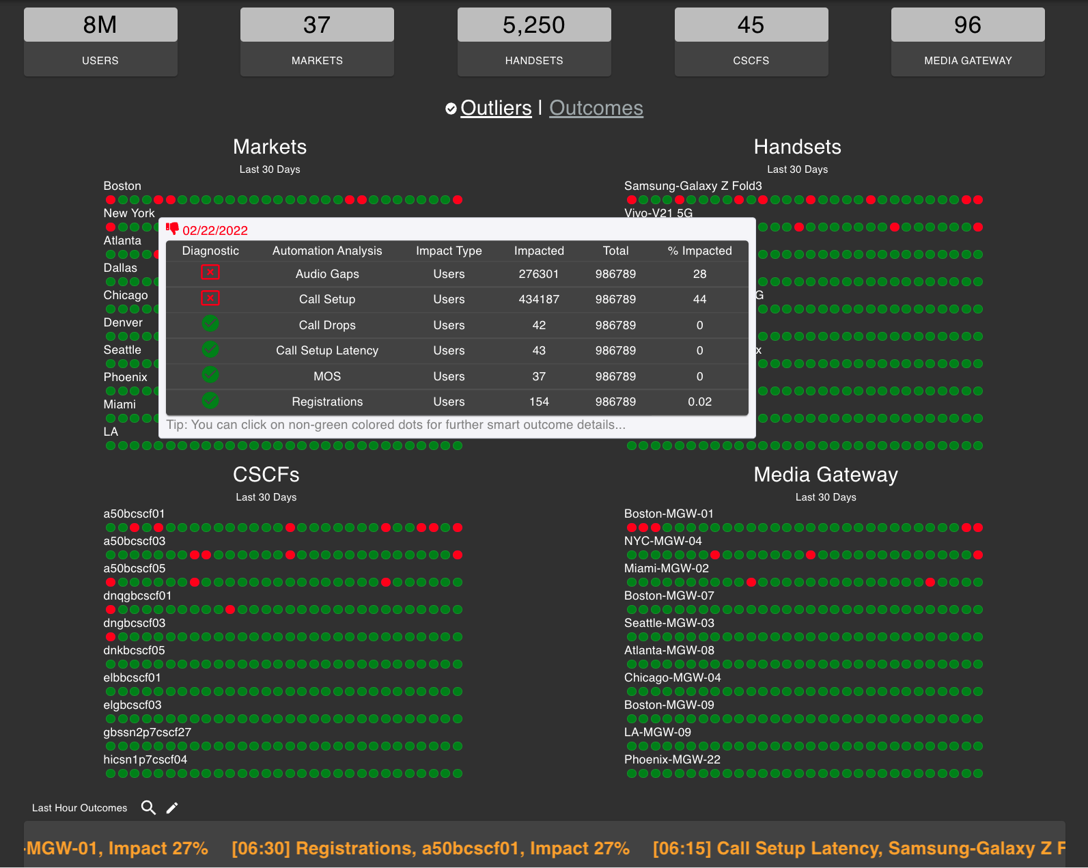
Audio Gaps (Automated)
Outlier Detected
Audio Gaps in a market
28% of the Users Impacted
What is the source of the problem and why is it happening?

Slide 26
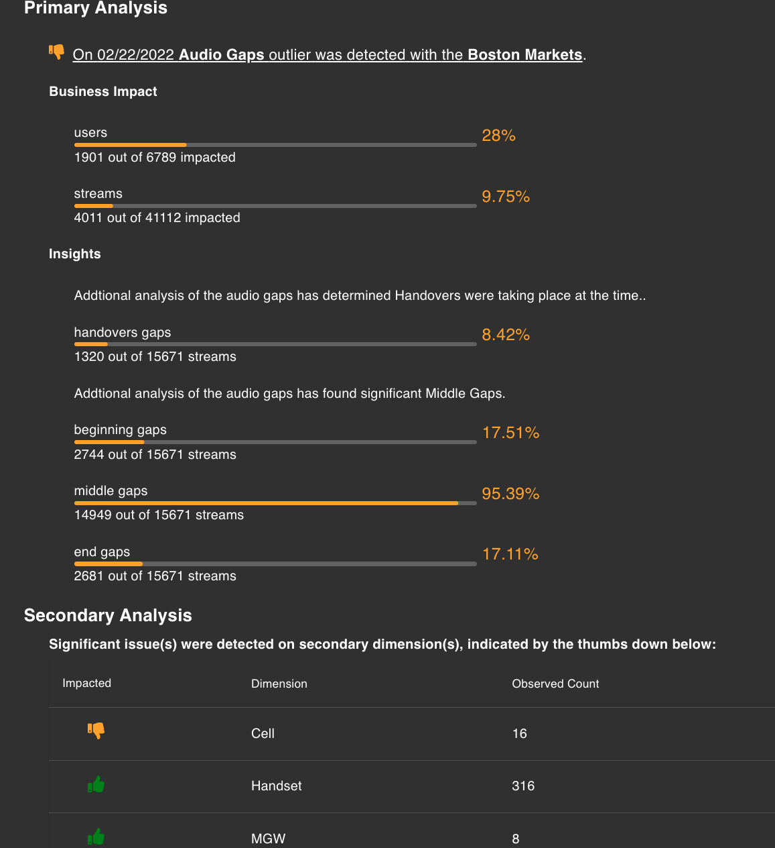
Drill Down Audio Gaps
Drilling down on outlier for detailed analysis…
Business Impact
1901 users are impacted
4011 streams are impacted
Insights
Audio gaps happening during handovers
Most of the gaps are middle gaps (during conversation)

Slide 27
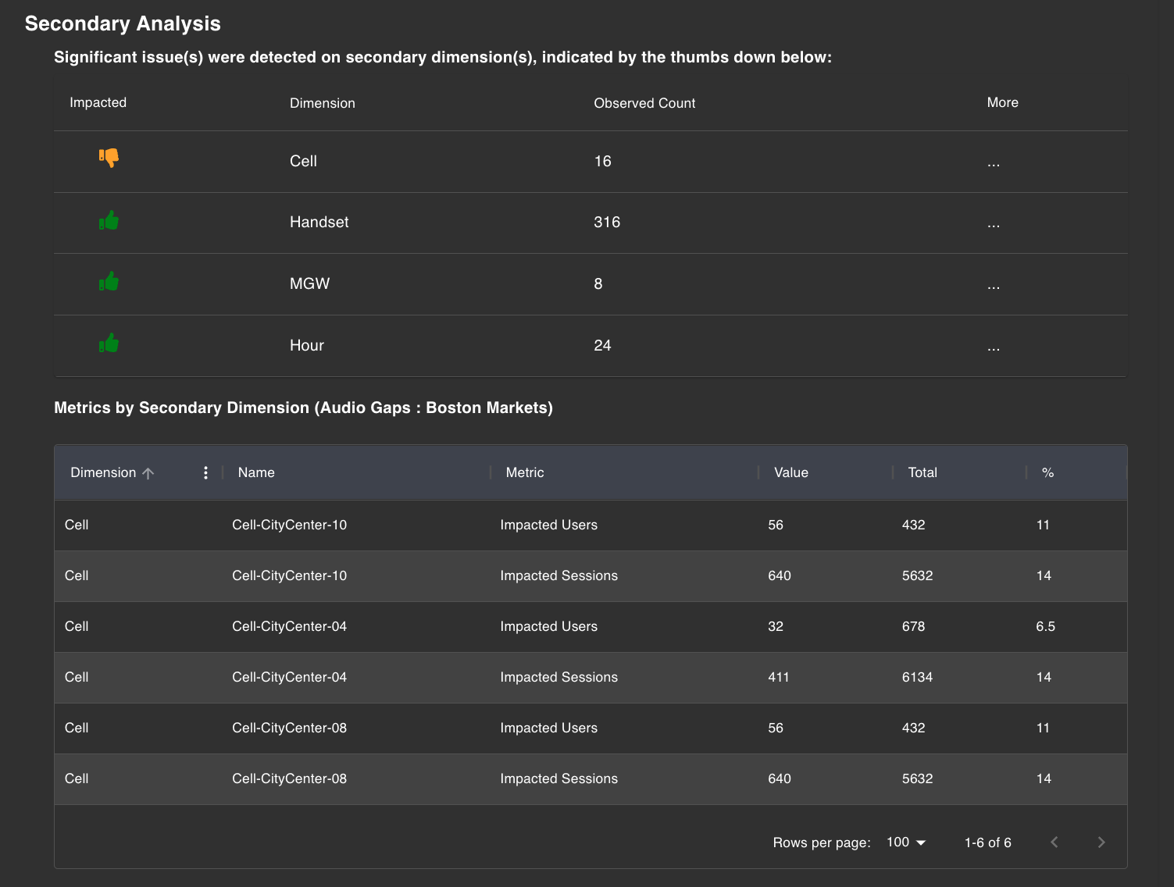
Audio Gaps Continued…
Multi dimensional analysis finds the culprit
Secondary Dimension Analysis
Indicates cell dimension as the problem source
Audio gaps are happening on the same cell

Slide 28
Automation
Machine Learning
Applying ML
to Smart Data
Analytics Chains
Deep Analysis
Our Domain Knowledge
Packaged
Comprehensive AI Diagnostic Checklist
Business Impact
Smart Outcomes
Number of Unique Subscribers Impacted
Actionable Business Intelligence
Automated Intelligence

Slide 29






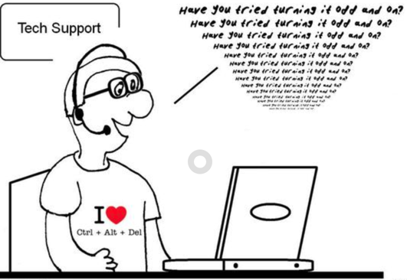

Hybrid networks-multiple problems
Not able to connect to the SaaS application
Video is buffering
There is too much noise
Can you hear me!!!!
(No Audio)
Database connection is timing out
Data Analyst/
Support Staff
not able to roam

Slide 30

Cloud
Native
East/West
Visibility
Fixed/FTTX
Automation
AI/ML
Vendor
Independence
5G SA

Slide 31

Key Takeaways
Visibility is the key aspect for manageability
With the increased data speeds the legacy approach is not enough to manage the networks.
The new age monitoring solution needs to
Cloud Native ready
Must be vendor agnostic and packet data driven
Embrace multiple networks and environments with Multi-protocol and Multi-Leg correlations
Provide AI/ML driven analytics for automation.

Slide 32
Thank You
Manuj Marwaha
Sr. Sales Consultant

