Slide 1

Transformation of Peering in Middle East
MENOG23 – Bernd Spiess

Slide 2
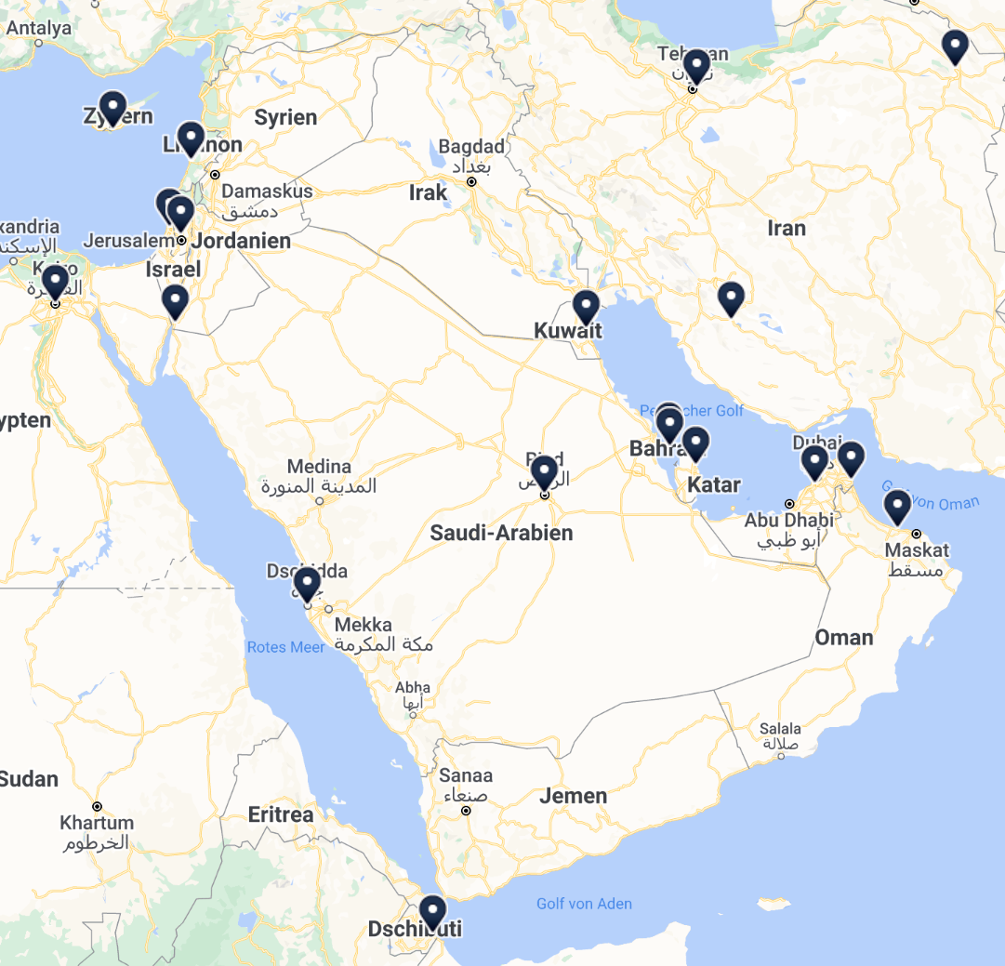
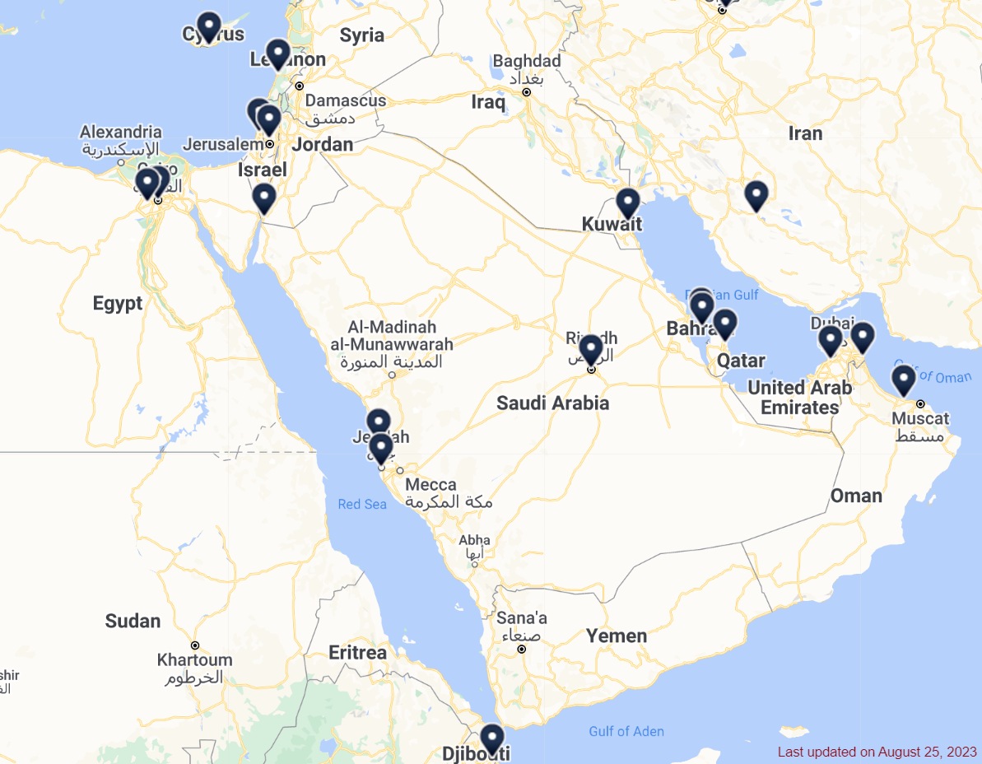


Peering Landscape …
2022 vs. 2023
EG-IX and SAIX JED Two new IX in Service year 2022-23
+ Equinix Jeddah?
Source : https://www.internetexchangemap.com

Slide 3
ME IXP Overview and IPv6 % in 2023?
(source: peeringdb.com, accessed: 10.10.2023, ixp > 1 peer)
Country | IXP | Peers | Total Speed | IPv6%
Bahrain | MANAMA-IX⁽¹⁾ | 27 | 1.6 Tbps | 91
Djibouti | DJIX | 13 | 155 Gbps | 85
Egypt | CAIX | 4 | 4 Gbps | 26
Egypt | EG-IX⁽¹⁾ | 7 | 422 Gbps | 100
Egypt | PyramIX | 29 | 34 Gbps | 100
Iran (=> Homepage) | Tehran IXP | 2 | 50 Gbps | 0
Jordan | AqabaIX⁽³⁾ | 17 | 212 Gbps | 93
KSA | JEDIX⁽²⁾ | 22 | 1.8 Tbps | 80
KSA | Equinix Jeddah | 4 | 220 Gbps | 100
KSA | SAIX (JED) | 3 | 56 Gbps | 100
KSA | SAIX (RHU) | 25 | 2.3 Tbps | 100
Kuwait | ix.kw | 16 | 274 Gbps | 84
Oman | Equinix Muscat | 8 | 380 Gbps | 100
Qatar | QIX | 12 | 112 Gbps | 92
UAE | SH-IX | 35 | 454 Gbps | 91
UAE | UAE-IX⁽³⁾ | 89 | 2.6 Tbps | 90
(1) powered by AMS-IX
(2) powered by LINX
(3) powered by DE-CIX

Slide 4
ME IXP Overview - Peak
(source: homepages – accessed: 3.9.2023 / updated: 10.10.2023 – rounded up to full numbers)
Country | IXP | Peak
Bahrain | MANAMA-IX⁽¹⁾ | (?) Gbps
Djibouti | DJIX | 15 Gbps
Egypt | CAIX | ?
Egypt | EG-IX⁽¹⁾ | 66 Gbps
Egypt | PyramIX | ?
Iran (=> Homepage) | Tehran IXP | ?
Jordan | AqabaIX⁽³⁾ | ?
KSA | JEDIX⁽²⁾ | 431 Gbps
KSA | Equinix Jeddah | ?
KSA | SAIX (JED)
KSA | SAIX (RHU) | 361 Gbps
Kuwait | ix.kw | 32 Gbps
Oman | Equinix Muscat | ?
Qatar | QIX | ?
UAE | SH-IX | ?
UAE | UAE-IX⁽³⁾ | 514 Gbps
(1) powered by AMS-IX
(2) powered by LINX
(3) powered by DE-CIX

Slide 5
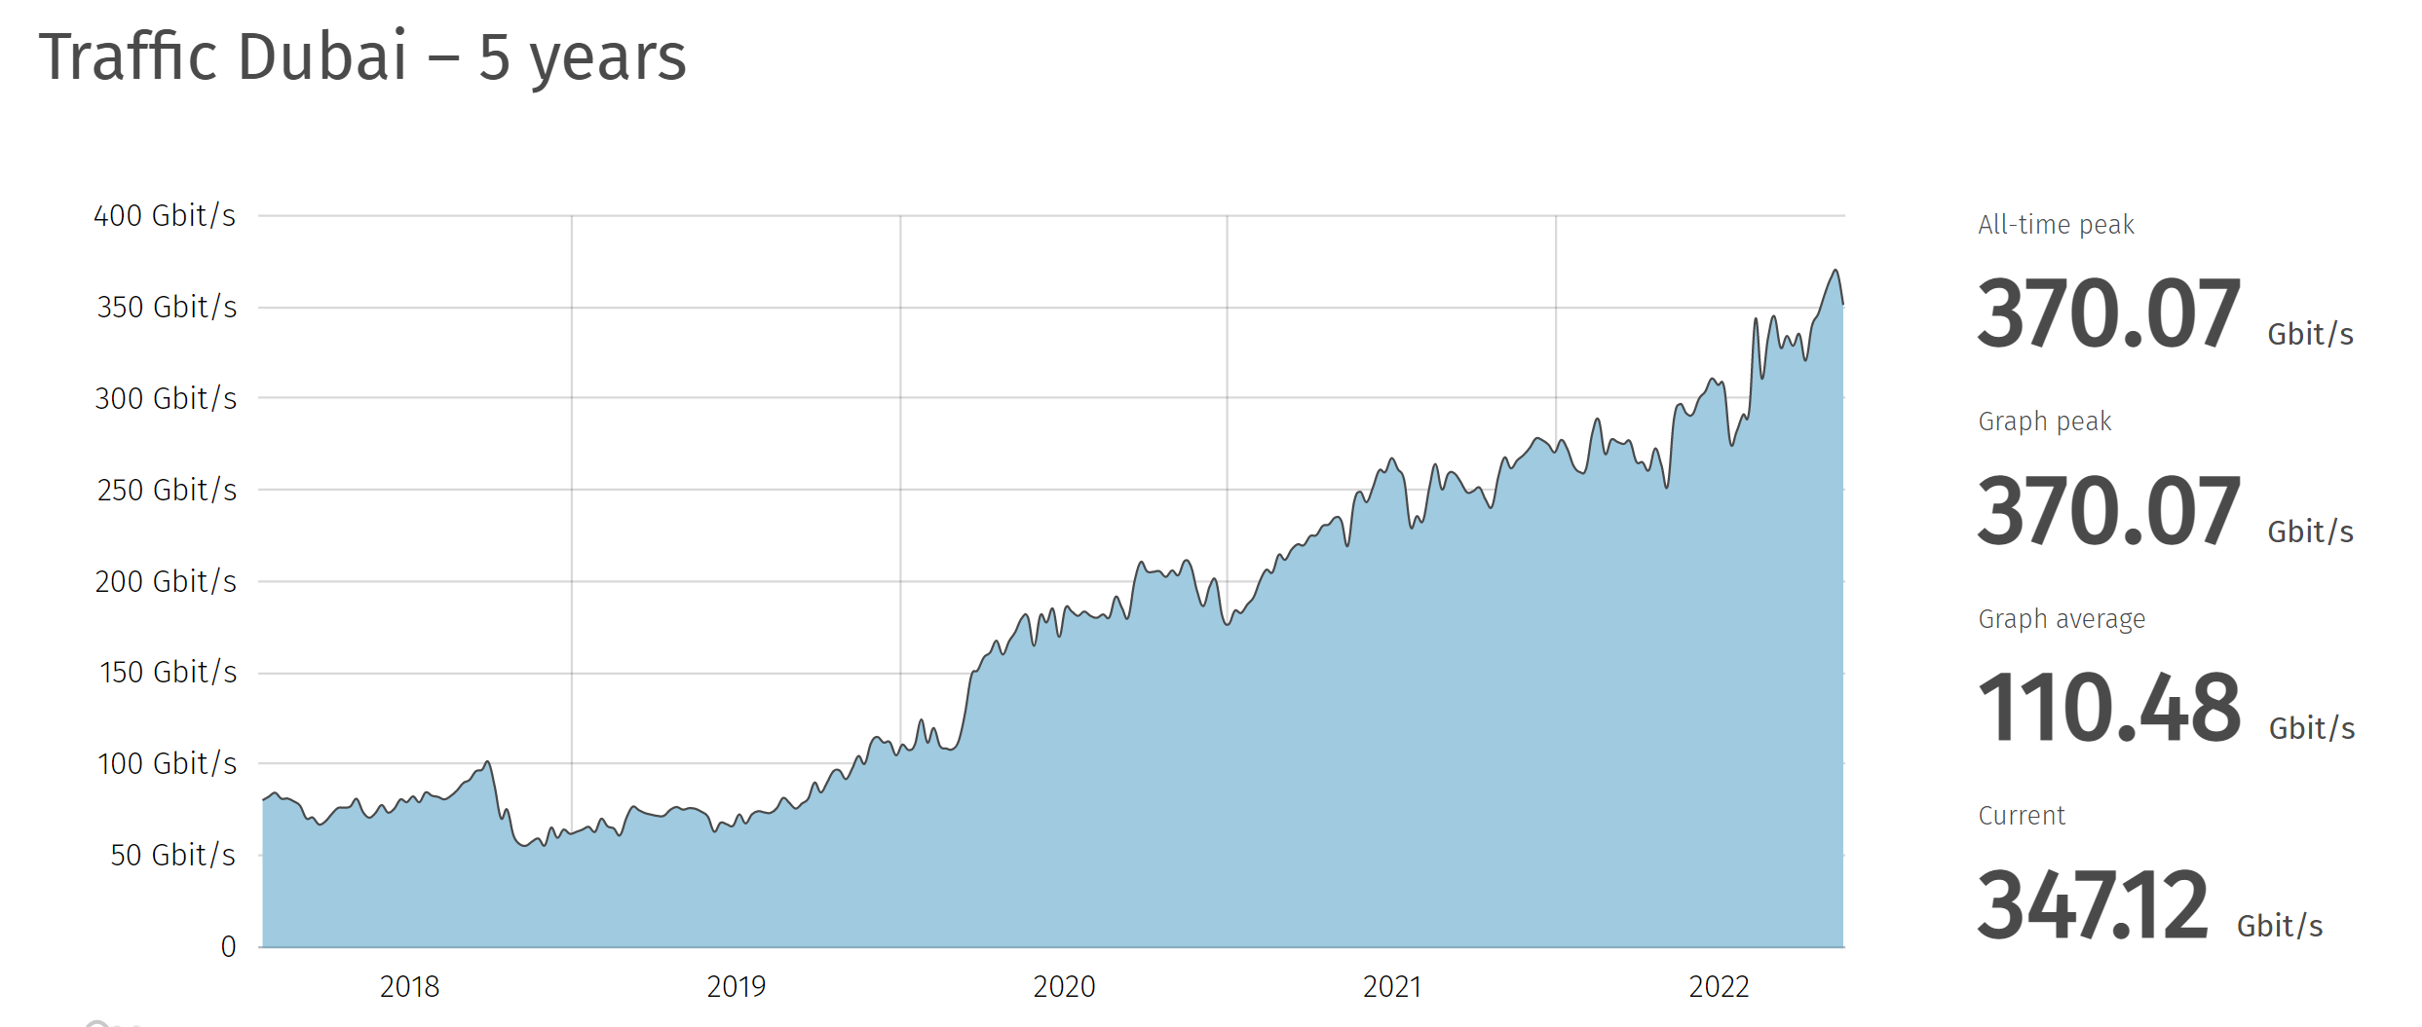
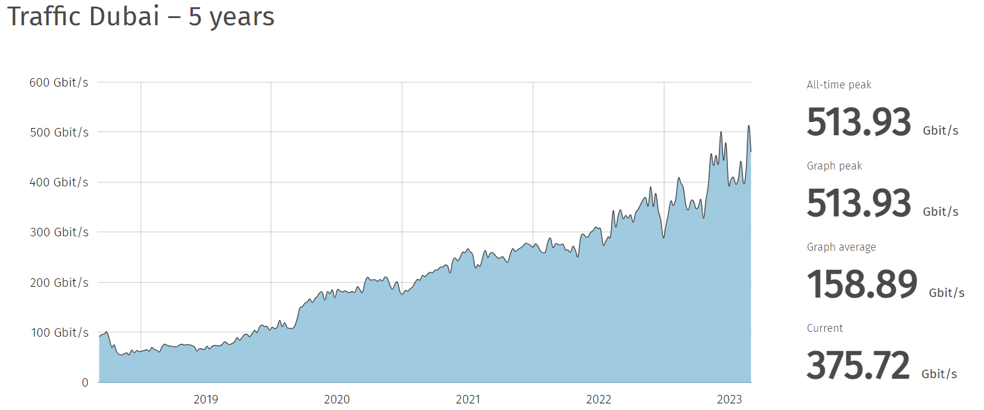
Growth Example of Traffic based on UAE-IX
2022
2023

Slide 6
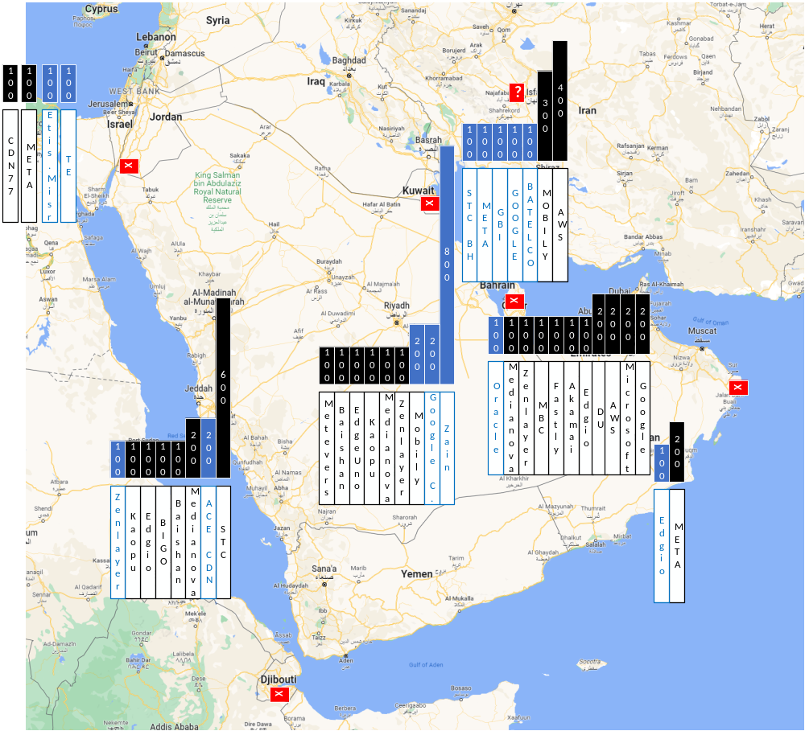
Where are the n x 100 Gbps
Connects?
(peeringdb.com)
3.9.2023
Note:
Content vs. Eyeball Networks
n x 10 not to be ignored
First 2 x 400 seen in Riad
+ 100 Kaopu + 100 Mobily on Equinix Jeddah

Slide 7
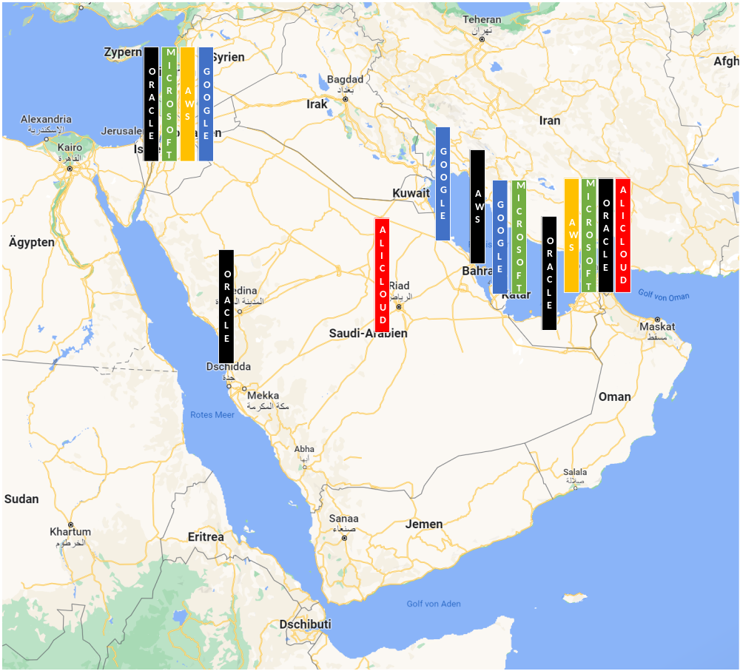
Big active
Cloud Zones are key developments of IX
(Homepagecheck)
Note:
Sorry for ignoring other players

Slide 8
Cloud / CDN and OTT are Key Game Changers in the Region
(Homepagecheck)
Country | IXP | Cloud Providers | CDN | OTT
Bahrain | MANAMA-IX | AWS / Microsoft / Google/KaopuCloud |  | Meta
Djibouti | DJIX |  | Meteverse Cloud / Cloudflare
Egypt | EG-IX | KaopuCloud | CDN77 | Meta
Jordan | AqabaIX | Google | Akamai
KSA | JEDIX | Alibaba / Google Microsoft / KaopuCloud | Meteverse Cloud / Edgio
KSA | SAIX (RHU) | Google | Meteverse Cloud
Kuwait | ix.kw | Google / KaopuCloud |  | Meta
Oman | Equinix Muscat |  | Edgio | Meta
Qatar | QIX | Microsoft |  | Meta
UAE | UAE-IX | AWS/Alibaba/ G42 / Google / Huawei Cloud / Microsoft / KaopuCloud / Oracle Cloud | Akamai / Edgio / Fastly | Starzplay MBC/Shahid
UAE | SH-IX | Google / Microsoft / KaopuCloud | Akamai / Edgio / Fastly

Slide 9
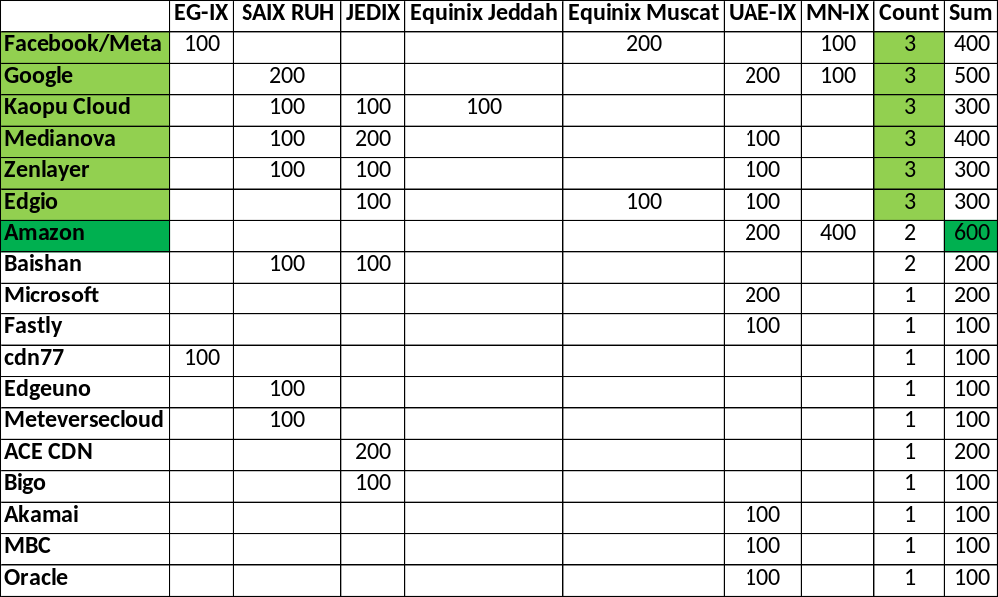
Leaders in IXP Participation in the Region | Content
+100
Only 100 Gig
are counted
(3.9.2023)

Slide 10
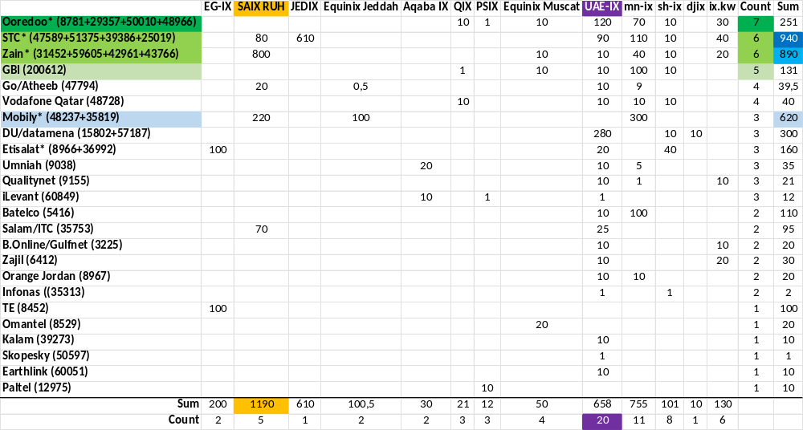
Leaders in IXP Participation in the Region | Operator
+100

Slide 11
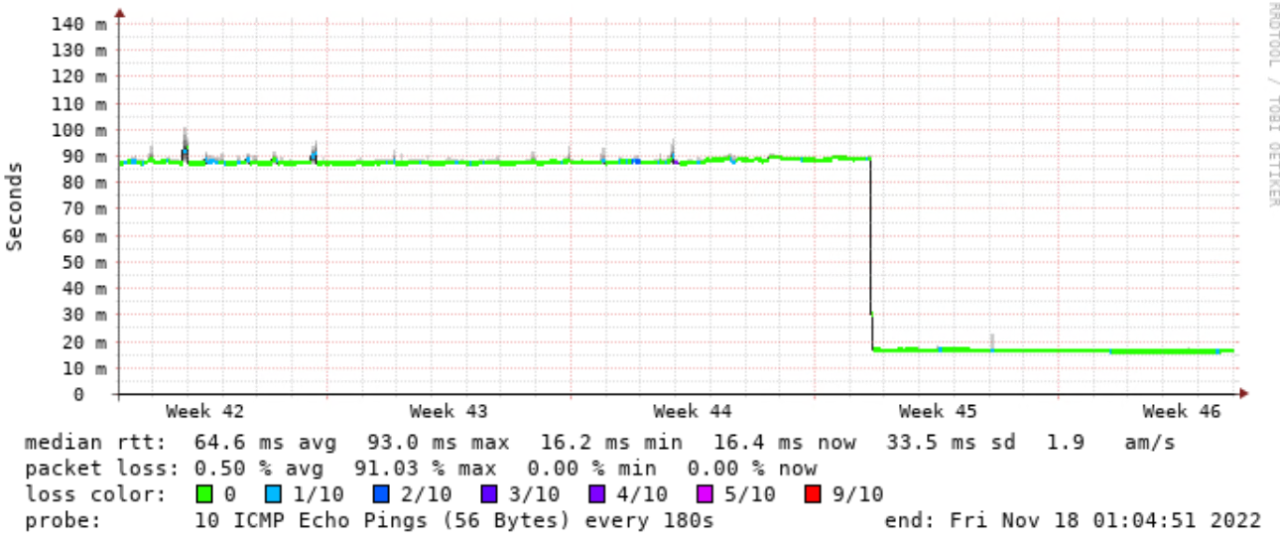
An Example of a Peering Effect (lower RTT)
RTT from Dubai/UAE-IX to Pakistan via a remote SH-IX peering

Slide 12
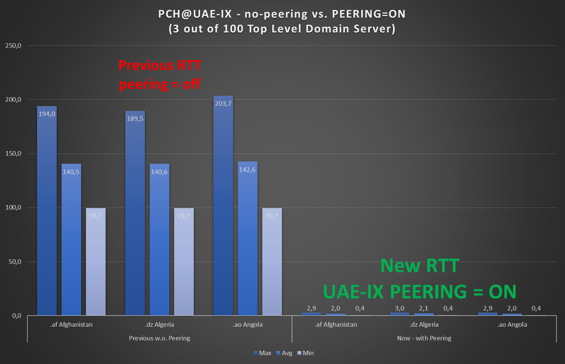
Why placing TLD Anycast into the region
PCH peering re-turn-up improved
~ 100 CC TLD
from
> 100 msec to
~ 1 msec RTT

Slide 13
Part II
IXP is nice
IXP with content is better
Reaching these in the region too is best
***
How is the reach of something in the Region?

Slide 14
Checking Interconnection in the Region
Method:
1) Looking Glass
2) Find Content
3) Find local Prefix of the Content
4) ping/trace from multiple countries
(all atlas probes except IL&IR => alive Anchors only,
no TR, EG, SY)

Slide 15
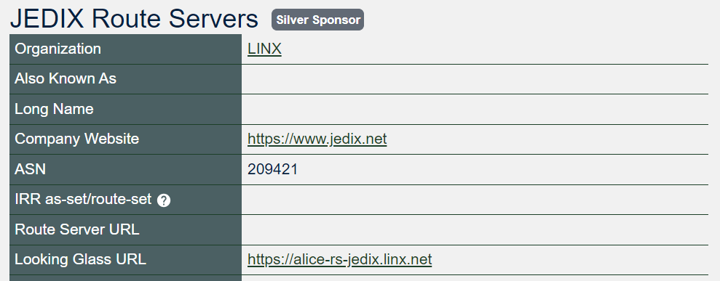
Table of used IXPs 3.9.23
IXP with Looking Glass in PeeringDB:
JEDIX
IX.KW
UAE-IX
No Looking Glass found in PeeringDB:
SAIX, Equinix Jeddah, MN-IX, QIX, Equinix Muscat, EG-IX, Pyramix, CAIX, BGP.Exchange (bad gateway?),
update: 10.10.23 Aqaba IX: existing now

Slide 16
#1 of 8 => ix.kw with ipv4 of Meta
AE | 15 msec | (AS60924)
BH | 25 msec | (AS16509)
IL | 249 msec | (AS202422)
IQ | 144 msec | (AS57908)
IR | 206 msec | (AS44531)
JO | 54 msec | (AS38968)
KW | 1 msec | (AS42642)
LB | 146 msec | (AS42334)
OM | 255 msec | (AS28885)
QA | 218 msec | (AS21859)
SA | 32 msec | (AS25019)
YE | 205 msec | (AS12486)

Slide 17
Conclusions, Assumptions, Surprises, Questions?
reach the IXPs = improve your regional latency!

Slide 18
#2 of 8 => JEDIX with ipv4 of Medianova
AE | 30 | (AS15412)
BH | 31 | (AS51375)
IL | 129 | (AS202422)
IQ | 87 | (AS57908)
IR | 139 | (AS48147)
JO | 113 | (AS8376)
KW | 27 | (AS42642)
LB | 85 | (AS60999)
OM | 161 | (AS28885)
QA | 152 | (AS21859)
SA | 15 | (AS208520)
YE | 111 | (AS12486)

Slide 19
#3 of 8 => JEDIX with ipv4 of Baishan/Edgenext
AE | 32 | (AS60924)
BH | 25 | (AS5416)
IL | 138 | (AS202422)
IQ | 95 | (AS57908)
IR | 166 | (AS48147)
JO | 107 | (AS8376)
KW | 32 | (AS42642)
LB | 89 | (AS60999)
OM | 163 | (AS204170)
QA | 166 | (AS21859)
SA | 16 | (AS25019)
YE | 120 | (AS12486)

Slide 20
#4 of 8 => JEDIX with ipv4 of Zenlayer
AE | 32 | (AS60924)
BH | 26 | (AS5416)
IL | 112 | (AS202422)
IQ | 95 | (AS57908)
IR | 151 | (AS12697)
JO | 131 | (AS38968)
KW | 37 | (AS42642)
LB | 100 | (AS42334)
OM | 320 | (AS28885)
QA | 296 | (AS21859)
SA | 20 | (AS25019)
YE | 121 | (AS12486)

Slide 21
#5 of 8 => UAE-IX with ipv4 of Valve
AE | 0 | (AS60924)
BH | 8 | (AS16509)
IL | 223 | (AS202422)
IQ | 38 | (AS57908)
IR | 34 | (AS39650)
JO | 40 | (AS8376)
KW | 15 | (AS42961)
LB | 172 | (AS42334)
OM | 11 | (AS204170)
QA | 15 | (AS42298)
SA | 12 | (AS47794)
YE | 147 | (AS12486)

Slide 22
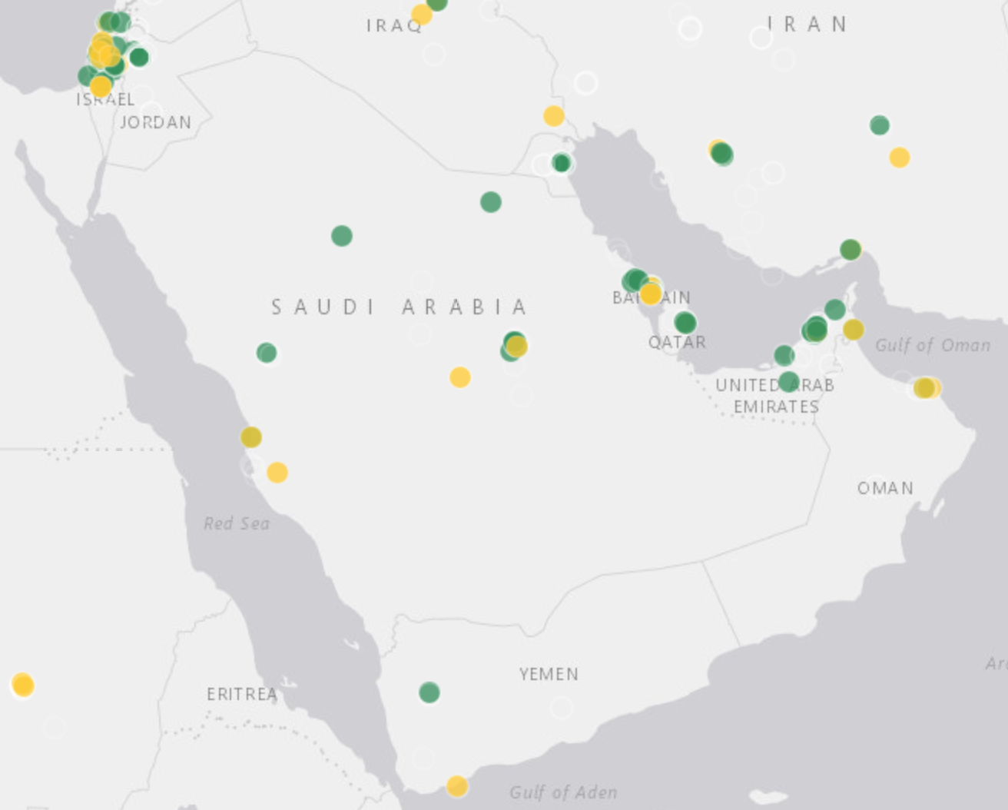
Conclusions, Assumptions, Surprises, Questions?
Surprise from last slide:
Why is SA faster to UAE-IX then to SA/Jeddix itself?
(no working Atlas Probe nearby Jeddah!)

Slide 23
#6 of 8 => UAE-IX with ipv4 of i3D
AE | 0 | (AS60924)
BH | 9 | (AS16509)
IL | 160 | (AS202422)
IQ | 39 | (AS57908)
IR | 39 | (AS39650)
JO | 41 | (AS8376)
KW | 19 | (AS42961)
LB | 151 | (AS43019)
OM | 14 | (AS204170)
QA | 15 | (AS42298)
SA | 12 | (AS47794)
YE | 136 | (AS12486)

Slide 24
#7 of 8 => UAE-IX with ipv4 of Tencent
AE | 1 | (AS60924)
BH | 11 | (AS16509)
IL | 157 | (AS202422)
IQ | 38 | (AS57908)
IR | 179 | (AS39650)
JO | 41 | (AS8376)
KW | 18 | (AS42961)
LB | 123 | (AS42334)
OM | 226 | (AS204170)
QA | 15 | (AS42298)
SA | 13 | (AS47794)
YE | 128 | (AS12486)

Slide 25
#8 of 8 => UAE-IX with ipv4 of Starzplay
AE | 0 | (AS45102)
BH | 9 | (AS16509)
IL | 133 | (AS202422)
IQ | 131 | (AS57908)
IR | 83 | (AS59441)
JO | 104 | (AS38968)
KW | 18 | (AS42961)
LB | 141 | (AS60999)
OM | 111 | (AS204170)
QA | 15 | (AS42298)
SA | 13 | (AS47794)
YE | 141 | (AS12486)

Slide 26
Conclusions, Assumptions, Surprises, Questions?
well interconnected hubs are potentially most green?
networks with peering-pro´s show more green than others?

Slide 27
Table of used IXPs
Round 2: Famous Targets, Present in the Region

Slide 28
#1 of 5 => amazon.sa on Akamai (similar: apple.com)
AE | 0 | (AS60924)
BH | 0 | (AS16509)
IL | 2 | (AS202422)
IQ | 45 | (AS198183)
IR | 32 | (AS44531)
JO | 2 | (AS38968)
KW | 20 | (AS42691)
LB | 39 | (AS43019)
OM | 4 | (AS28885)
QA | 69 | (AS21859)
SA | 7 | (AS47794)
YE | 272 | (AS12486)

Slide 29
#2 of 5 => 9.9.9.9 (quad9) / PCH/Quad9
AE | 0 | (AS36236)
BH | 10 | (AS16509)
IL | 46 | (AS202422)
IQ | 30 | (AS198183)
IR | 78 | (AS59441)
JO | 58 | (AS38968)
KW | 112 | (AS42961)
LB | 3 | (AS43019)
OM | 74 | (AS204170)
QA | 131 | (AS42298)
SA | 0 | (AS208520)
YE | 147 | (AS12486)

Slide 30
#3 of 5 => RIPE k.root
AE | 0 | (AS69824)
BH | 14 | (AS39273)
IL | 46 | (AS202422)
IQ | 75 | (AS39216)
IR | 0 | (AS59441)
JO | 69 | (AS8376)
KW | 5 | (AS42961)
LB | 4 | (AS43019)
OM | 221 | (AS28885)
QA | 0 | (AS21859)
SA | 0 | (AS208520)
YE | 161 | (AS12486)

Slide 31
#4 of 5 => NETNOD i.root
AE | 0 | (AS57187)
BH | 8 | (AS16509)
IL | 49 | (AS202422)
IQ | 76 | (AS39216)
IR | 15 | (AS59441)
JO | 54 | (AS38968)
KW | 93 | (AS42961)
LB | 56 | (AS60999)
OM | 227 | (AS28885)
QA | 5 | (AS42298)
SA | 0 | (AS208520)
YE | 173 | (AS12486)

Slide 32
#5 of 5 => Fastly
AE | 0 | (AS60924)
BH | 13 | (AS39273)
IL | 43 | (AS202422)
IQ | 46 | (AS51018)
IR | 109 | (AS59441)
JO | 37 | (AS38968)
KW | 20 | (AS42961)
LB | 38 | (AS60999)
OM | 102 | (AS28885)
QA | 105 | (AS21859)
SA | 19 | (AS35819)
YE | 190 | (AS12486)

Slide 33
Conclusions, Assumptions, Surprises, Questions?
Interconnection gaps in the Region = is the Region competitive?
Why is Yemen totally not interconnected at all here?
In case you see yourself here with often >30ms please act!
In case your IXP are missing here: a looking glass please
In case your network is never shown: implement RIPE Atlas!

Slide 34
Thank You!
bernd.spiess@de-cix.net

