Slide 1
Dynamic DDoS Trends in the Middle East
Dr. Emad Fahmy, Sales Engineering Director, NETSCOUT

Slide 2

Agenda
01
02
03
Dynamic DDoS Trends from Latest Threat Report
Middle East Adaptive DDoS Case Study
Lessons Learned and Future Preparedness
Analysis of emerging attack vectors and threat landscape evolution based on the comprehensive threat intelligence report.
Real-world examination of a sophisticated multi-vector attack campaign targeting critical infrastructure across Egypt, UAE, and Saudi Arabia.
Strategic insights for building resilient defense architectures and implementing adaptive mitigation strategies against evolving threats.

Slide 3
Agenda
01
02
03
Dynamic DDoS Trends from Latest Threat Report
Middle East Adaptive DDoS Case Study
Lessons Learned and Future Preparedness
Analysis of emerging attack vectors and threat landscape evolution based on the comprehensive threat intelligence report.
Real-world examination of a sophisticated multi-vector attack campaign targeting critical infrastructure across Egypt, UAE, and Saudi Arabia.
Strategic insights for building resilient defense architectures and implementing adaptive mitigation strategies against evolving threats.

Slide 4
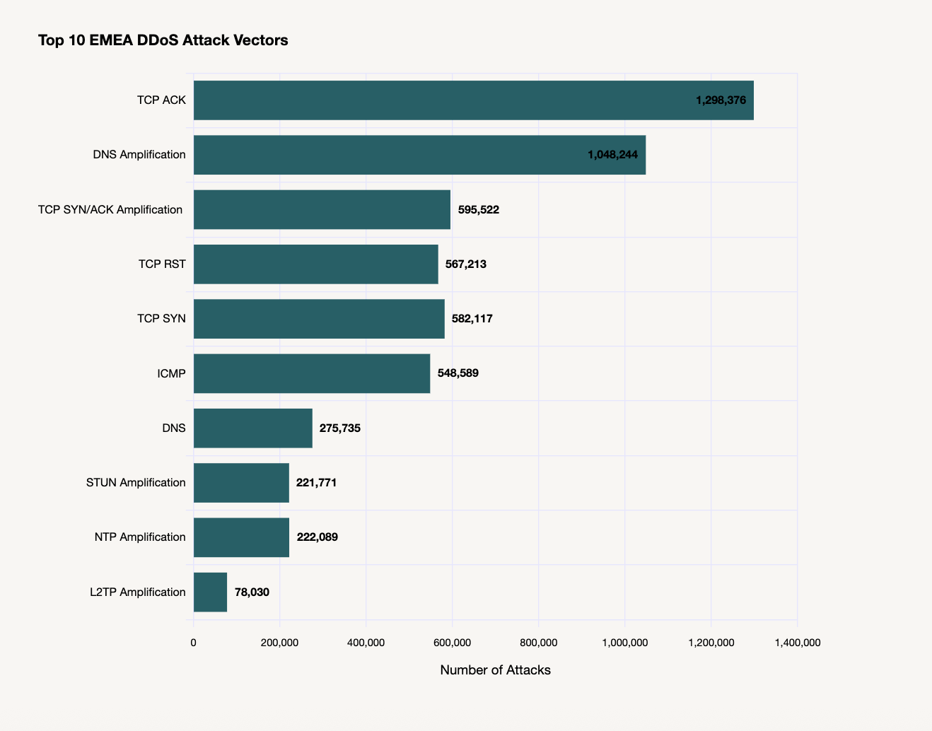
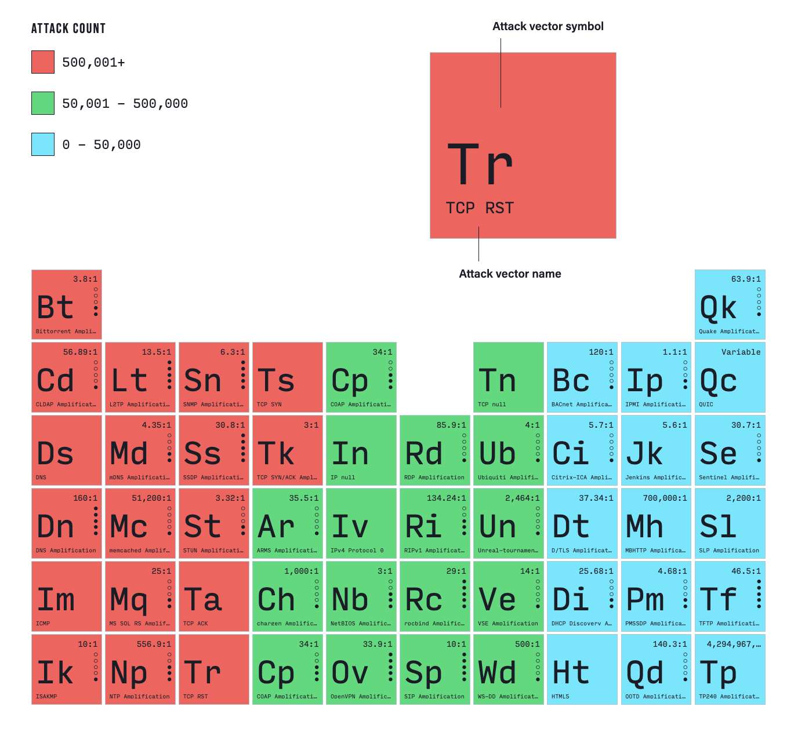
Top 10 EMEA DDoS Attack Vectors
Source : NETSCOUT DDoS Threat Intelligence Report / January 2025 to June 2025

Slide 5
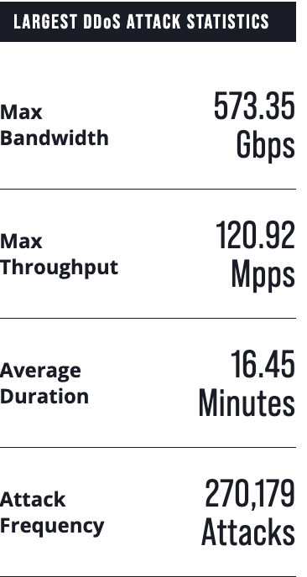
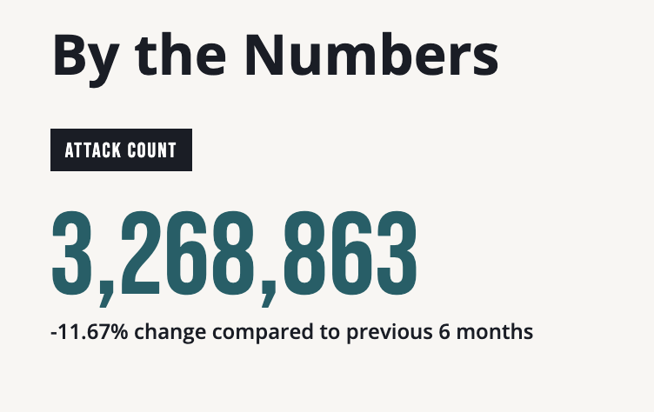
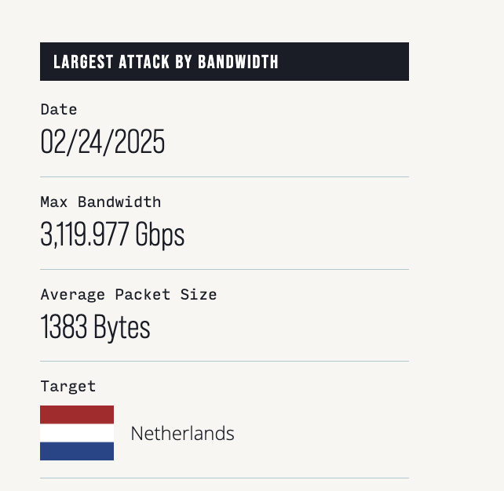
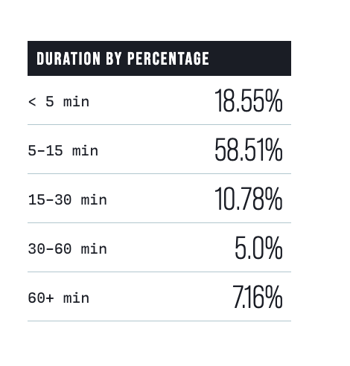

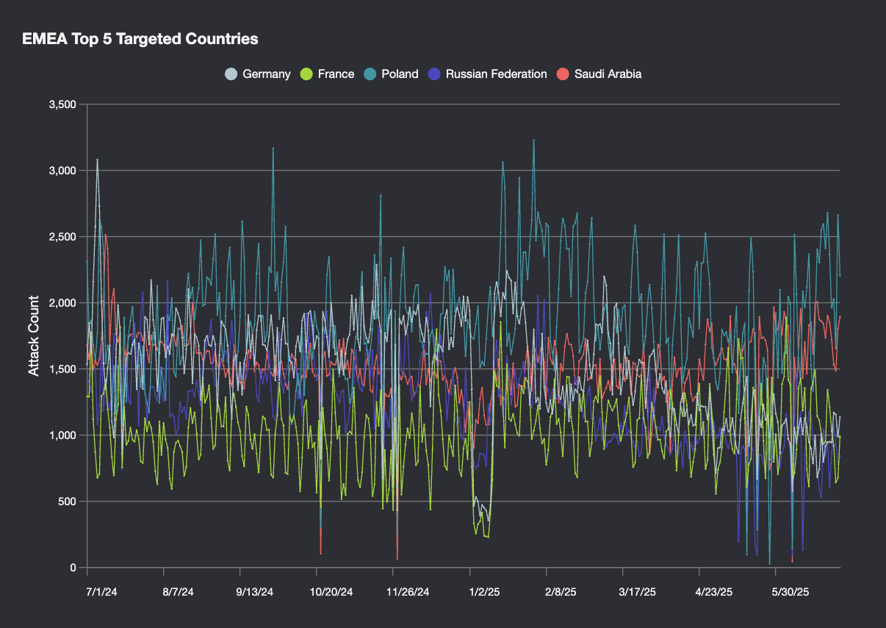
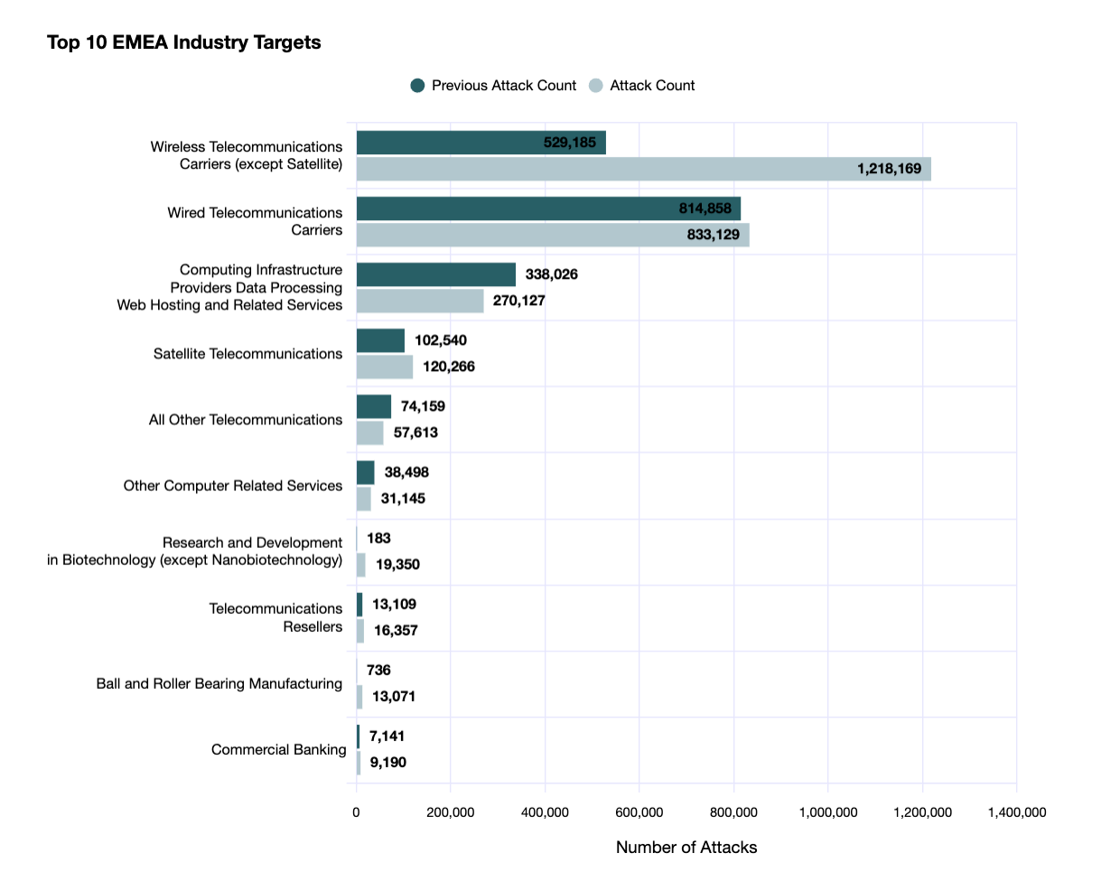
EMEA Top Targeted Attacks
Source : NETSCOUT DDoS Threat Intelligence Report / January 2025 to June 2025
Notes:
- The point to made is that when these actors picks a country (maybe not , they will select multiple destinations within specific areas, we have been seen airports, banks and other sectors. Sort of carpet bombing across the entire industry.
TODO: "What does the number 6,843 actually mean?” → This is the number of claimed attacks, what they have said officially that they are going to attack,
When DDoS hacktivism really took off, it was Killnet leading the charge. Anonymous Sudan took over and led in terms of the number of attacks through the first half of 2023. However, sometime around July, NoName057 took over and in a huge way, smashing hundreds of websites over the 6mo period of time with application layer attacks. In the second half of 2023 we witnessed more than 289 actors claiming attacks against 6,843 targets, 4,650 websites, across 139 industries, and in 101 different countries. Compare that to just NoName launching 780 attacks themselves.

Slide 6


Major Geopolitical Hacktivists
NoName057(16) activity includes:
  Custom DDoS malware (DDoSia),
  Gamification of attack infrastructure
  Sophistication in attacks leveraging cloud and bulletproof hosting providers.
Anonymous Sudan activity includes:
  Geopolitical hacktivists primarily active in EMEA
  Has targeted platforms like Starlink and Telegram
  Pro-Russian aligned targeting any opponents to their ideology
6
Notes:
Explain why I picked these two:
1) They are the most active groups across Europe, Middle East and Africa
2) They use different attack tactics
Noname: In 60% of the attacks, they are using public hosting providers. The are masquerading themselves, hiding within public clouds. Also use bulletproof hosting + proxies.
Anonymous Sudan used off the shelf attacks, often booters/stressers. NTP, DNS and CLDAP are the most used and easily available in booters/stresers,

Slide 7
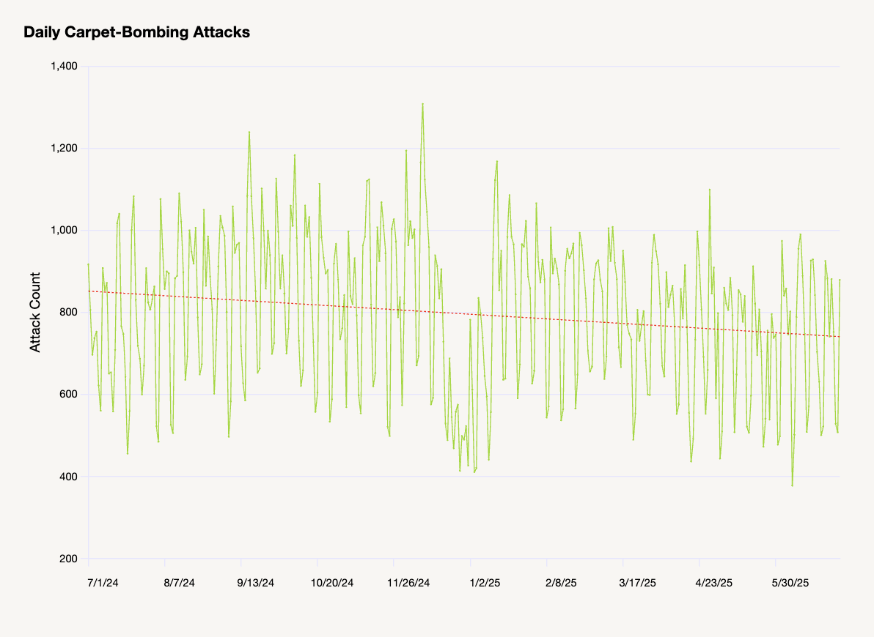
Carpet-Bombing DDoS Attacks on the Rise
Massive Increase in Carpet-Bombing Attacks
These distributed attacks target entire network ranges rather than individual hosts, making detection exponentially more challenging.
Critical Challenge for Service Providers
Traditional detection methods fail when attacks distribute across thousands of destinations simultaneously within provider networks.
Flowspec Limitations Exposed
Standard BGP Flowspec mechanisms prove insufficient against
sophisticated distributed attack patterns.
Adaptive Protection Required
Requires intelligently automated detection and mitigation with
Adaptive DDoS Protection
Source : NETSCOUT DDoS Threat Intelligence Report / January 2025 to June 2025
Notes:
Threat Report 11 shows increase in attack counts over time
We improved visibility this year, so we were likely undercounting before

Slide 8

Traditional DDoS Attack
Targets Single Host
C&C “Target Host 9.9.9.9”
Bot
1.1.1.1
Bot
2.2.2.2
Attacker
Bot
3.3.3.3
TARGET
10.0.96.3
Bot
4.4.4.4

Slide 9


Carpet Bombing DDoS Attacks
Targeting Entire Networks
10.0.0.2
C&C “Target 10.0.0.0/16”
10.0.96.3
And many thousands more!
Attacker
Network Infrastructure
BotNET
10.0.112.4
Major Problems:
Can’t detect with existing tools – traffic volume per destination is too small!
Can’t redirect to ISP scrubbing centers without automated attack destination analysis
10.0.211.5
Notes:
Carpet Bombing Attacks target an entire subnet containing hundreds or thousands of individual host addresses.
This causes collateral damage across the entire subnet which can encompass multiple organizations
Attack traffic per host is minimal and may not trip thresholds but can still affect the circuit
Difficult to detect because most solutions monitor only traffic intended for potential victim
Make it clear that every customer needs this – what problem are we solving

Slide 10
Agenda
01
02
03
Dynamic DDoS Trends from Latest TR13
Middle East Adaptive DDoS Case Study
Lessons Learned and Future Preparedness
Analysis of emerging attack vectors and threat landscape evolution based on NETSCOUT's comprehensive threat intelligence reporting.
Real-world examination of a sophisticated multi-vector attack campaign targeting critical infrastructure across Egypt, UAE, and Saudi Arabia.
Strategic insights for building resilient defense architectures and implementing adaptive mitigation strategies against evolving threats.

Slide 11

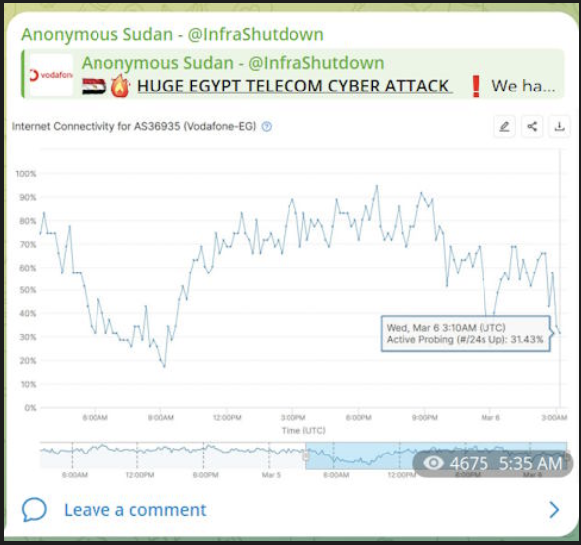

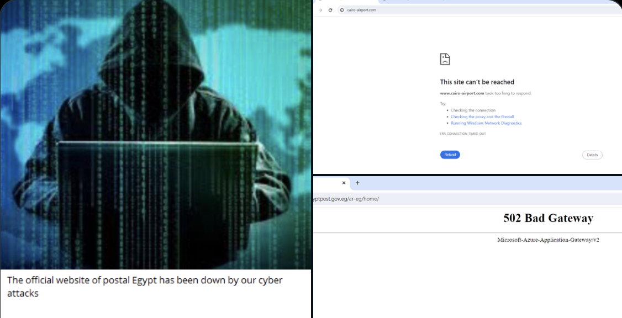

Cyber Attacks on ME in 2024/2025
The coordinated nature of these attacks across
multiple countries and sectors suggests
advanced threat actor capabilities
and strategic targeting of regional digital
infrastructure.
A sophisticated multi-vector attack campaign targeted critical infrastructure across three major Middle Eastern nations, demonstrating the evolution of state-sponsored and hacktivist DDoS capabilities.

Slide 12
Targets and Impact of Attack Campaign
Cyber Attacks Victims and Impact
VICTIMS
IMPACT
DNS Services
Caching and Media Streaming Services
Government Services (Gov SSO)
E-banking and Payment Services
Main Service Providers
Public Post
Electricity Company
Airport
Banks
Complaints for several days over difficulties accessing services

Slide 13
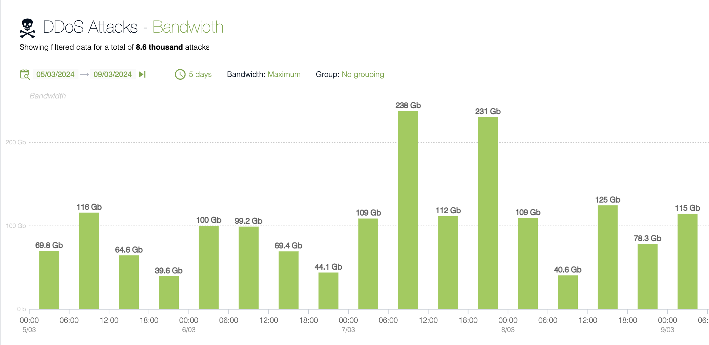
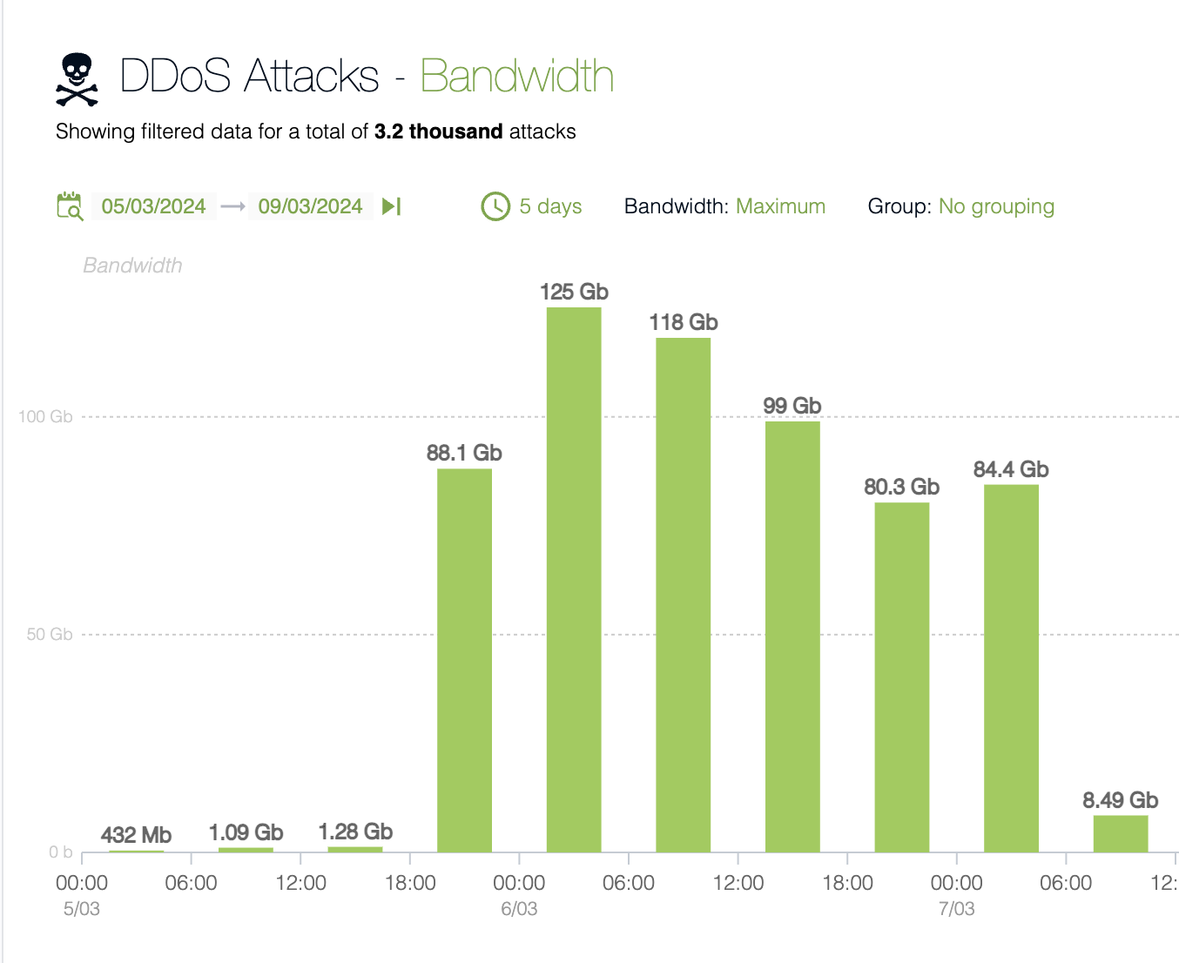
Multi-Vector & Multi-Services Attack Campaign
Multi-Services
Multi-Vector
Concentrated attacks targeting financial sector infrastructure and government digital services, with particular focus on payment processing systems serving the Kingdom's digital economy transformation initiatives.
Telecommunications infrastructure bore the brunt of sustained multi-vector attacks, affecting service providers, government SSO systems, and critical utility services across the nation's digital backbone.

Slide 14
Anatomy of DDoS Attacks
Attack Highlights
Multi-vector Attack Evolution: started off as TCP State Exhaustion attacks, then followed by UDP,DNS and https attacks with more than 20 Multi vectors coming from highly Distributed IP sources, mixed in with legitimate source IPs. The dominant attack vector was TCP ACK.
Unprecedented Scale and Duration: Large Volume (hundreds of Gbps), Long Duration (single attack can last for days) and High Frequency (thousands of simultaneous attacks at the same time)
Strategic Target Selection: Critical Services, DNS ,Web and Caching which affected payment systems for Millions of users. All this attack traffic, mixed in with legitimate traffic, caused their BW to saturate and Firewall CPUs to peak, randomly dropping sessions.
Hybrid Attack sources: External from the Internet and Internal from inside the country which represented a difficulty for IGW TMS to stop them together.

Slide 15
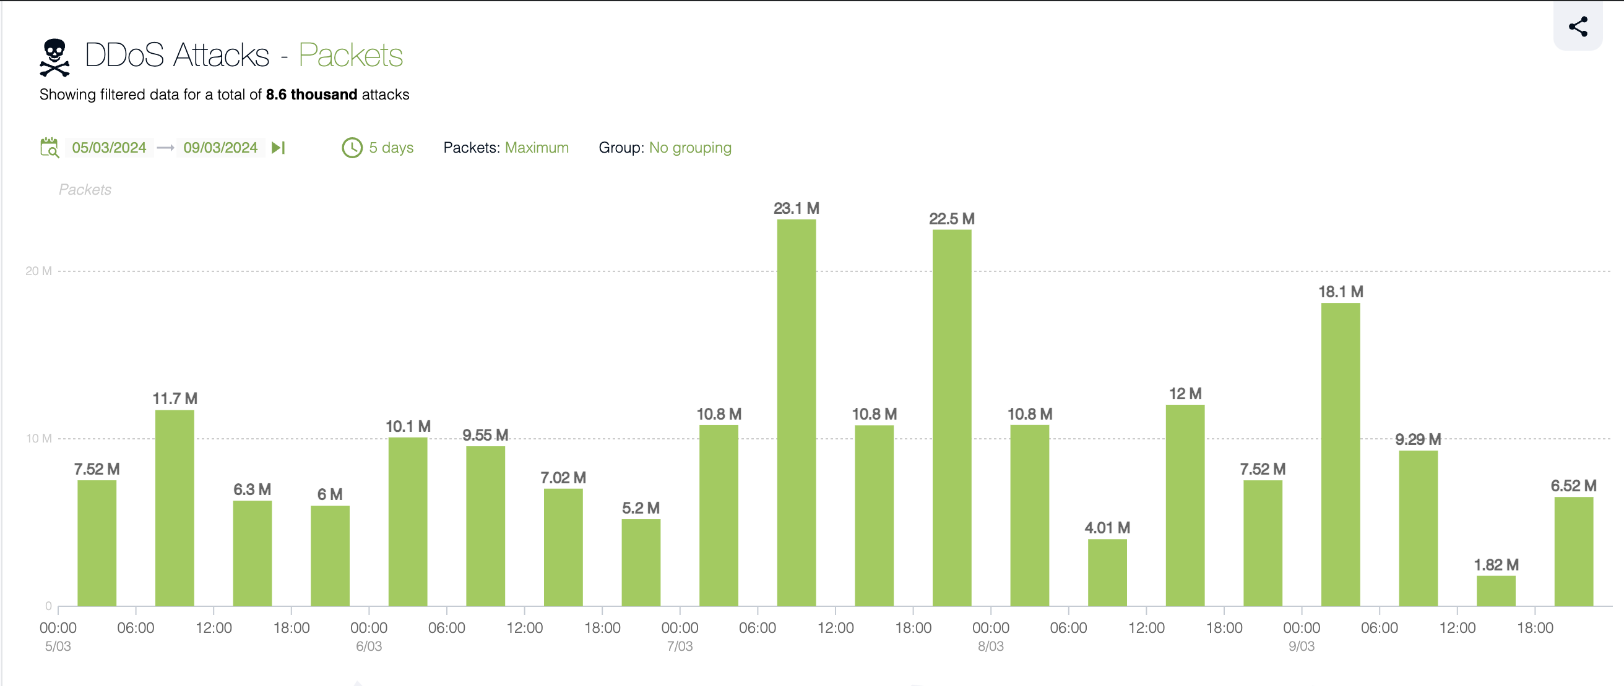
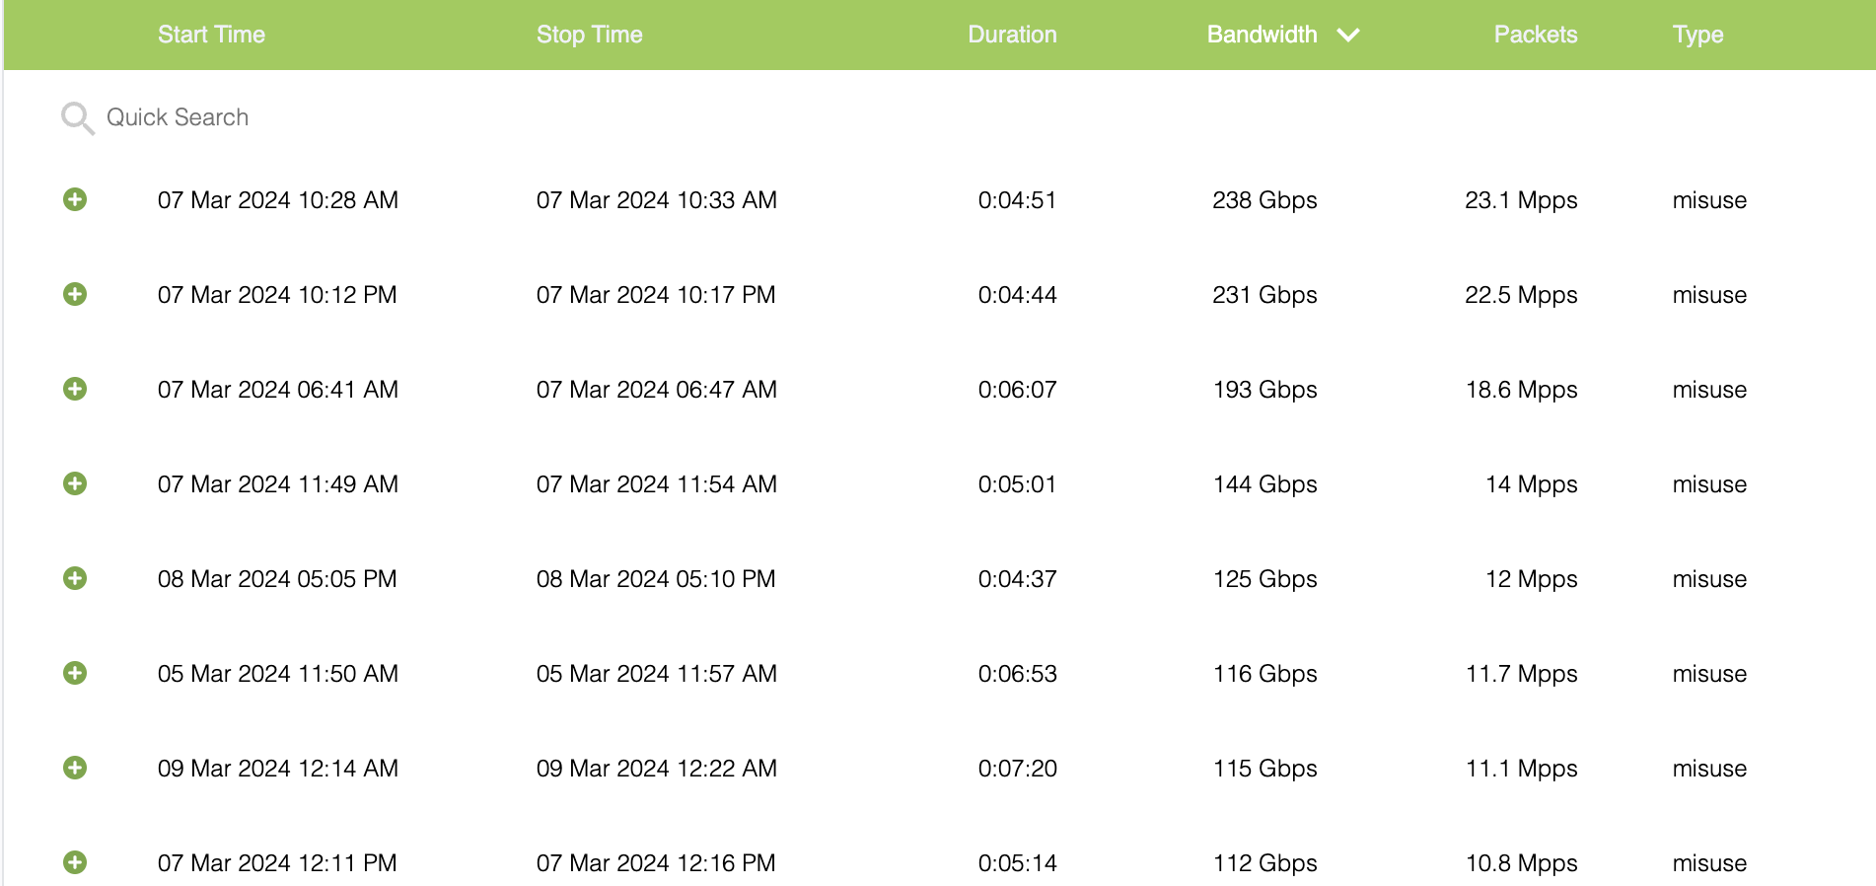
Thousands of Attacks with Millions of Packet Counts
The attack campaign demonstrated sophisticated understanding of target network capacity limitations and optimal timing for maximum service disruption across multiple time zones.
Attack frequency timeline showing sustained assault patterns with peak intensities during critical business hours, maximizing disruption impact.
Coordinated burst patterns designed to exhaust
connection tables and overwhelm stateful inspection
systems.

Slide 16
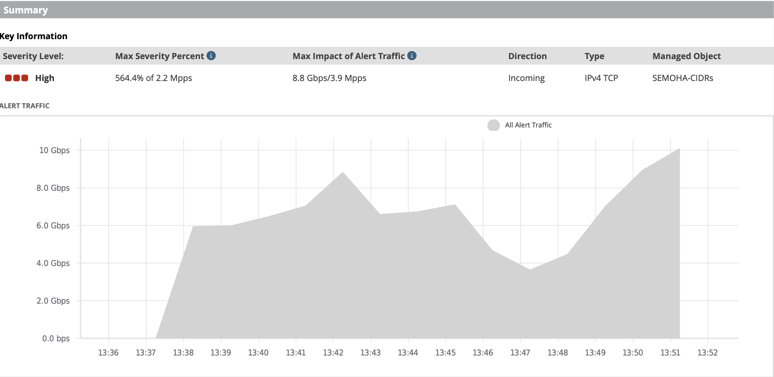
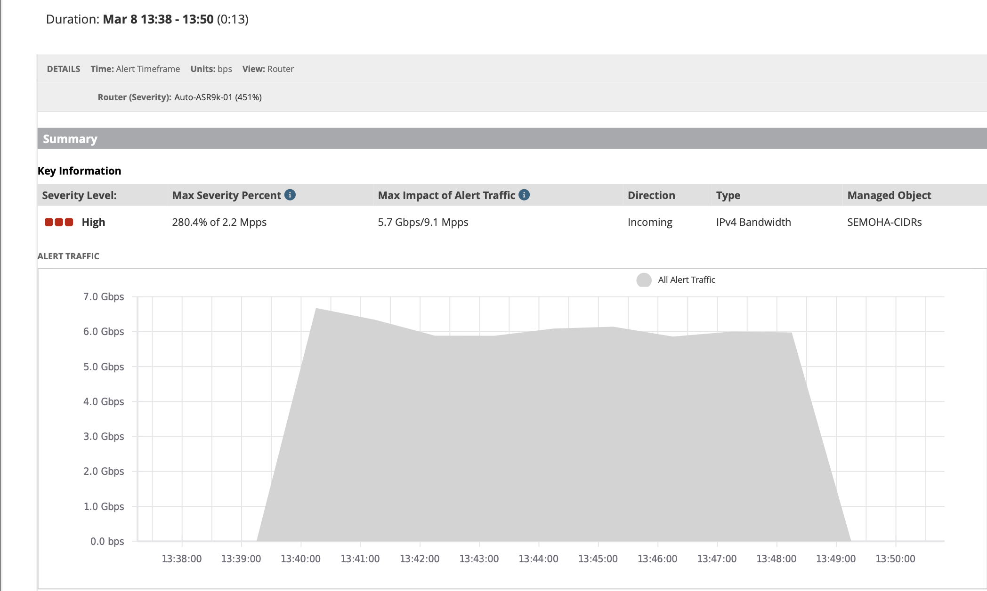
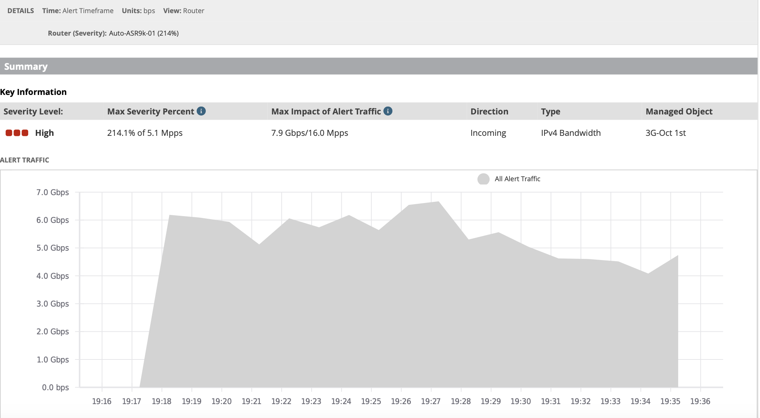
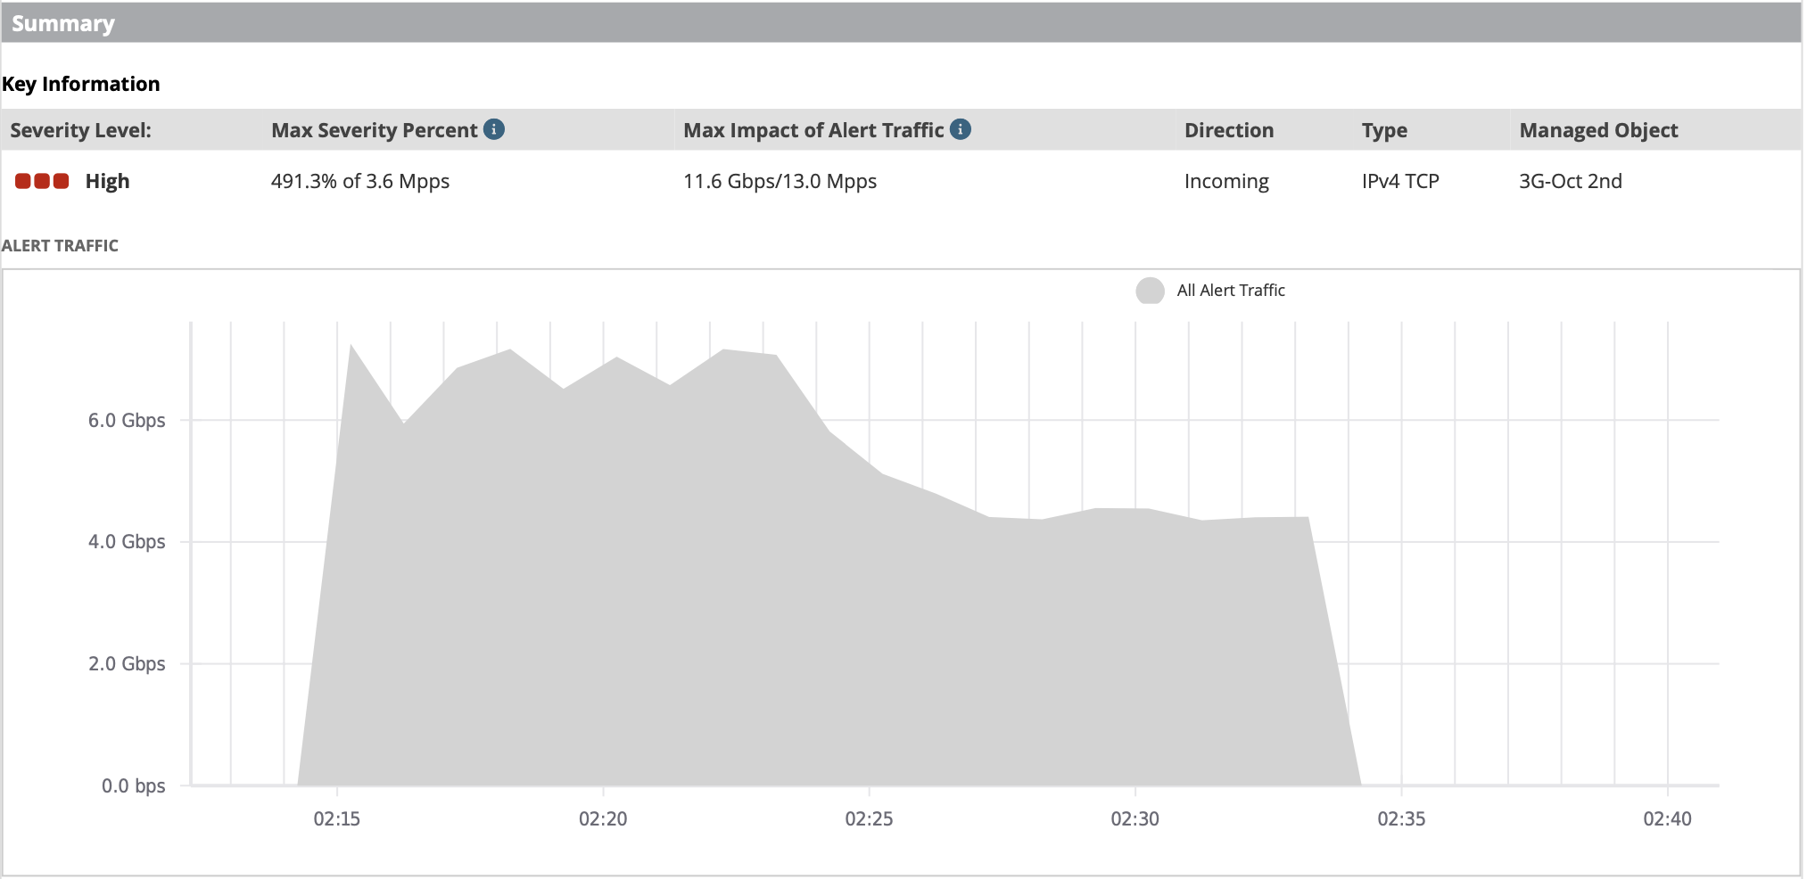
Targets and Impact of Attack Campaign
Initial Detection and Alerts

Slide 17
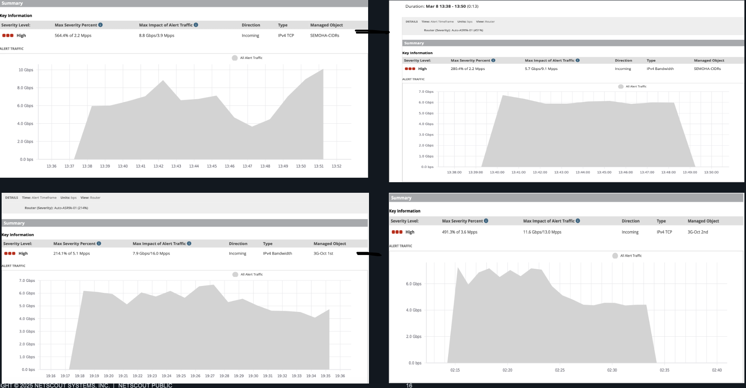
Initial Detection and Alert Analysis
Initial Alert Phase
Threat Classification
First anomaly detection triggers identify unusual traffic patterns across multiple service provider networks
Multi-vector attack classification enables targeted mitigation strategy
deployment
1
2
3
4
Pattern Recognition
Response Coordination
Advanced analytics correlate distributed attack signatures across geographic regions
Cross-regional incident response coordination activates comprehensive defense protocols

Slide 18
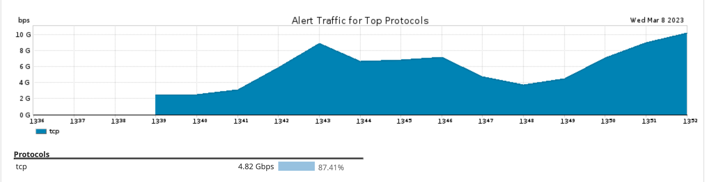
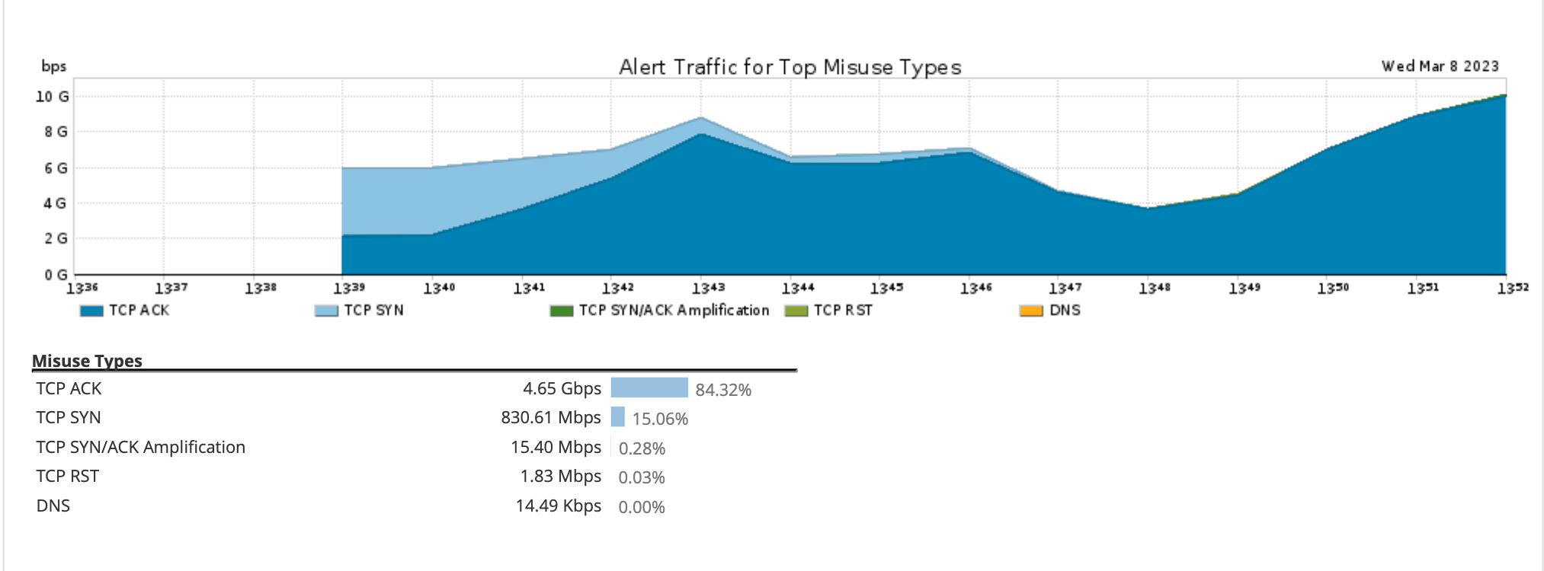
Anatomy of a Single DDoS Attack
Noteworthy Attack Details During Lifetime of Campaign
Carpet Bombing: Notice Main Attack type TCP ACK followed by TCP SYN, SYN/ACK and RST.

Slide 19
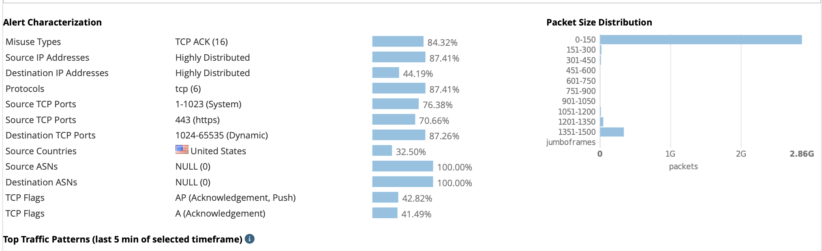
Anatomy of a Single DDoS Attacks
Noteworthy Attack Details During Lifetime of Campaign
Carpet Bombing: Notice Packet Size Distribution:
Very small packet <150

Slide 20
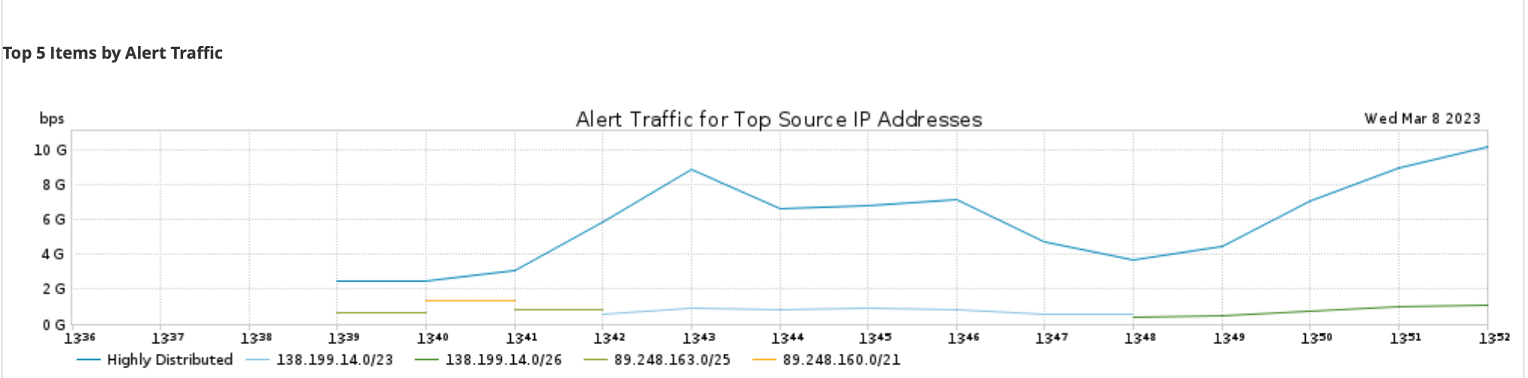
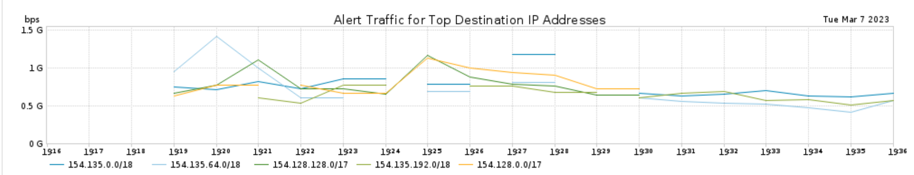
Anatomy of a Single DDoS Attacks
Noteworthy Attack Details During Lifetime of Campaign
Carpet Bombing: Notice Highly Distributed Src and Dst IP Addresses with large subnets

Slide 21
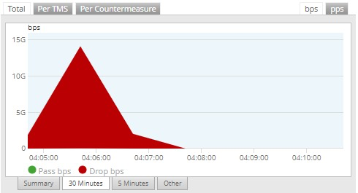
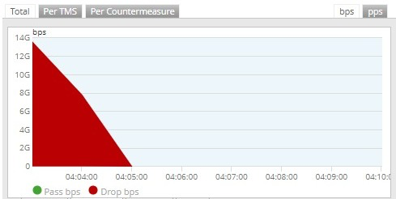
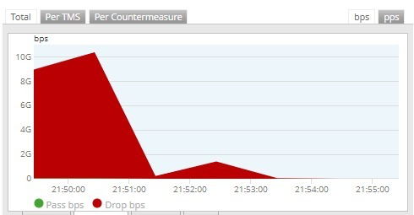
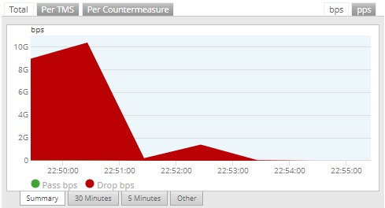
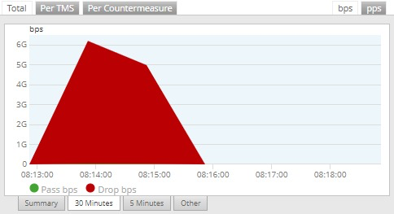
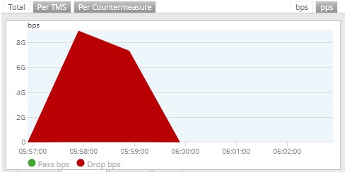
Mitigation Sample of Attack
Mitigations:
Tens of Simultaneous Mitigations
With 9TB blocked in a single day

Slide 22
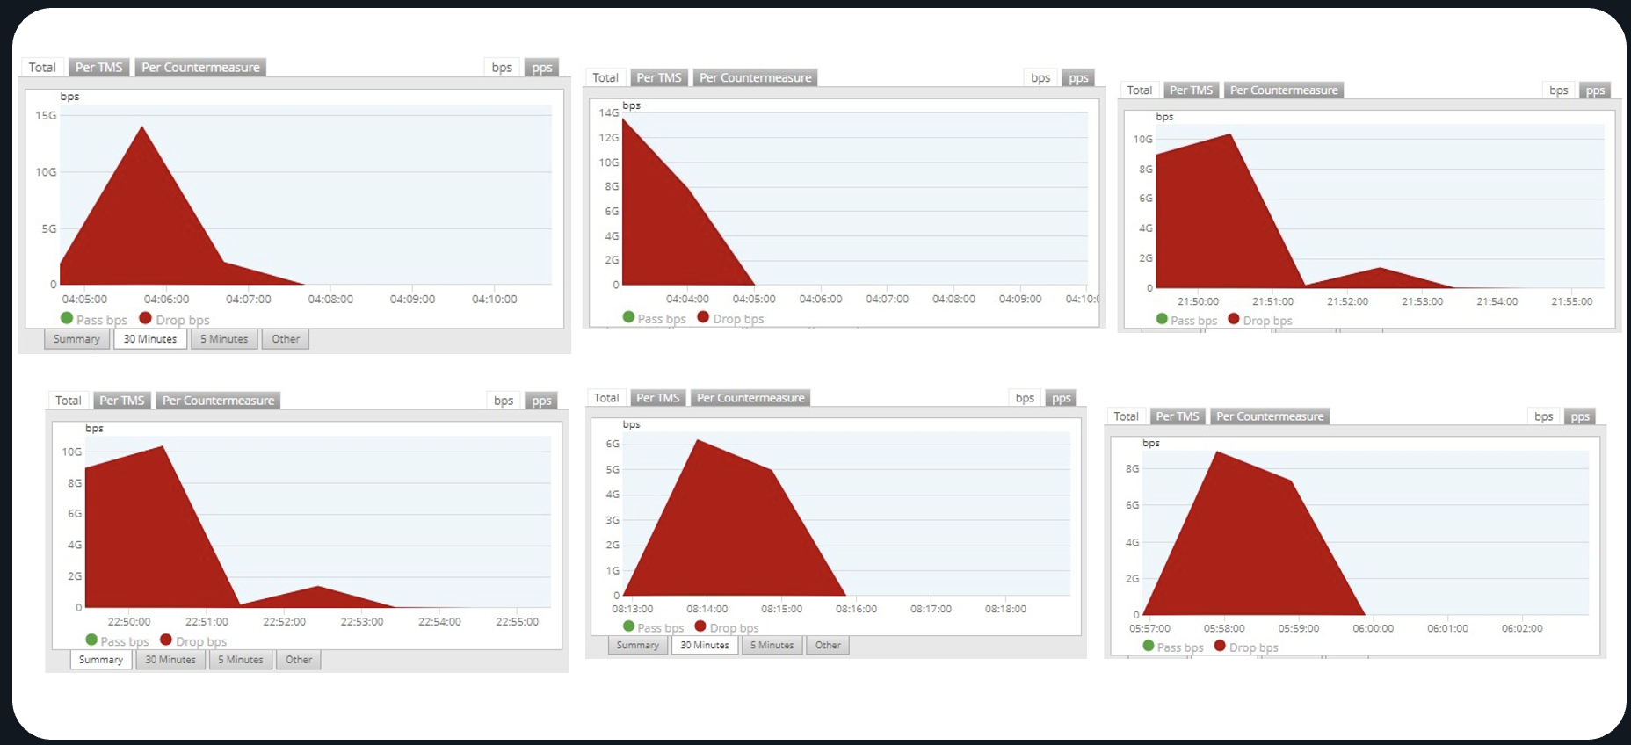
Mitigation Response Analysis
Tens of Simultaneous Mitigations
9TB Blocked in a Single Day
The comprehensive mitigation response required coordinated deployment of multiple countermeasure systems operating simultaneously across affected network infrastructure to effectively counter the distributed multi-vector attack campaign.
9TB
40+
99.7%
Traffic Blocked Daily
Simultaneous Mitigations
Attack Traffic Filtered
Peak mitigation capacity demonstrating scale of defense response required
Coordinated countermeasures deployed across multiple attack vectors
Effectiveness rate of adaptive mitigation systems during peak attack

Slide 23
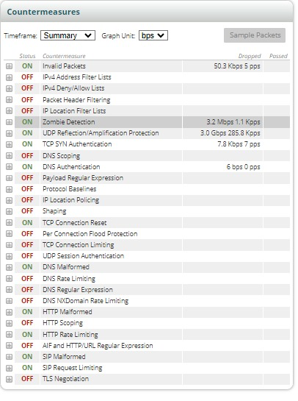
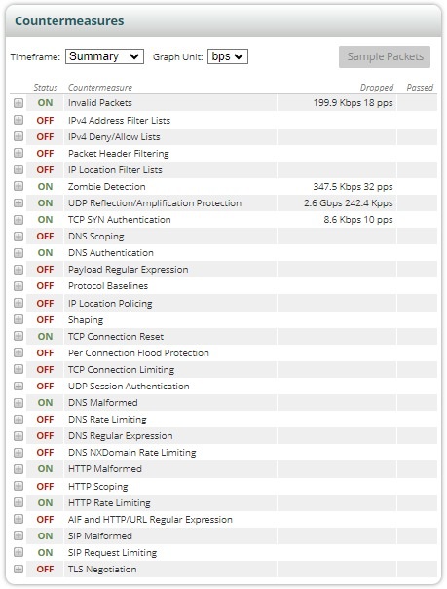
Mitigation C.M Sample of Attack
Key Takeaway: Successful defense against sophisticated carpet-bombing attacks requires adaptive, multi-layered countermeasure ecosystem capable of simultaneous deployment across multiple attack vectors and protocols
TCP SYN Auth
TCP Conn Reset
UDP Reflection/Amp
Zombie Detection
Invalid packets
DNS Auth
DNS Malformed
HTTP Malformed
HTTP Rate Limit
SIP Request Limit
SIM Malformed

Slide 24
Agenda
01
02
03
Dynamic DDoS Trends from Latest TR13
Middle East Adaptive DDoS Case Study
Lessons Learned and Future Preparedness
Analysis of emerging attack vectors and threat landscape evolution based on NETSCOUT's comprehensive threat intelligence reporting.
Real-world examination of a sophisticated multi-vector attack campaign targeting critical infrastructure across Egypt, UAE, and Saudi Arabia.
Strategic insights for building resilient defense architectures and implementing adaptive mitigation strategies against evolving threats.

Slide 25
Network operators Challenges & What was missing
Challenges | What was missing
Large Voume: Multi-vector Carpet-Bombing attacks with massive volumes overwhelmed existing defenses. | Presence of sufficient mitigation capability, surpassing the customer’s scrubbing center.
Saturation of the international links: caused Internet Gateways to reach their maximum capacity, impacting service availability." | Cloud Mitigation: Each network operator should be covered by cloud mitigation capability acting as a second layer of protection to absorb large-scale attacks beyond on-premise capacity.
Adaptive Attack Detection Challenges: Rapidly changing vectors, small packet sizes, and wide subnet distribution complicate detection and mitigation. | More sophisticated detection mechanisms and adaptive response capabilities to counter evolving attack patterns.
Network congestion: caused by BGP redirection, where prefix announcements were rejected by network devices. | More distributed DDoS scrubbing architecture combined with smaller, well-defined customer networks for redirection.
Mixed attack source complexity: simultaneous external (Internet-sourced) and internal (nationally sourced) attacks. | Layered defense strategies were required, as single-point mitigation failed against hybrid attacks targeting multiple entry points
FlowSpec alone proved insufficient: Flow spec on Routers used as the only protection technique fails against evolving attack patterns. | Effective defense required with mixed mitigation on local devices plus cloud protection

Slide 26
Is Flowspec only enough?
Traditional DDoS Flowspec Response
Traditional DDoS Attack Impact
Carpet Bombing Impact
Limited Vector Blocking
Blocks only some attack vectors (some Reflection/Amplification, initial IP fragment only)
Possibly rate limit non-initial fragments
Possibly rate limit UDP
Usually Scrubbing Device is used to finish mitigating other attack vectors
Target Specific Effect
Target may lose access to targeted applications
Broken UDP applications (gaming, video streaming or conferencing) for Target
Broken DNS for Target
Target sees Fragmented traffic (e.g file downloads) broken or greatly slowed
Impact limited to target of attack
Network Wide Devastations
ALL Users lose access to targeted applications
ALL Users lose access to UDP applications
ALL Users’ fragmented traffic (e.g. file downloads) broken or greatly slowed
All Users see DNS impact
Broad impact
Critical Insight: Flowspec solutions designed for traditional targeted attacks become counterproductive against carpet bombing campaigns due to their broad network impact.

Slide 27
Adaptive DDoS Protection from a Global Threat Visibility
Active DDoS Sources
Active Reflectors / Amplifiers
Abused Open Proxies
Persistent Attack Sources
DDoS Botnets
Known DDoS Botnet members
Other Sources
“Bulletproof” Hosters (e.g., Stark Industries)
Tor Exit Nodes
  All Verified from Real-Time Worldwide DDoS Attack Data

Slide 28





Driving Adaptive DDoS Protection from A Global
Threat Visibility is important
Active Reflectors & Amplifiers
Other Intelligence Sources
Real-time identification of compromised servers being used for reflection and amplification attacks, providing proactive blocking capabilities against known malicious infrastructure.
"Bulletproof" Hosting Services
Tracking of hosting providers known for harboring malicious infrastructure, including services like Stark Industries that consistently host attack resources.
Abused Open Proxies
Continuous monitoring and detection of compromised proxy servers exploited by attackers to mask their true origins and launch distributed attack campaigns.
Tor Exit Nodes
Monitoring of Tor network exit points that may be exploited for anonymous attack launching and malicious traffic routing.
Persistent Attack Sources
Tracking of IP addresses with consistent malicious behavior patterns, enabling preemptive blocking of known persistent threat actors and attack infrastructure.
Global Verification: All intelligence sources are verified from real-time worldwide DDoS attack data, ensuring accuracy and relevance for immediate threat response.
Known DDoS Botnet Members
Identification and cataloging of confirmed botnet participants, allowing for immediate recognition and mitigation of botnet-sourced attack traffic.

Slide 29
How will an Adaptive DDoS Detection & Protection help?
Stops Carpet Bombing Attacks!
Measures total DDoS traffic for entire network, not just per-host; includes Known Attacker Detection from Global Visibility
Analyze attack destinations to determine specific subnets needing mitigation
Detection
Redirect specific subnets to an Intelligent Scrubbing Device automatically and continue to update as attack moves
Mitigation
Notes:
Detects based on:
Total traffic by misuse type for MO (not host)
Compare to threshold for MO (not host)
Detects total volume of DDoS misuse traffic no matter how distributed among many destinations

Slide 30












Final Recommendations to Handle Attack Challenges
Upgrade DDOS Mitigation Capability
Enable Advanced DDOS Detection
Deploy enhanced DDOS Scrubbing Center with sufficient capacity to handle large-scale attacks. Proper capacity planning ensures network resilience during peak attack scenarios and maintains service availability.
Implement advanced DDOS detection for improved attack recognition. This enables faster identification of malicious traffic patterns and more accurate threat classification across network segments.
Deploy Adaptive Capabilities
Optimize protected Customer Subnets
Secure adaptive DDoS Defense as a critical defense component. This technology provides dynamic response capabilities against evolving attack vectors and sophisticated threat patterns.
Divide large customer protected prefixes into smaller, more manageable segments. This approach improves detection accuracy and enables more granular traffic analysis and response mechanisms.
Apply Flow Spec Integration when
needed
Deploy Multi-Layer Cloud Mitigation
Apply Flow Spec capabilities on Network platforms. This integration provides enhanced traffic filtering and automated response capabilities for complex attack scenarios.
Implement Cloud DDOS Mitigation as part of comprehensive defense strategy. Multiple mitigation layers including application Attacks protection that can provide coverage against both external internet and national attack sources.

Slide 31

Summary: Vaccine for the Dynamic DDOS Attacks
Vaccine for the Digital Body
01
02
Pre-Attack Global Intelligence Provision
Early Problem Identification
Global Attack Visibility provides comprehensive pre-attack intelligence and early detection capabilities, enabling proactive defense measures before threats escalate into full-scale attacks.
This technology makes it possible to identify potential attacks before they become critical problems, monitoring both inbound threats targeting the network and outbound malicious activity from compromised internal resources.
03
Immune System Analogy
The system operates similarly to biological immune systems, proactively identifying and neutralizing threats before they can spread throughout the network infrastructure and cause widespread damage.
Proactive Defense: Like vaccination provides immunity before exposure, Global Threat Provisioning and Adaptive Detection and Mitigation provides protection before attacks materialize into network-threatening events.

Slide 32
Thank you.
Emad.fahmy@netscout.com

