Slide 1
Let's Measure IPv6
Aftab Siddiqui
Head of Stakeholder Engagement
[APNIC Foundation]

Slide 2
APNIC Foundation
The APNIC Foundation is dedicated to a global, open, stable and secure Internet that is affordable and accessible to the entire Asia Pacific community
The Foundation focuses on increasing investment in education and training, community development, research, and related digital development projects and activities
If you're interested in conducting research and measurement work with us, we are always seeking interesting ideas.

Slide 3
IPv6 Adoption
IPv6 adoption varies significantly around the world and across different types of networks. Some regions and countries have significantly higher adoption rates. Major content delivery networks have been at the forefront.

Slide 4
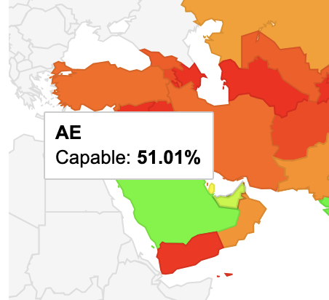
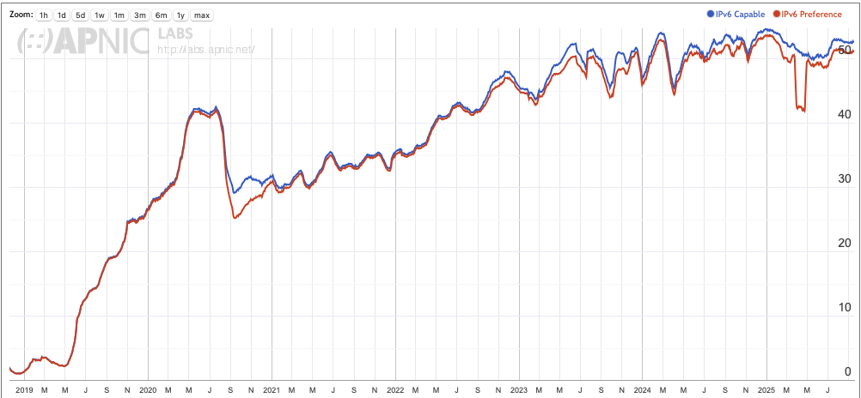
IPv6 Adoption Statistics in UAE
APNIC Labs
https://stats.labs.apnic.net/ipv6/AE

Slide 5
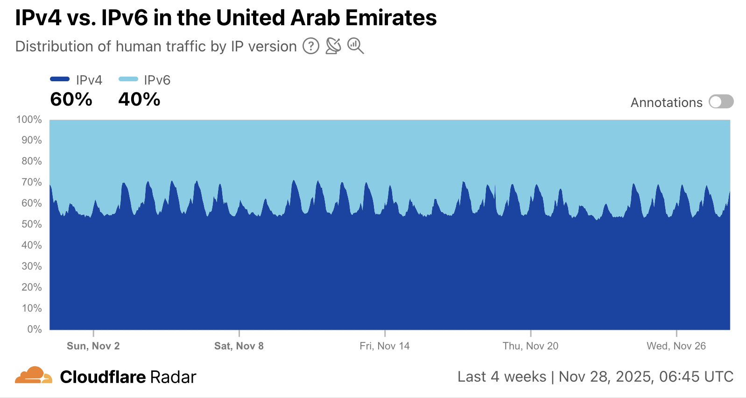
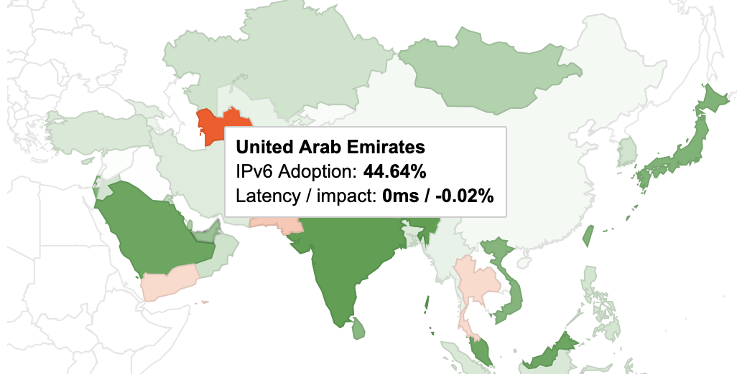
IPv6 Adoption Statistics in UAE
Google IPv6
https://www.google.com/intl/en/ipv6/statistics.html#tab=per-country-ipv6-adoption
Cloudflare Radar
https://radar.cloudflare.com/adoption-and-usage/ae?dateRange=28d

Slide 6

IPv6 Adoption Statistics in UAE
APNIC Labs: 51.01%
Cloudflare: 40%
Google IPv6: 44.64%
Which number is correct?

Slide 7
IPv6 Adoption Measurement
Most of the IPv6 measurement platforms out there are extremely useful, but they only tell part of the story. Most of them focus on user capability which they can measure from their platforms, which means we often end up with a picture that looks neat but isn’t the whole reality. In fact, these views can sometimes hide the real progress (or lack of it) happening at the network level.
To really understand the actual state of IPv6, we need to go beyond the usual measurements, need to build on the existing platforms and the amazing insights they already provide.

Slide 8
Measurement is hard!!!
Bias Type | What it is
Sampling Bias | Measurement frequency or timing favours certain networks or times of day.
Confirmation Bias | You design tests to prove a hypothesis (e.g. “IPv6 is faster than IPv4”).
Interpretation Bias | When an analyst draws conclusions not directly supported by the dataset.
Presentation Bias | When data is shown without context, caveats or clear interpretation guidance.

Slide 9
IPv6 Adoption Statistics in AE
ASN | AS Name | IPv6 Capable | IPv6 Preferred | Samples
AS5384 | EMIRATES-INTERNET Emirates Internet | 56.14% | 54.59% | 1,119,602
AS15802 | DU-AS1 | 49.64% | 48.07% | 338,387
AS59878 | ASBFB | 29.25% | 25.47% | 106
AS57568 | TR_ARVANCLOUD | 11.50% | 10.99% | 1,783
AS216071 | VDSINA | 4.36% | 4.26% | 2,088
https://stats.labs.apnic.net/ipv6/AE
Looking specifically at networks registered in the UAE, we find that only a small subset supports IPv6.
https://stats.labs.apnic.net/ipv6/BT

Slide 10
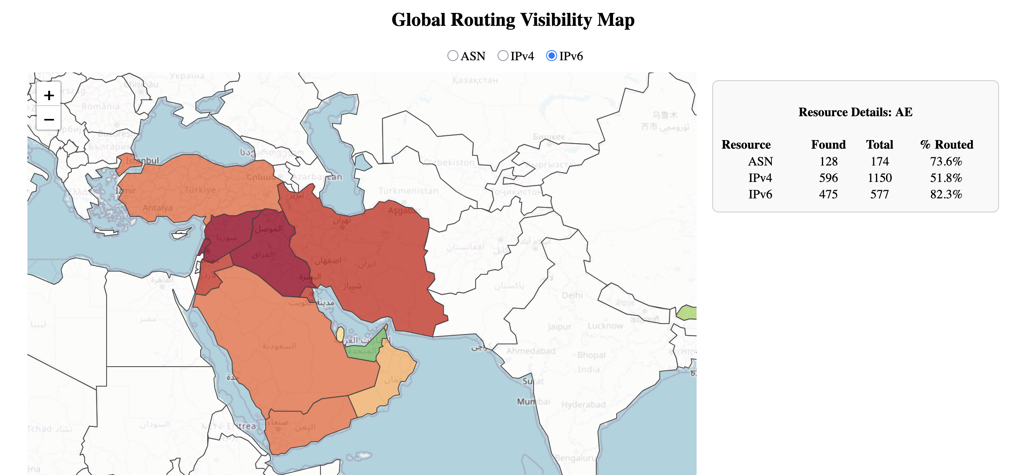
How should we measure?
Do you want to measure how many networks in the country providing IPv6 to their end users?

Slide 11
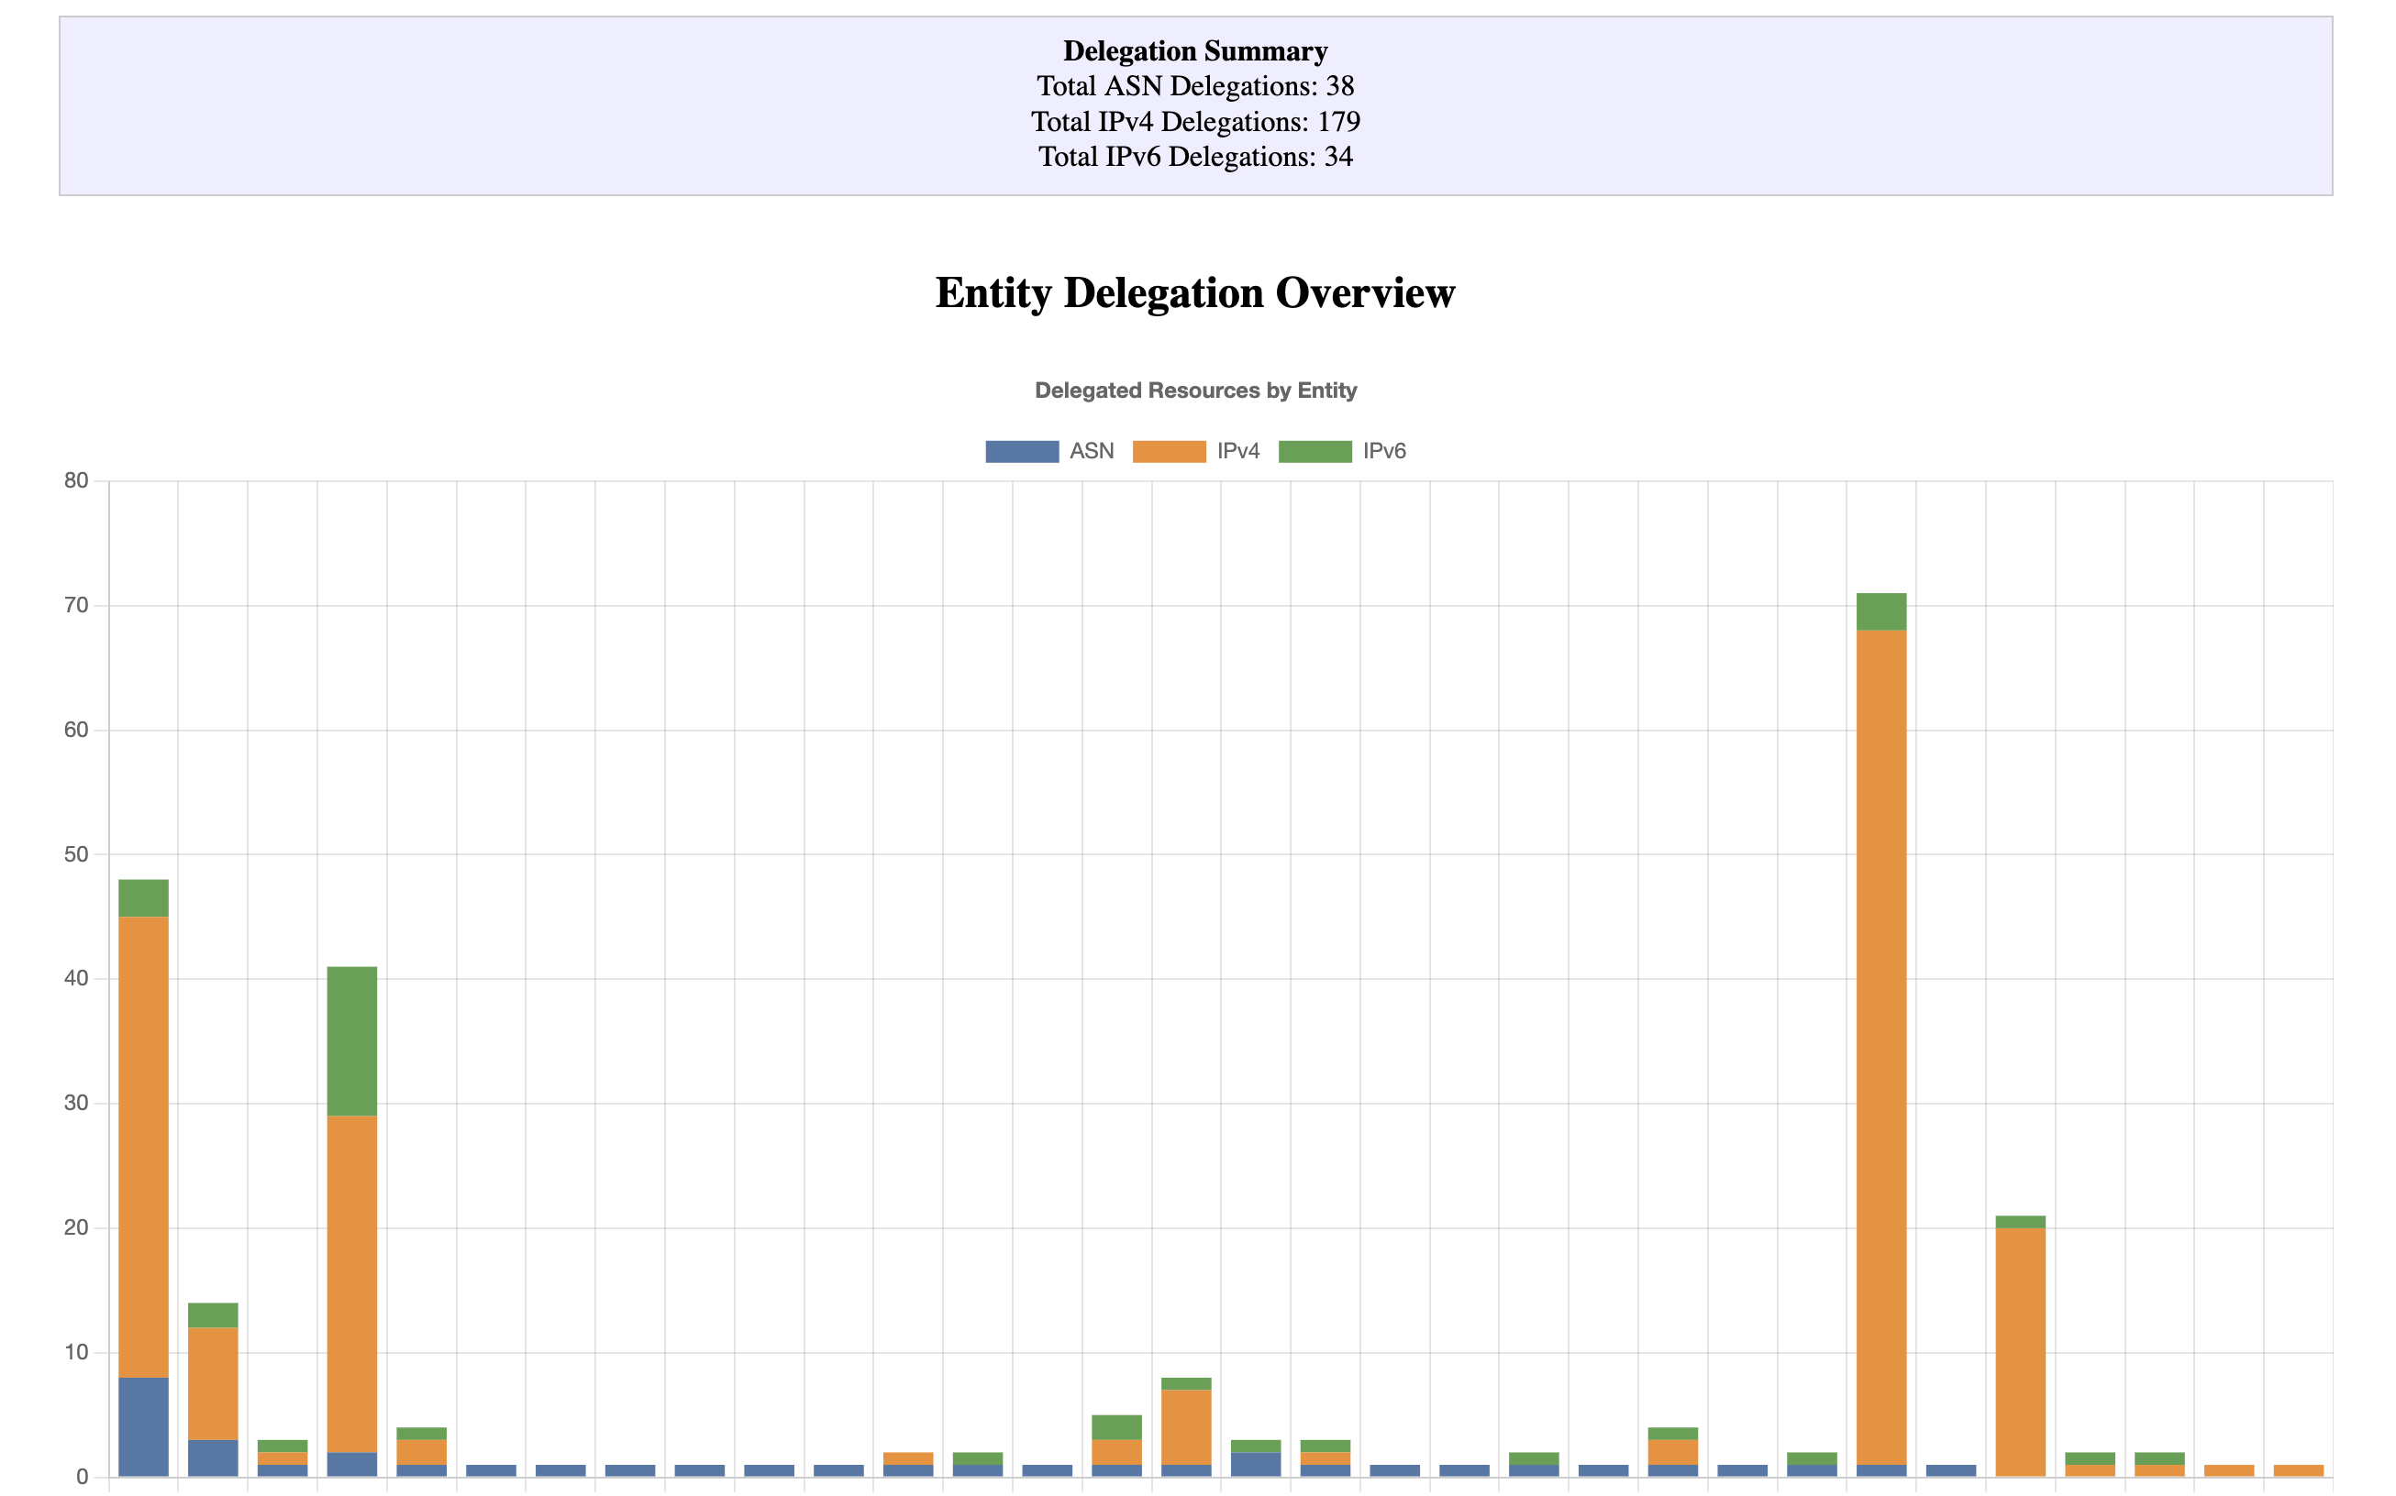
How should we measure?
Do you want to measure how many networks in the country providing IPv6 to their end users?

Slide 12
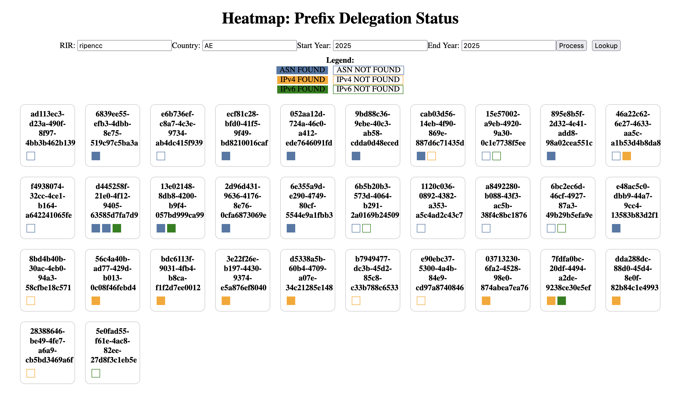
How should we measure?
Do you want to measure how many networks in the country providing IPv6 to their end users? Many networks who received IPv6 in 2025 not using them.

Slide 13
Data review for other economies
Data for SA, QA, OM, BH from the measurement platform
https://ipv6deploy.net
https://ipv6deploy.net/globalmap

Slide 14
Take aways
Measurements are Indicative, Not Absolutes
IPv6 probe-success rates and BGP statistics gives you a snapshot of “what’s out there,” but they can’t capture every nuance. Treat the numbers as directional guides rather than the final answer.
Large Operators Drive the Numbers
Large consumer ISPs account for the lion’s share of IPv6 announcements and probe-success samples. We should applaud their engineering teams for building robust IPv6 backbones and customer-facing rollouts.
Smaller Networks Lag Behind
Many small carriers, enterprise networks still either don’t advertise IPv6 at all or only do so for the sake of it.
FOCUS HERE

Slide 15
Summary
These measurements form a holistic view of network resilience, performance optimization, efficiency, and technical autonomy which are critical indicators for assessing a nation's internet infrastructure maturity and identifying areas requiring policy intervention or infrastructure investment.
Accuracy of these measurements is very important because inaccurate data can lead to misallocated resources, flawed network engineering decisions, and incorrect assessments of internet resilience, potentially resulting in suboptimal infrastructure development or overlooked security vulnerabilities.
Thankyou!

