Slide 1
Status of IXPs in the Middle East
Amreesh Phokeer
November 2025

Slide 2
A review of IXPs in the MENOG region based on the Internet Society’s Pulse IXP Tracker

Slide 3
Regional Overview

Slide 4
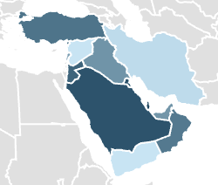
Regional Metrics at a Glance
Numbers of IXPs in the MENOG region: 24
Average of domestic network coverage at IXPs: 53%
Cumulative capacity: 31 TBPS
Notes:
Countries with no IXP: Yemen, Syria
The countries are 14,
Bahrain Iran Iraq Jordan KSA Kuwait Lebanon Oman Palestine Qatar Syria Türkiye UAE Yemen
The chart reflects Domestic network coverage at IXPs but we will see that in detail later

Slide 5

Analysis of Trends
Overall stability in number of IXP, capacity, and number of members
Noticeable growth in Oman, Qatar, and KSA
New IXPs in Iraq, Iran, and Oman
Notes:
The number of IXPs in the region has been relatively stable, but with pockets of growth.
Oman, Qatar, and Saudi Arabia stand out for increasing membership and adding capacity.
New IXPs have emerged in Iraq, Iran, and Oman, showing renewed focus on local interconnection.
Note that political and regulatory challenges still shape the pace of development.
Very little change in number of members and capacity in most countries: UAE Bahrain Iran Iraq Jordan Kuwait Lebanon Oman Palestine
Some development in Türkiye and Jordan

Slide 6
Source: https://pulse.internetsociety.org/ixp-tracker
Notes:
The domestic network coverage shows that in most countries, we have good percentage of networks that connect at an IXP, however, there is a big room for improvement here.

Slide 7
Source: https://pulse.internetsociety.org/ixp-tracker and TeleGeography
Notes:
However, when we compare the previos results with this chart, which presents the total capaity at local IXPs as percentage of the overall capacity (IXP capacity + national capacity from TeleGeography) we see that some of the countries that have high IXP penetration, have little traffic going through the IXPs, reflecting a trend of nominal membership, as in Palestine, Qatar, and Jordan.

Slide 8
Country by Country Analysis

Slide 9

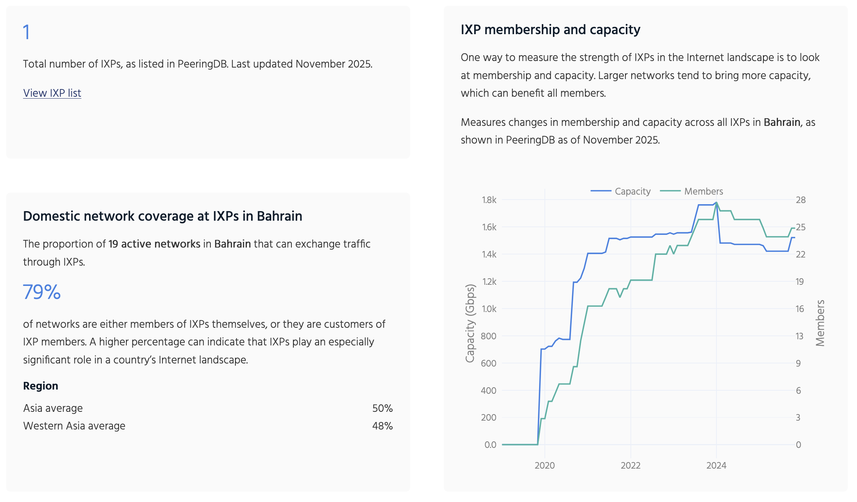
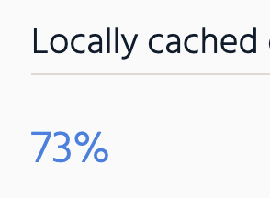
Bahrain
Source: https://pulse.internetsociety.org/ixp-tracker

Slide 10

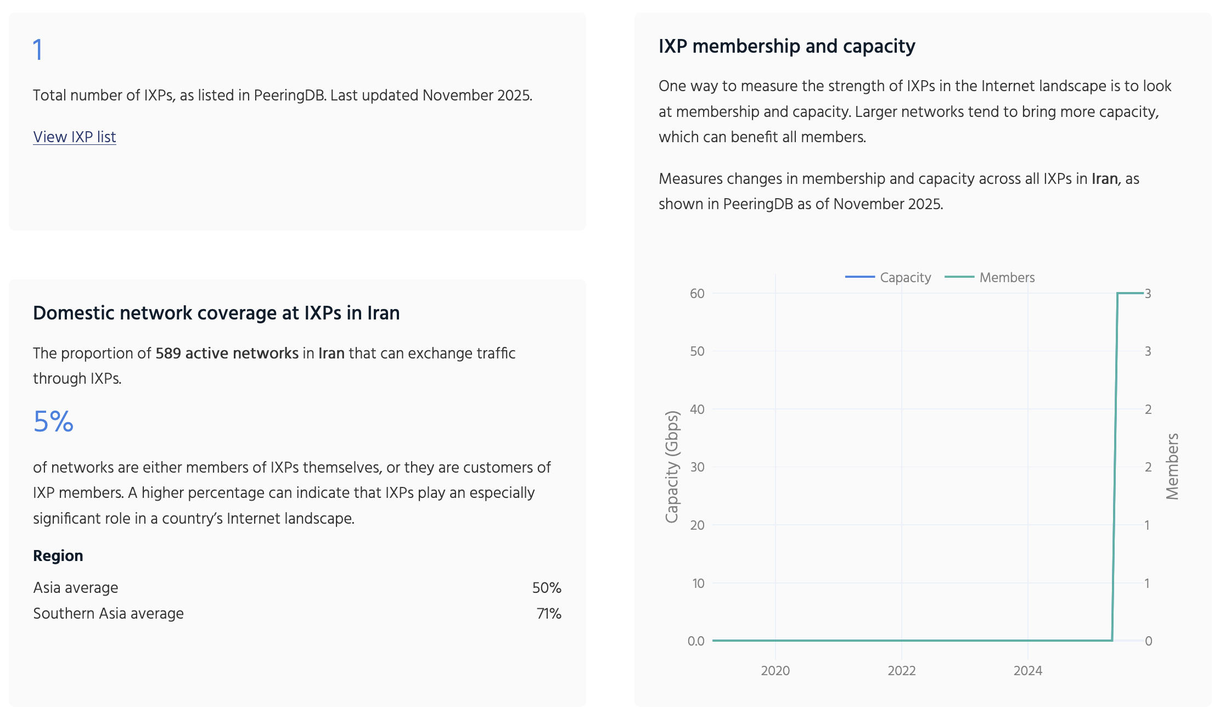
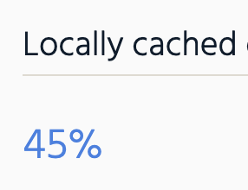
Iran
Source: https://pulse.internetsociety.org/ixp-tracker

Slide 11

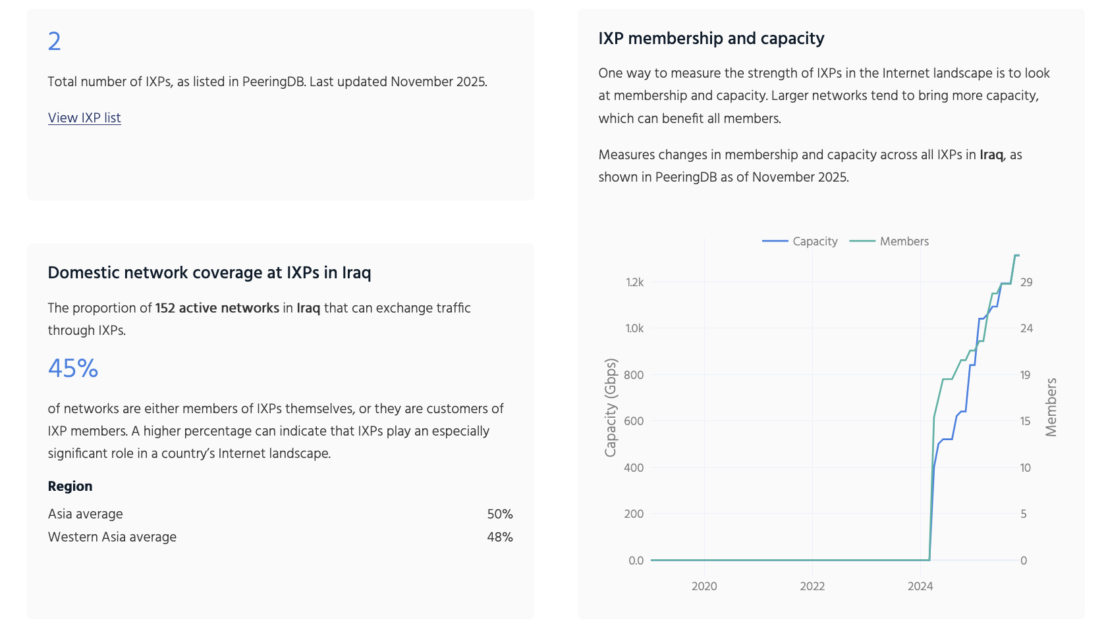
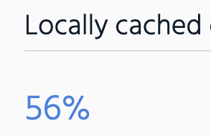
Iraq
Source: https://pulse.internetsociety.org/ixp-tracker

Slide 12
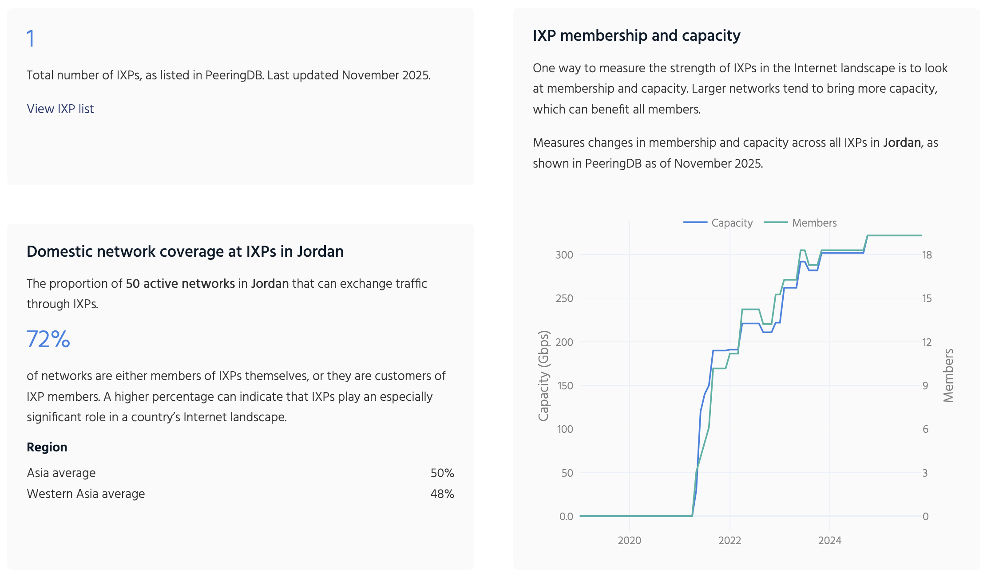

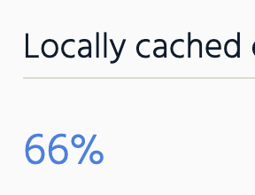
Jordan
Source: https://pulse.internetsociety.org/ixp-tracker

Slide 13
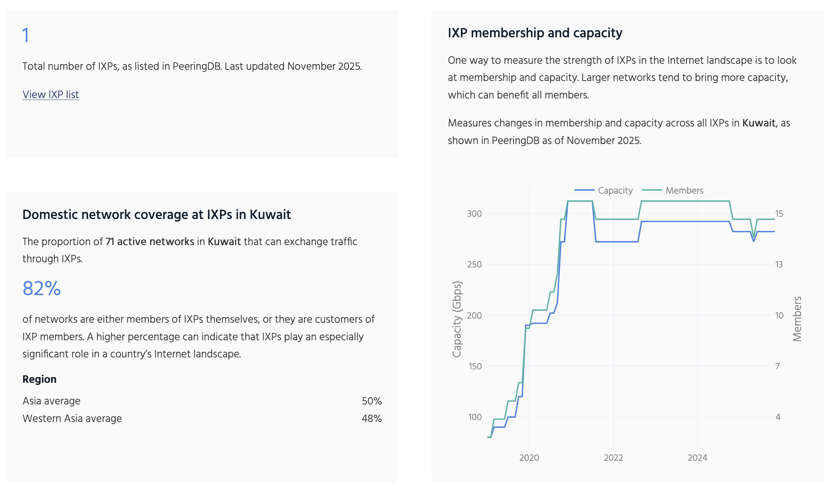

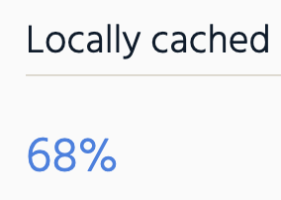
Kuwait
Source: https://pulse.internetsociety.org/ixp-tracker

Slide 14
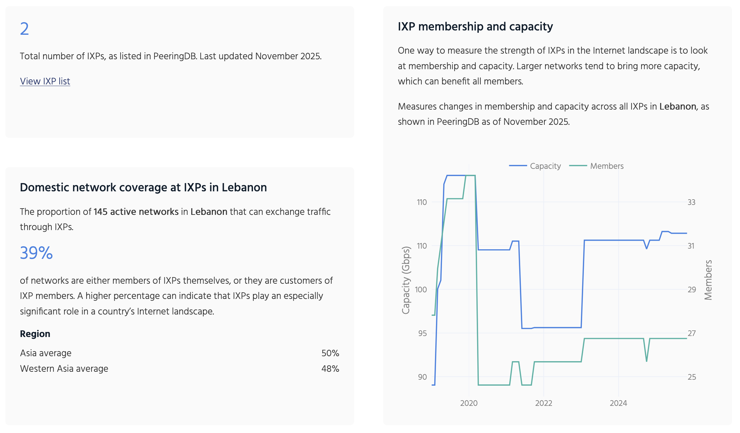

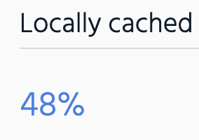
Lebanon
Source: https://pulse.internetsociety.org/ixp-tracker

Slide 15

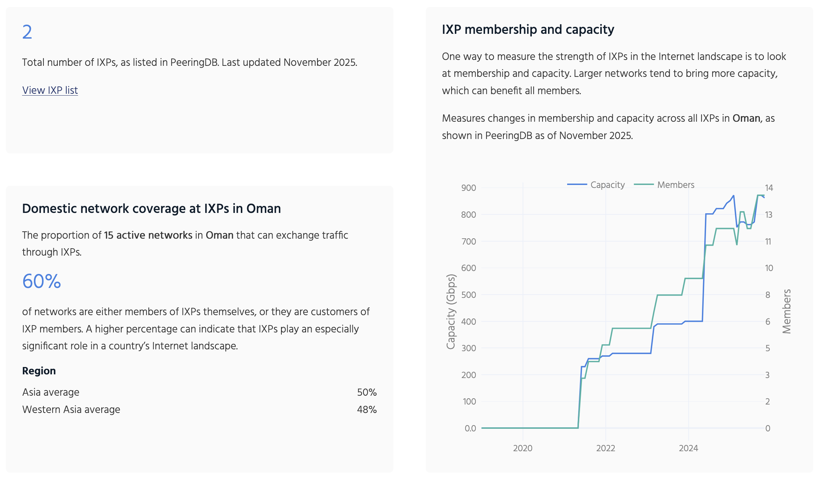
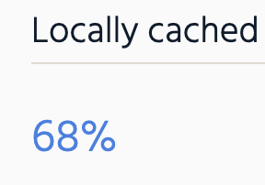
Oman
Source: https://pulse.internetsociety.org/ixp-tracker

Slide 16

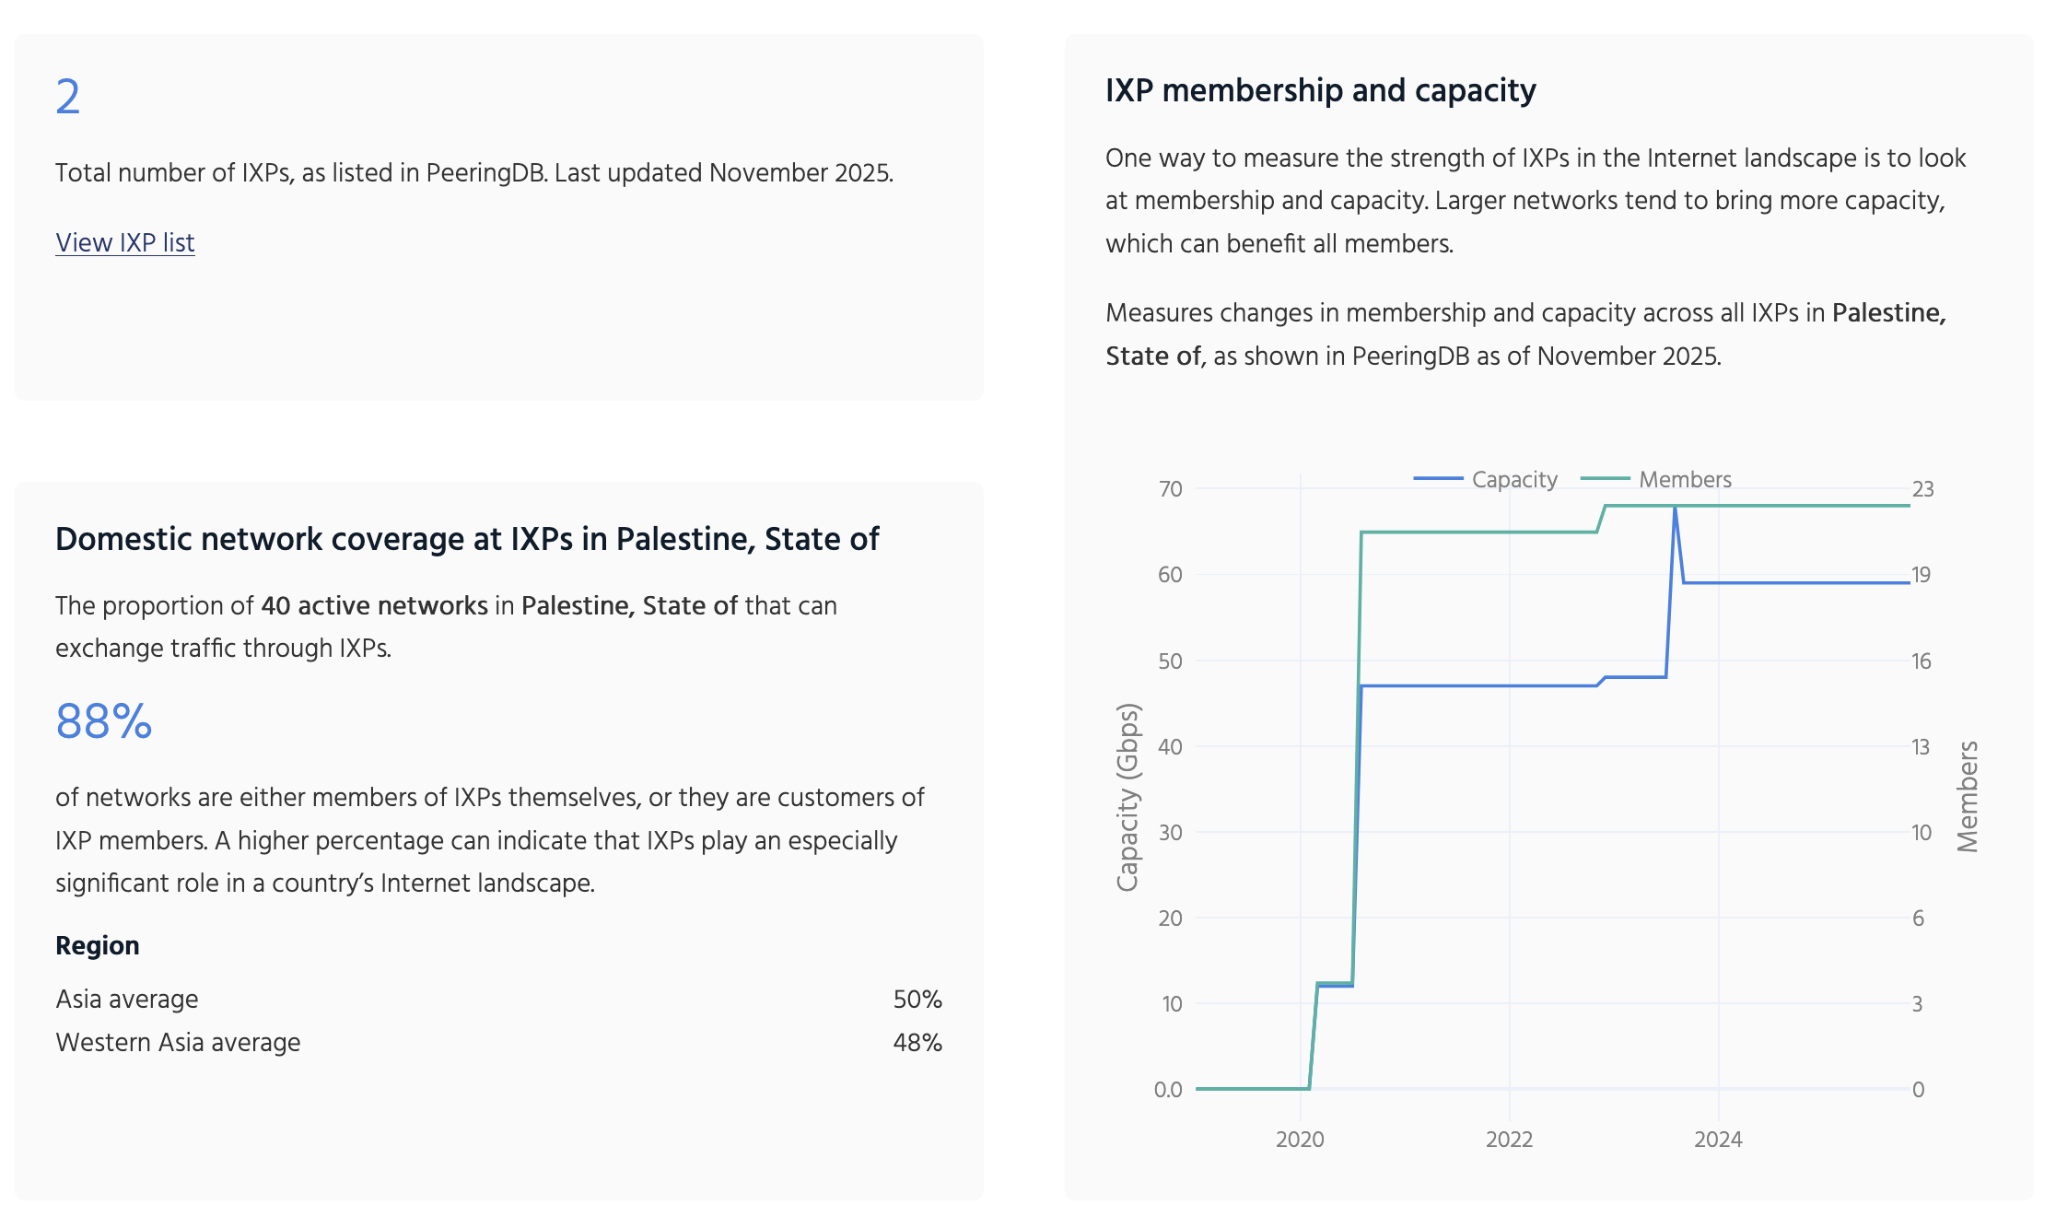
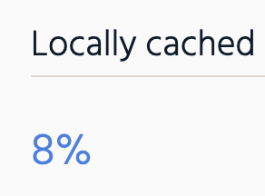
Palestine
Source: https://pulse.internetsociety.org/ixp-tracker

Slide 17

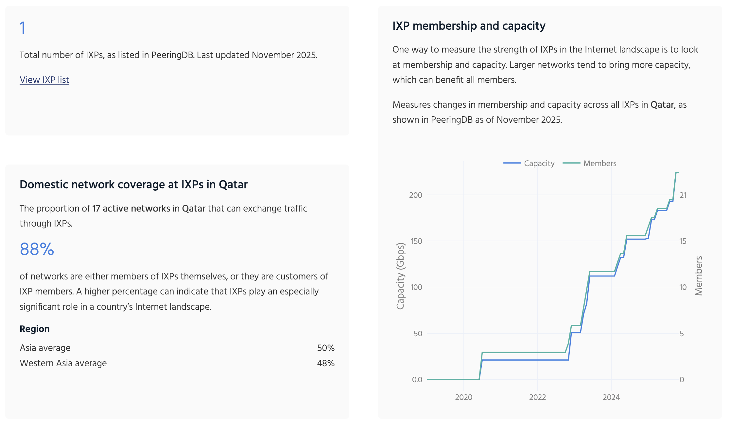
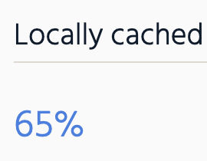
Qatar
Source: https://pulse.internetsociety.org/ixp-tracker

Slide 18

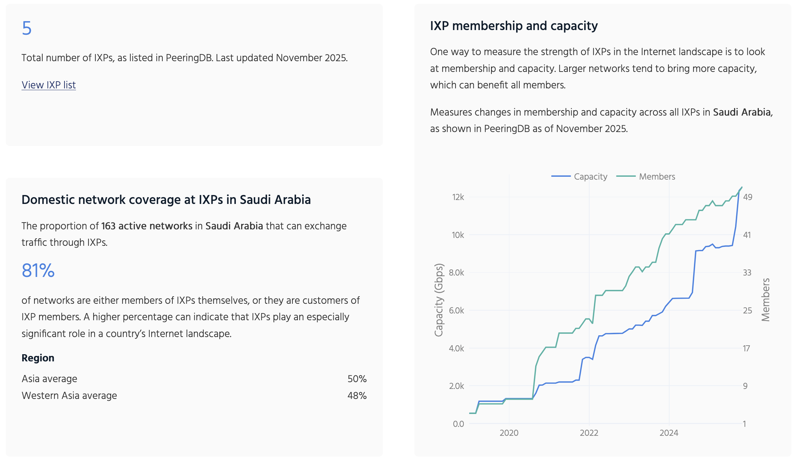
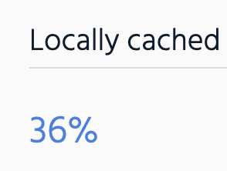
Saudi Arabia
Source: https://pulse.internetsociety.org/ixp-tracker

Slide 19

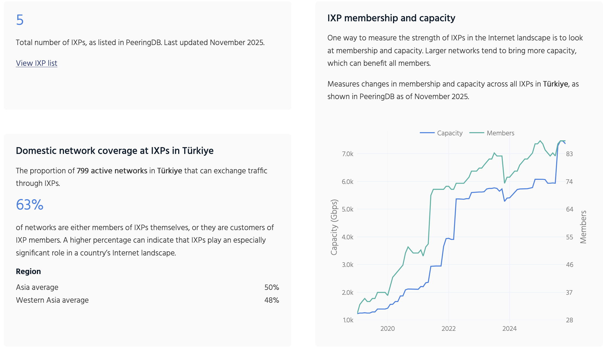
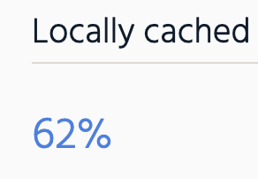
Türkiye
Source: https://pulse.internetsociety.org/ixp-tracker

Slide 20
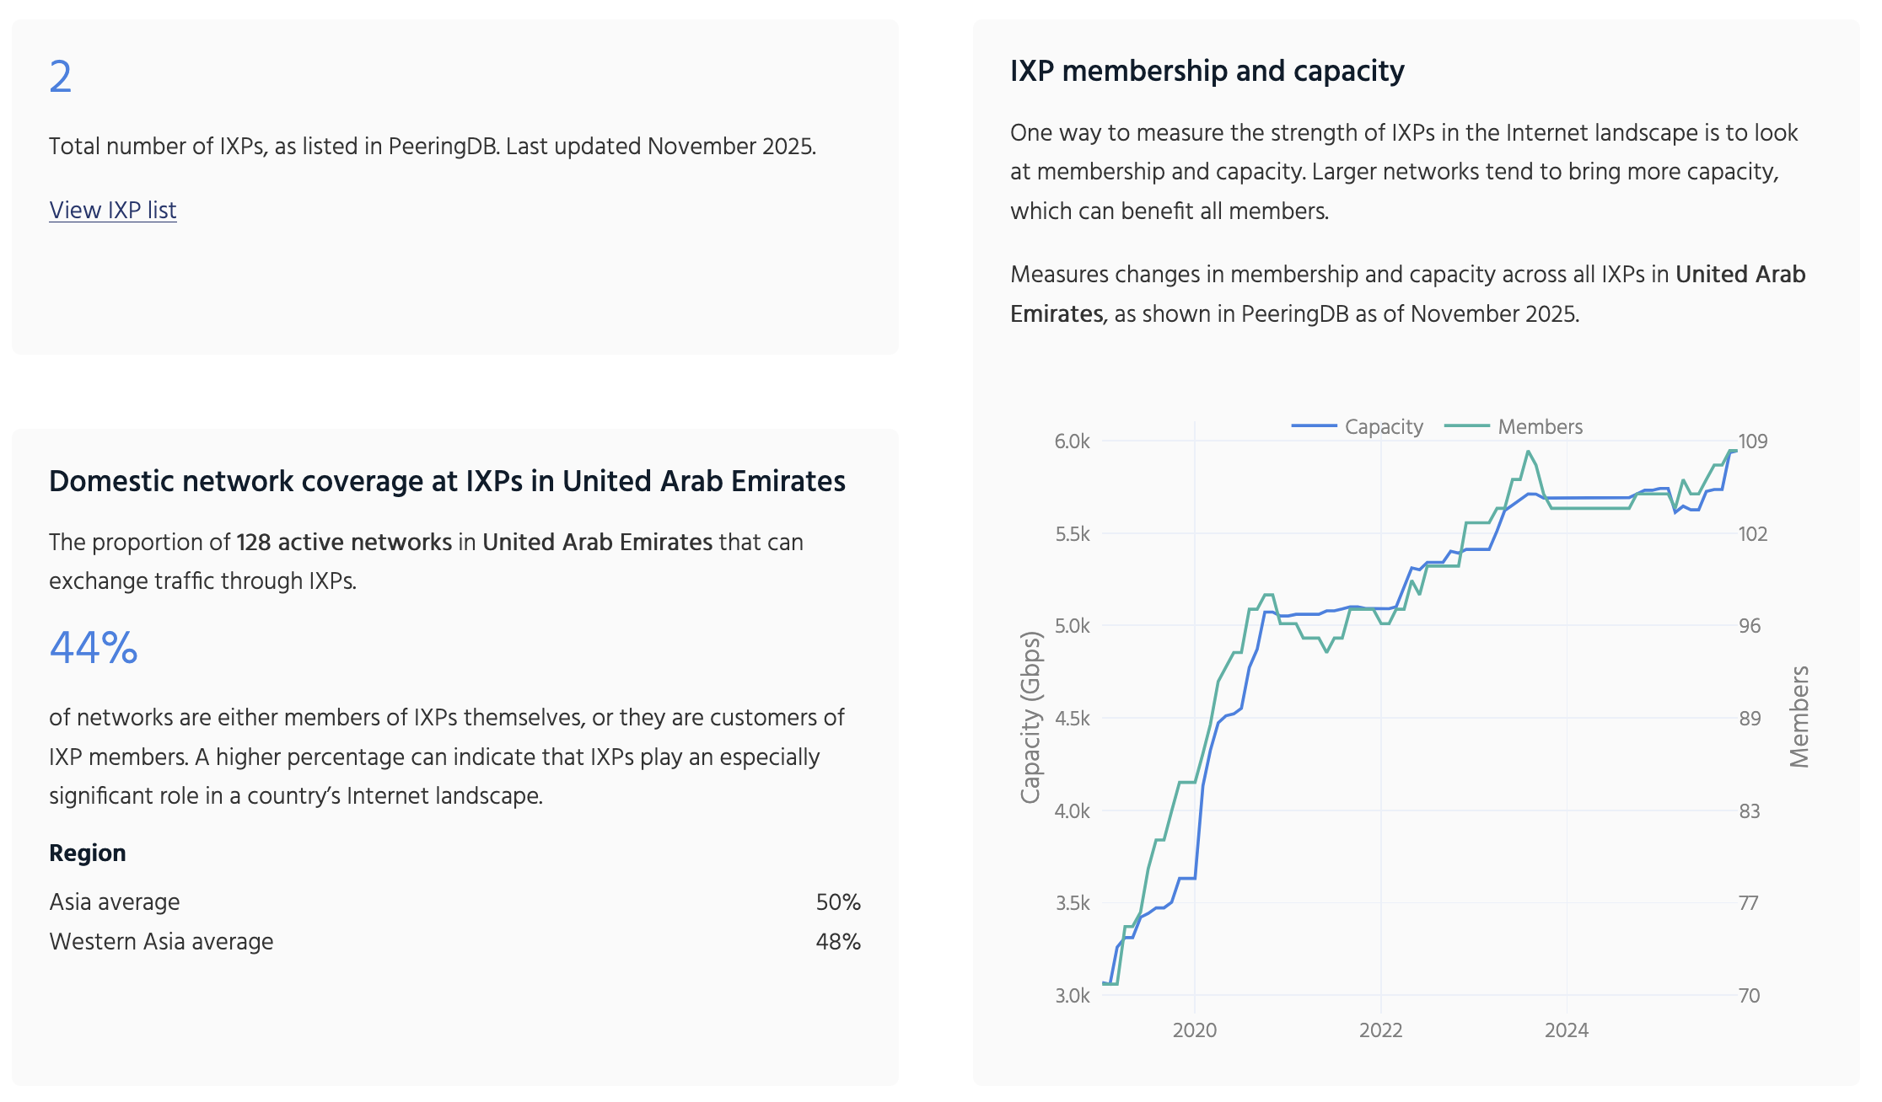

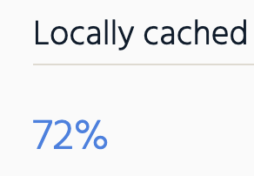
UAE
Source: https://pulse.internetsociety.org/ixp-tracker

Slide 21
Success Factors and the Future

Slide 22
Key Success Factors and Challenges
Success Factors:
Government and regulatory support.
Collaboration between local and international stakeholders.
Local content hosting and Content Delivery Networks (CDNs).
Challenges:
Regulatory hurdles and political instability.
Lack of technical expertise and funding.
Limited network operator participation
Notes:
1. Strong Government & Regulatory Support
Policies that enable multilateral interconnection and reduce barriers.
Examples:
UAE: Liberalized data center and hosting policies helped UAE-IX attract >100 networks.
Saudi Arabia: CITC’s national peering policy increased participation at JEDIX and RIYADH-IX.
2. Neutrality and Independence of the IXP
Operators trust IXPs that are neutral and not controlled by a single ISP, regulator, or vendor.
Examples:
NAPAfrica (South Africa): Operated by a neutral data center, allowing all ISPs equal access.
LINX/AMS-IX: Community-governed models where members control the IXP’s technical and financial decisions.
3. Affordable Port Pricing & Transparent Policies
Low-cost, predictable fees encourage local ISPs to participate, especially smaller ones.
Examples:
DE-CIX Frankfurt: Competitive pricing for 100G/400G ports.
Rwanda IXP: Subsidized port fees to encourage early adoption.
4. Critical Mass of Participants
IXPs thrive when both local and international networks connect — “network effect”.
Examples:
AMS-IX: Grew because ISPs, CDNs, cloud providers, and enterprises all joined.
NAPAfrica: Attracted CDNs early (Google, Akamai), leading to huge traffic growth and more ISPs joining.
5. Presence of CDNs and Local Content
Local caching reduces cost and improves performance — driving IXP usage.
Examples:
Oman (OMIX): When CDNs joined, domestic traffic and participation increased.
KIXP (Kenya): Google Global Cache deployments were transformational for local traffic localization.
6. Good Data Center Infrastructure
IXPs flourish in carrier-neutral data centers with reliable power, physical security, and ample space.
Examples:
Equinix (multiple IXPs): Standard for Tier 3+ facilities that attract global networks.
Qatar (MEEZA/QIX): Growth accelerated with new data center facilities.
7. Skilled Technical Operations Team
A well-run IXP requires 24/7 support, monitoring, automation, and strong community engagement.
Examples:
DE-CIX: Highly automated fabric, enabling rapid provisioning of 100G/400G ports.
LINX: Well-known for engineering expertise and best practice documentation.
8. Community Building & Member Engagement
Successful IXPs invest in outreach, training, and regional coordination.
Examples:
MENOG & AfNOG: Training workshops directly helped the establishment and growth of IXPs in the region.
IXP Association groups (Euro-IX, APIX, Af-IX): Promote knowledge sharing and best practices.
9. Clear Business Model & Sustainability
IXPs need a long-term financial model — membership fees, port fees, or government seed funding.
Examples:
AMS-IX & LINX: Member-owned not-for-profit models.
UAE-IX: Commercial model run by DE-CIX but still neutral and sustainable.
10. Encouraging Local Hosting & Cloud On-Ramps
When governments and industries host data locally, IXPs become vital exchange points.
Examples:
Saudi Arabia: Local cloud/data center investment increased demand for domestic peering.
Egypt: Large ecosystem around Cairo IX partly due to regional content hosting.

Slide 23
Key findings and future
Based on the trends we are seeing and the changes in regulatory environments, this is what we expect to see in the future in the region.
Notes:
The region is moving toward better interconnection, but progress is uneven.
Expect growth in markets where regulators are supportive and where local content continues to expand.
Some countries are shifting from state-controlled models to more open interconnection markets — which is positive for resilience.
Regional geopolitics will continue to influence cross-border traffic flows and infrastructure investments.

Slide 24
Give the gift of opportunity
100% of your donation funds work
to achieve an Internet for everyone.
Notes:
Thank the audience and invite them to explore the Pulse IXP Tracker for the latest data.
Briefly mention that ISOC’s work depends on community support and contributions.
Reinforce that resilient Internet infrastructure — including IXPs — is essential for social and economic development in the region.

