Slide 1


WHEREIS
IP Address Registration Geo-Consistency
Amreesh Phokeer
Internet Measurement and Data Expert
November 2025

Slide 2
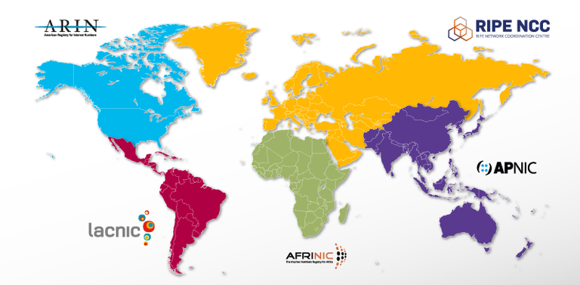
Regional Internet Registries
“The primary role of RIRs is to manage and distribute public Internet address space within their respective regions.” [ARIN NRPM, RIPE-738, NRO]
Internet numbers registry goals [RFC 7020]:
Allocation pool management (finite resource, uniqueness)
Hierarchical allocation (efficiency)
Registration accuracy (to meet operational needs)

Slide 3
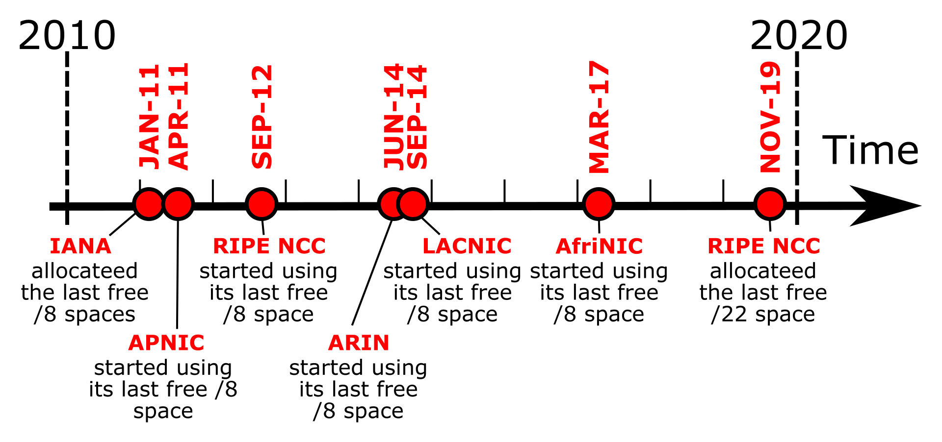
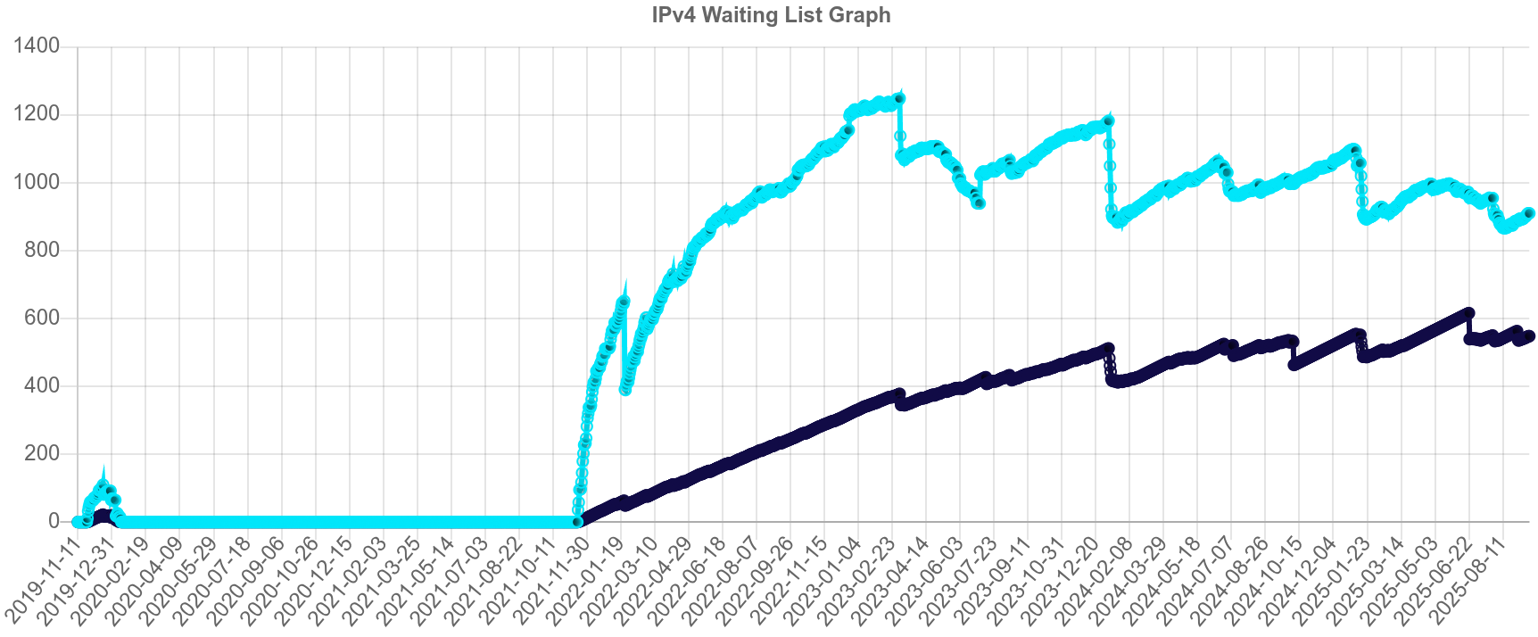
IPv4 address exhaustion
901 LIRs on waiting list
553 days that the first LIR in queue has been waiting

Slide 4
Where are prefixes used after allocation?
Notes:
Where are prefixes used post-allocation?
How, what, where: are prefixes used outside of their registered RIR region?
What are the potential technical implications?
What are the potential policy implications?

Slide 5
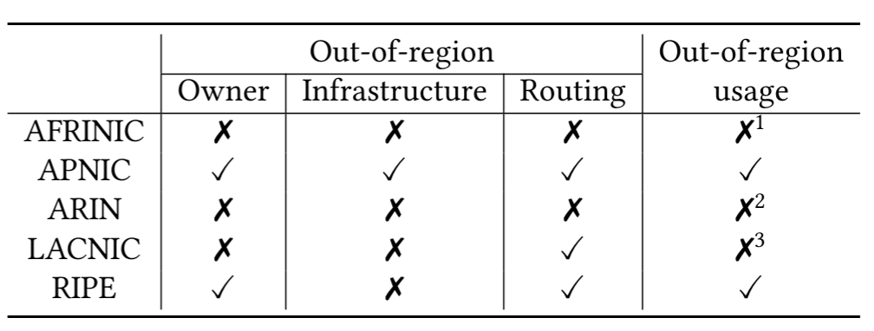

Is out-of-region use allowed?

Slide 6
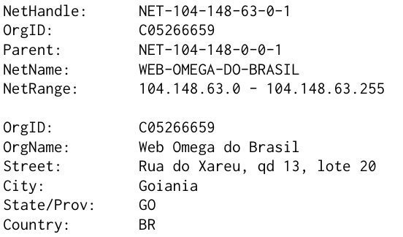
WHOIS to the rescue
WHOIS RIR: ARIN
WHOIS Organization RIR: LACNIC (Brazil)
Actual location RIR: ?

Slide 7

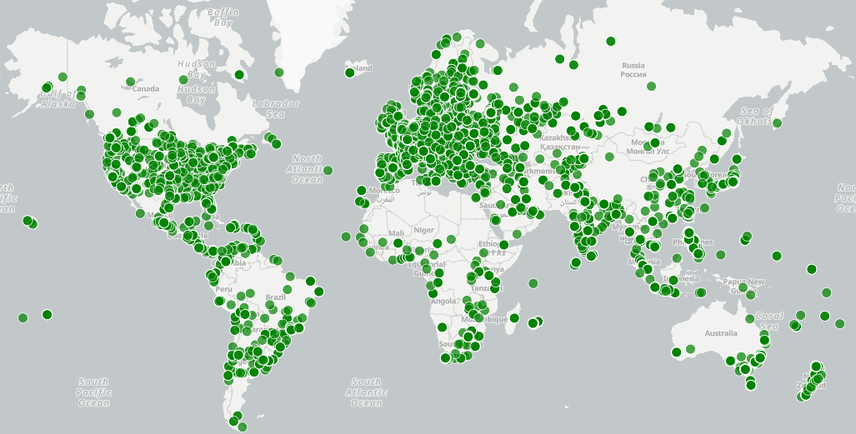
Globally distributed network of measurement probes
Managed by the RIPE NCC
7.8k hardware probes
5.3k software probes
889 anchors (more powerful probes)
Credit-based system to schedule measurements
→ Find geo-inconsistent prefixes using RTT measurements and speed-of-light inference

Slide 8
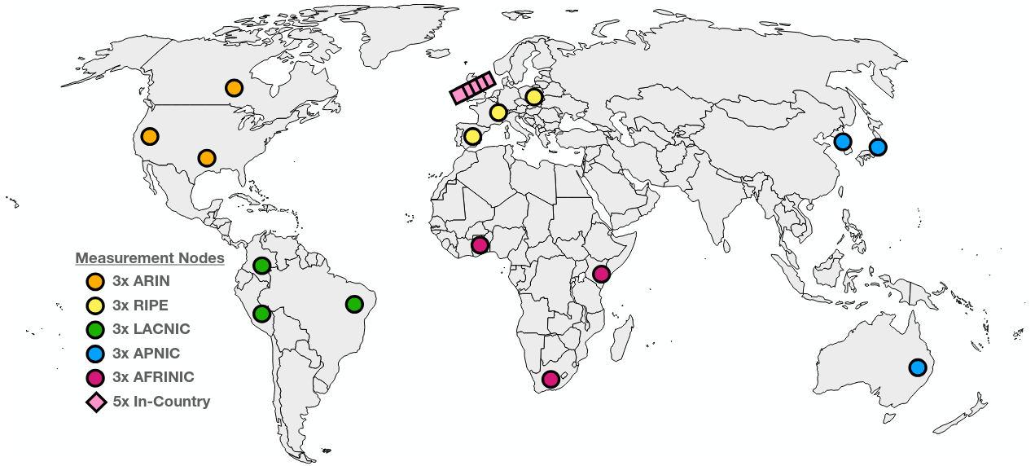
RIPE Atlas measurements
→ Measure from 20 probes in different country and RIR locations

Slide 9
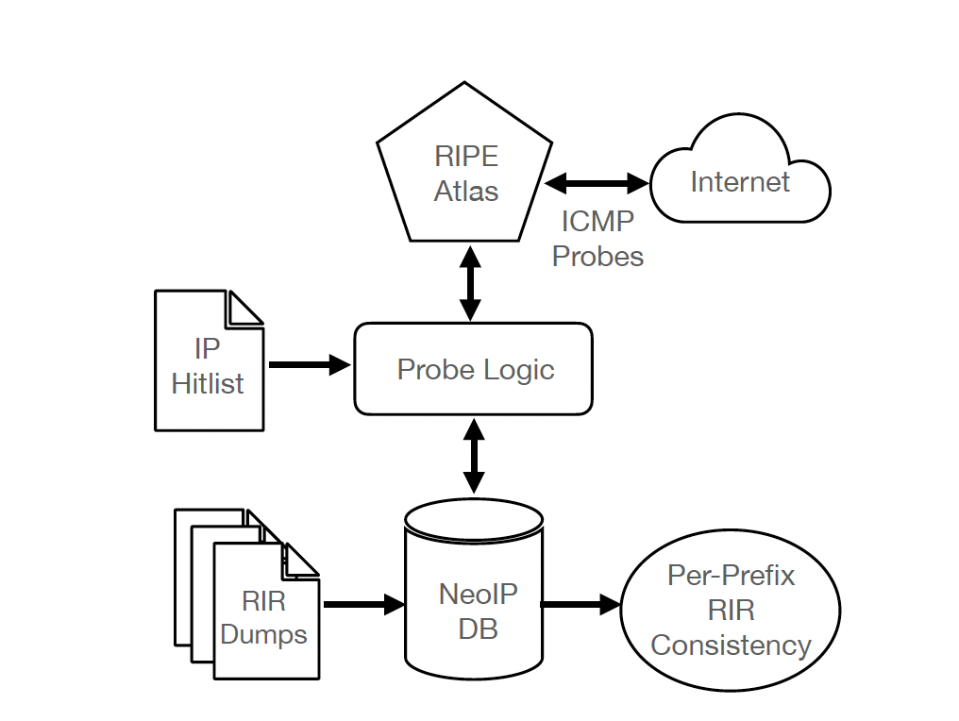
Methodology

Slide 10
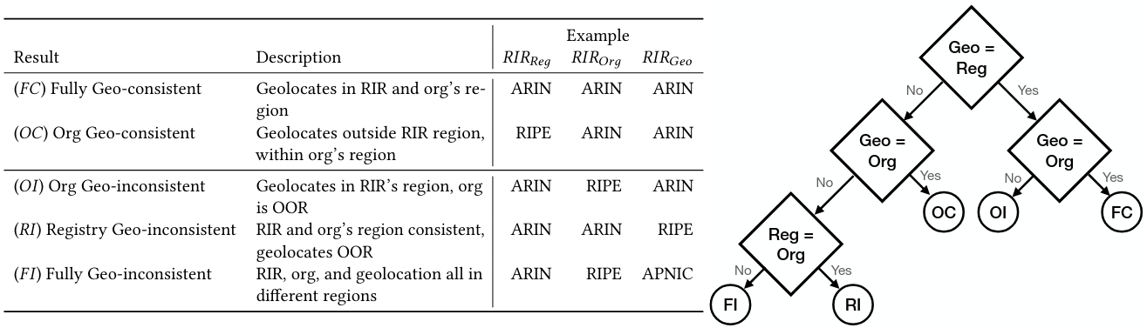
Terminology: Classifying different inconsistencies
→ Different types of inconsistencies depending on Reg, Org, and Geo regions

Slide 11
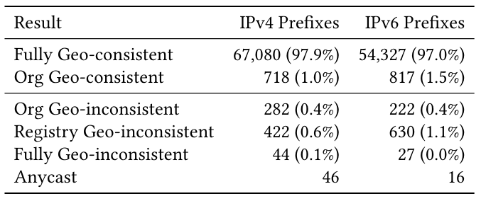
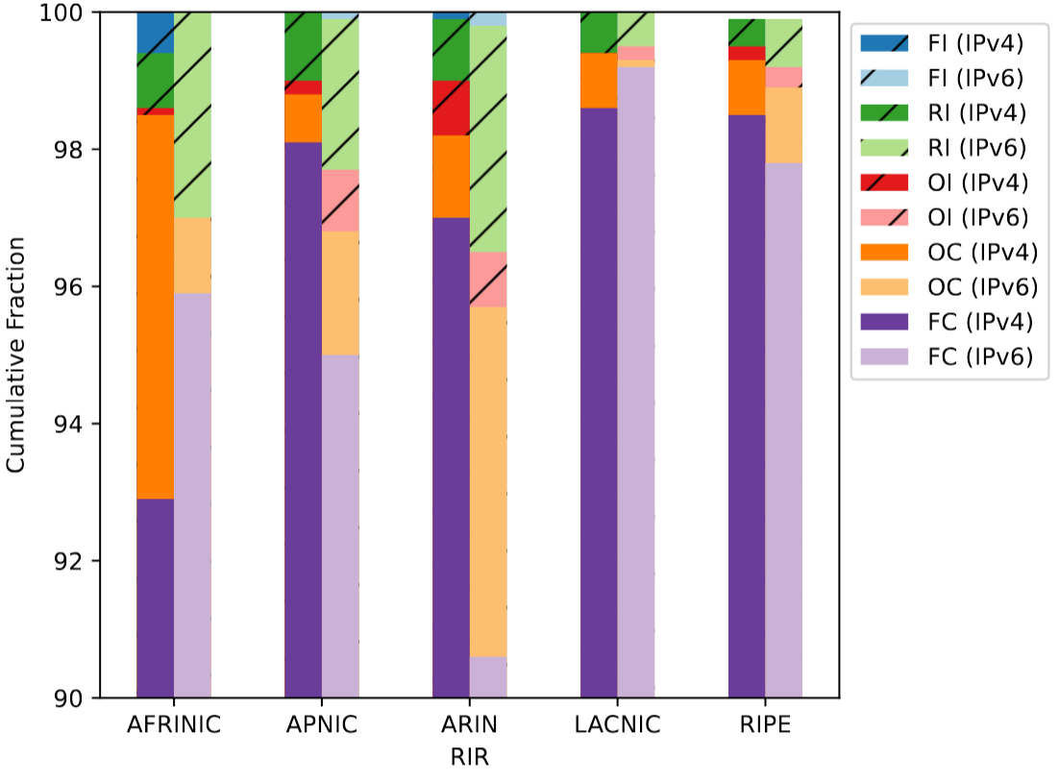
Geo-consistency results
~70k IPv4, ~55k IPv6 prefixes
98% consistent
AFRINIC, ARIN most inconsistent
IPv6 not more consistent
→ More than 98% are geo-consistent, some variation between RIRs

Slide 12
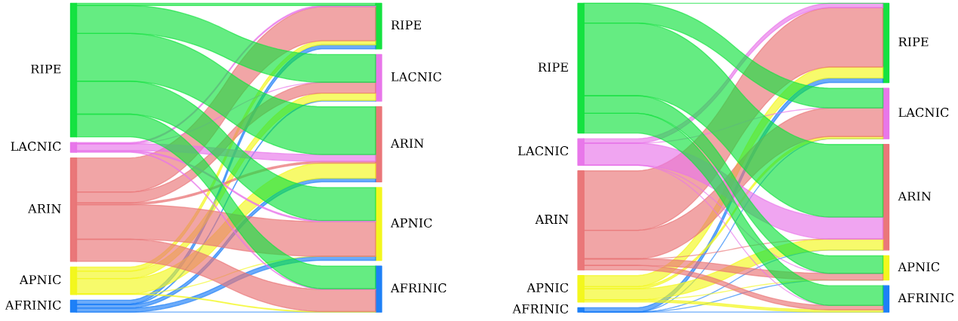
Where are inconsistent prefixes used?
IPv4
IPv6
→ AFRINIC IPv4 prefixes are mostly used in APNIC, RIPE, and ARIN regions

Slide 13
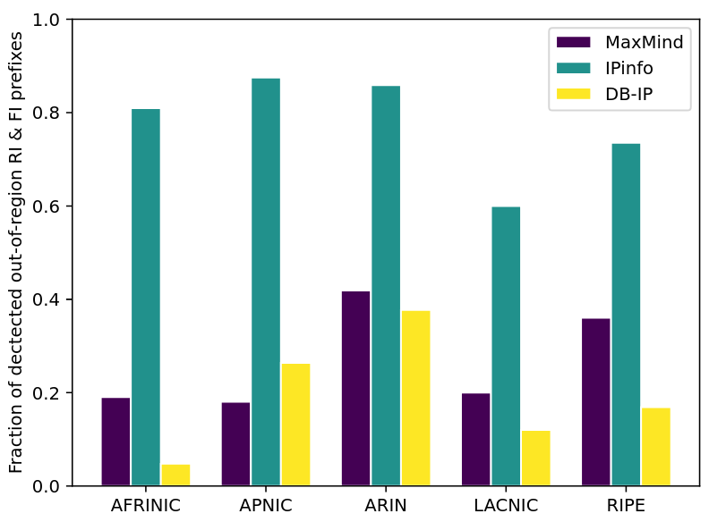
Effect on IP geolocation DBs
→ IPinfo detects many more OOR prefixes, MaxMind & DB-IP seem to rely on incorrect WHOIS information
Notes:
Self-delusion: geo databases use WHOIS data themselves
Across three geo databases, at most 60% of our inferred inconsistencies are out-of-region

Slide 14
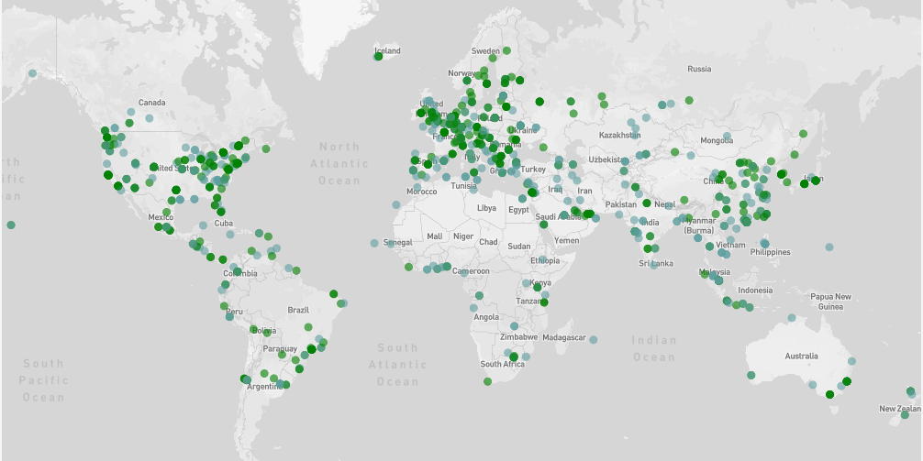
IPinfo’s probe network
1100+ globally distributed probes
440+ ASes
135+ countries
460+ cities
Measurements resulting in
300+ TB of data per month
→ IPinfo leverages probe network to validate geolocation information

Slide 15
Leveraging IPinfo’s probe network
Approach
  Use RTT measurements from IPinfo’s probe network
  Target all pingable IP addresses
  Same detection algorithm as with RIPE Atlas
RIPE Atlas results
  748 geo-inconsistent IPv4 prefixes
  879 geo-inconsistent IPv6 prefixes
IPinfo results
  45.7k geo-inconsistent IPv4 prefixes
  1.5k geo-inconsistent IPv6 prefixes
→ IPinfo’s probe network detects 60x more inconsistent IPv4 prefixes compared to RIPE Atlas

Slide 16
Impact and validation
Shared data and obtained validation from ARIN, RIPE, and AFRINIC
Shared data and obtained validation from leasing provider IPXO, resulted in corrections to the WHOIS records
AFRINIC:
  Exhaustive WHEREIS of all AFRINIC prefixes
  Inconsistencies distributed across 51 BGP announcements and 23 ASNs
  Two ASNs account for >53%

Slide 17
WHEREIS – take aways
Increase transparency and help community understand where scarce resources are used
Quantify extent to which registry information is accurate and can serve operational needs
Inform ongoing discussion over “in-region” address use and policy
98% consistent in most conservative view; 2% very inconsistent
Rob Beverly <rbeverly@sdsu.edu>
Amreesh Phokeer <phokeer@isoc.org>
Oliver Gasser <oliver@ipinfo.io>

