Slide 1

Accelerating IPv6 Adoption

Slide 2

Yasir Zamir (PMP®)
Network Architect & Security Expert
Senior Network Planning
Notes:
All things IP, so lets start with an anology

Slide 3

Notes:
"Think of the entire IPv4 address space as a colossal parking lot—finite in size.
In this parking lot, the Local Internet Registries, or LIRs, are like individual cars needing a parking spot to function.
As you can imagine, with the explosion of the internet, , that lot is now not just full, it's gridlocked. We have hundreds of cars—new LIRs—queuing outside, desperately waiting for spaces that simply do not exist."

Slide 4
Notes:
"Think of the entire IPv4 address space as a colossal parking lot—finite in size.
In this parking lot, the Local Internet Registries, or LIRs, are like individual cars needing a parking spot to function.
As you can imagine, with the explosion of the internet, , that lot is now not just full, it's gridlocked. We have hundreds of cars—new LIRs—queuing outside, desperately waiting for spaces that simply do not exist."

Slide 5

Notes:
IPv6 offers 340 undecillion addresses—that's more than grains of sand on Earth.
we move from fighting over the last few parking spaces to having enough space to give every grain of sand on every beach and in every desert its own unique address—and still have enough left to address every star in the known galaxy.
The transition to IPv6 is not an upgrade; it is the creation of a whole new universe.
But here's the challenge: designing and implementing IPv6 can feel overwhelming.

Slide 6
Notes:
With this backdrop, let us review the status of IPv6 Adoption in the Middle East

Slide 7
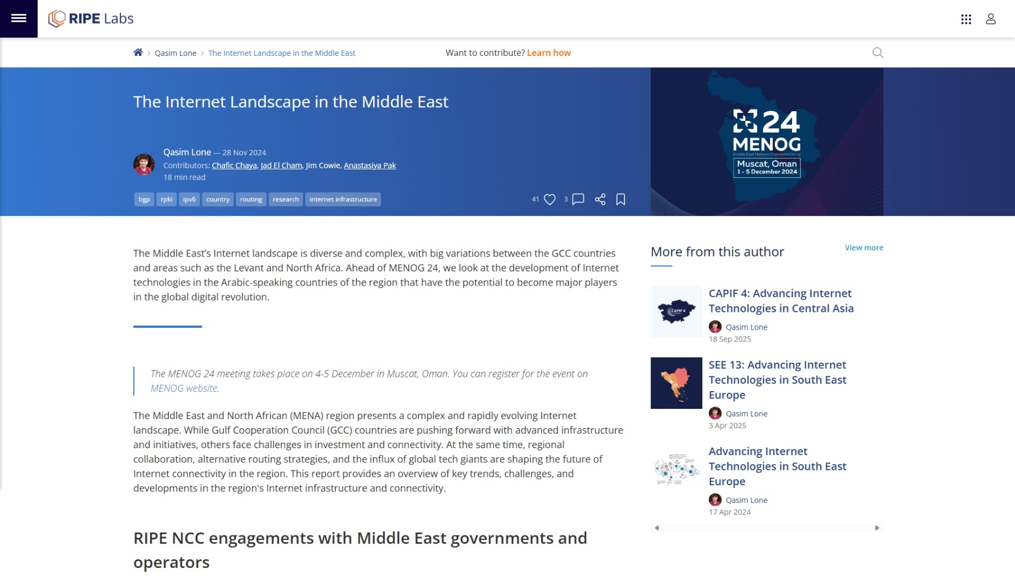
Notes:
"Based on the article, the Middle East is rapidly building a future-proof Internet and employs a nuanced, two-pronged approach to measuring IPv6 progress.

Slide 8
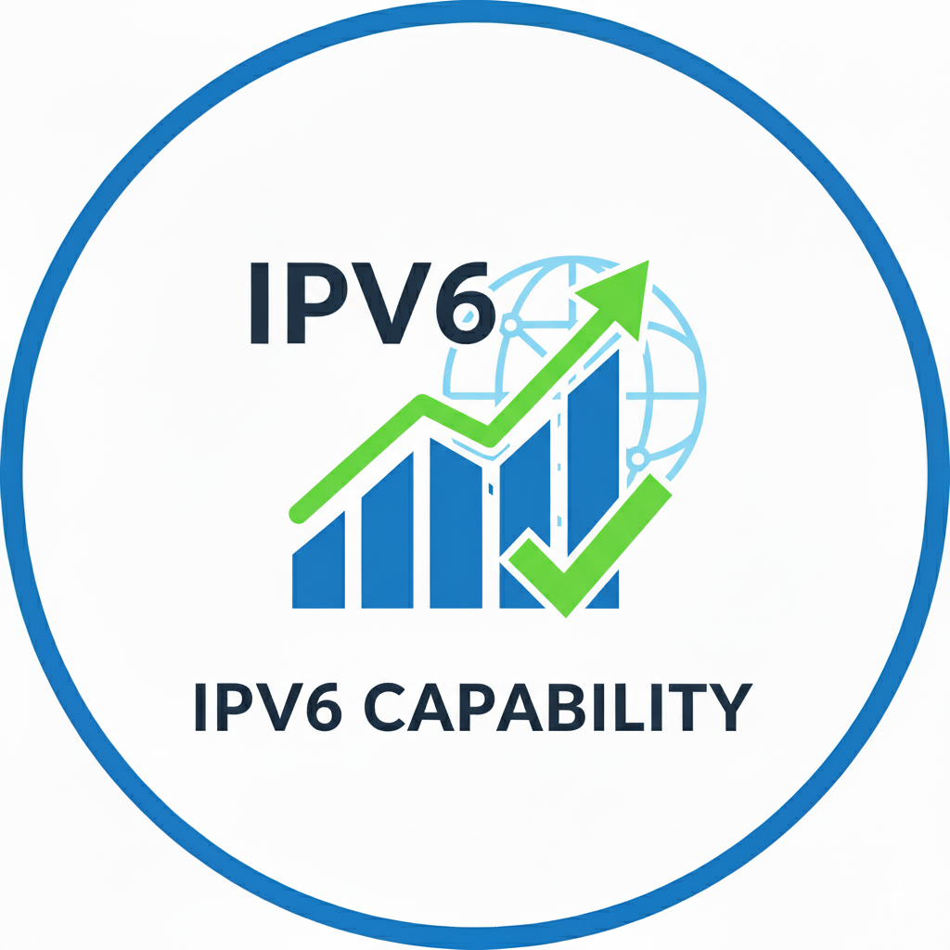
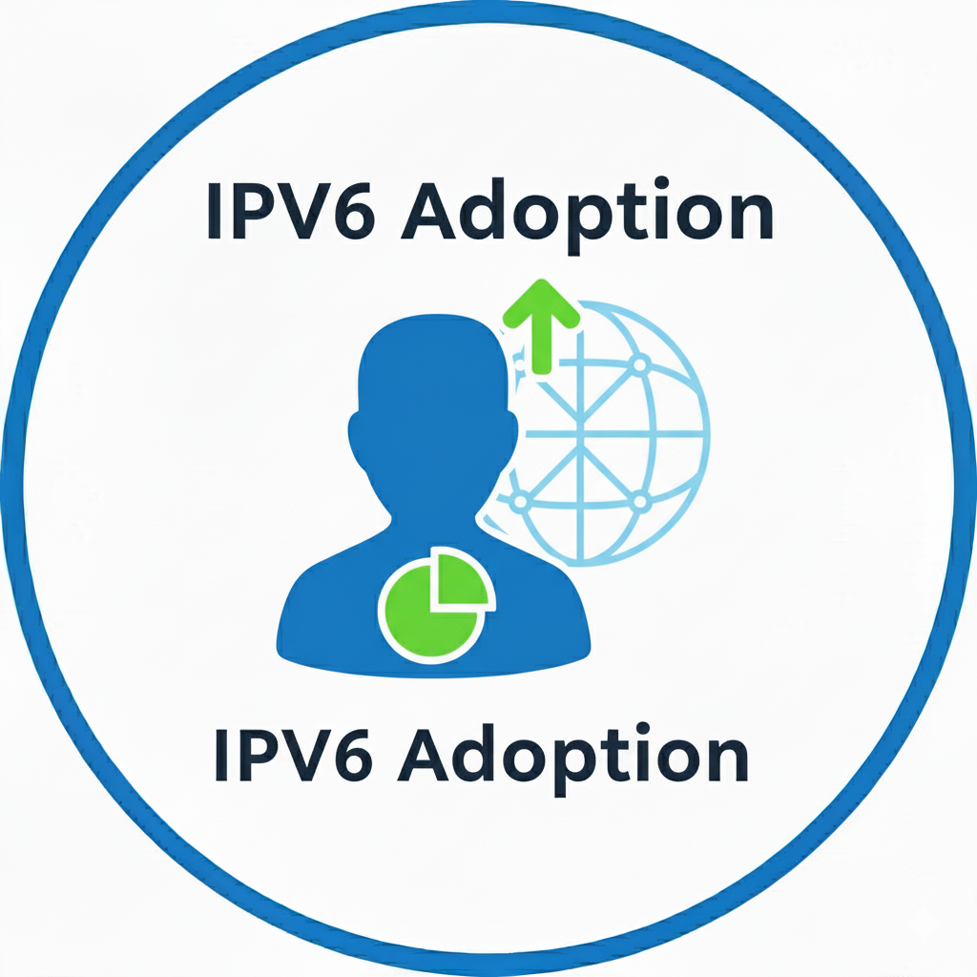
Two key aspects of IPv6 progress
Notes:
The first is Capability. This is a measure of infrastructure readiness , defined simply by the percentage of ASes announcing at least one IPv6 prefix in the global routing table.
The second is actual Adoption. We use Content Delivery Network data to measure the percentage of users accessing content over IPv6. This end-user metric is critical because it tells us precisely how much IPv6-enabled infrastructure is being actively utilized.

Slide 9
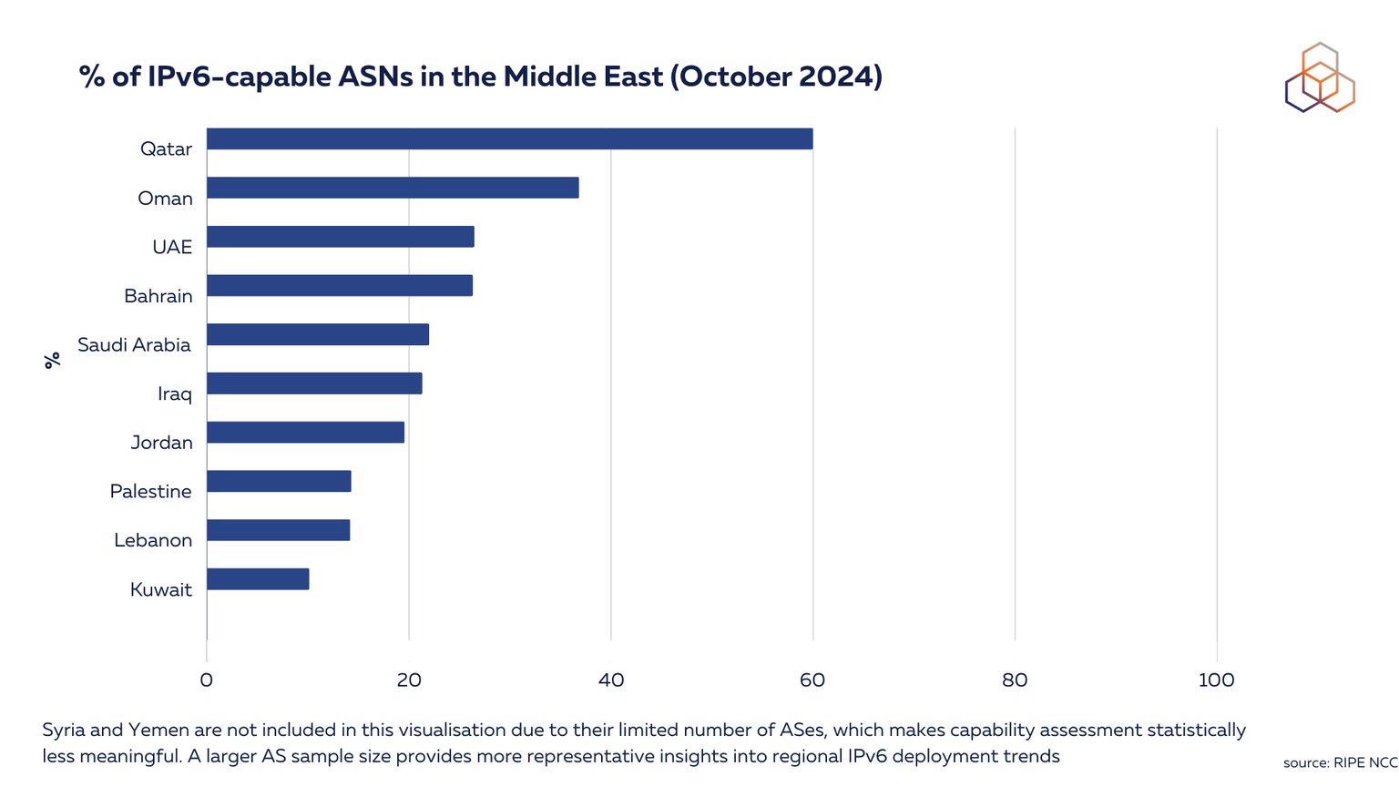
Notes:
"Let's first look at the IPv6 Capability metric. This simply tracks the percentage of Autonomous Systems announcing an IPv6 prefix in the global routing tables.
Here, Qatar stands out, leading the region at 60%. However, with the regional average at only 25% , the majority of the Middle East remains well below the 50% mark. This confirms that the basic IPv6 infrastructure readiness is still a significant challenge across much of the region

Slide 10
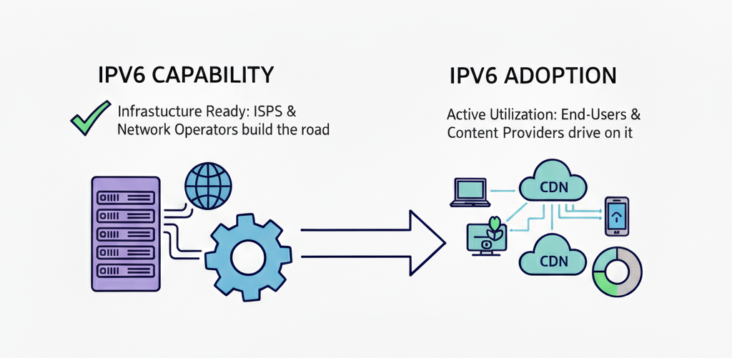
Capability vs. Utilization: The Causal Gap
Notes:
The fundamental reason IPv6 capability precedes IPv6 adoption is simple: Capability is the prerequisite infrastructure investment; adoption is the measure of active utilization by the end-user ecosystem. It’s the difference between building the road and actually driving on it. Quite simply, no road, no traffic.

Slide 11
Key Challenges in IPv6 Adoption

Slide 12

Key Challenges in IPv6 Adoption
Notes:
"So, why is this transformation so slow? Why the gap between capability and adoption? It comes down to three key hurdles that network operators face every single day:
The Legacy Burden: It's not just flipping a switch. You're dealing with vast networks built over decades. Many older devices and critical software simply do not support IPv6 natively.

Slide 13

Key Challenges in IPv6 Adoption
Notes:
"So, why is this transformation so slow? Why the gap between capability and adoption? It comes down to three key hurdles that network operators face every single day:
The Immediate Cost: The long-term savings are clear, but the upfront financial barriers are real. Implementing IPv6 requires significant investment in new hardware, software upgrades, and crucial re-training for technical staff.

Slide 14
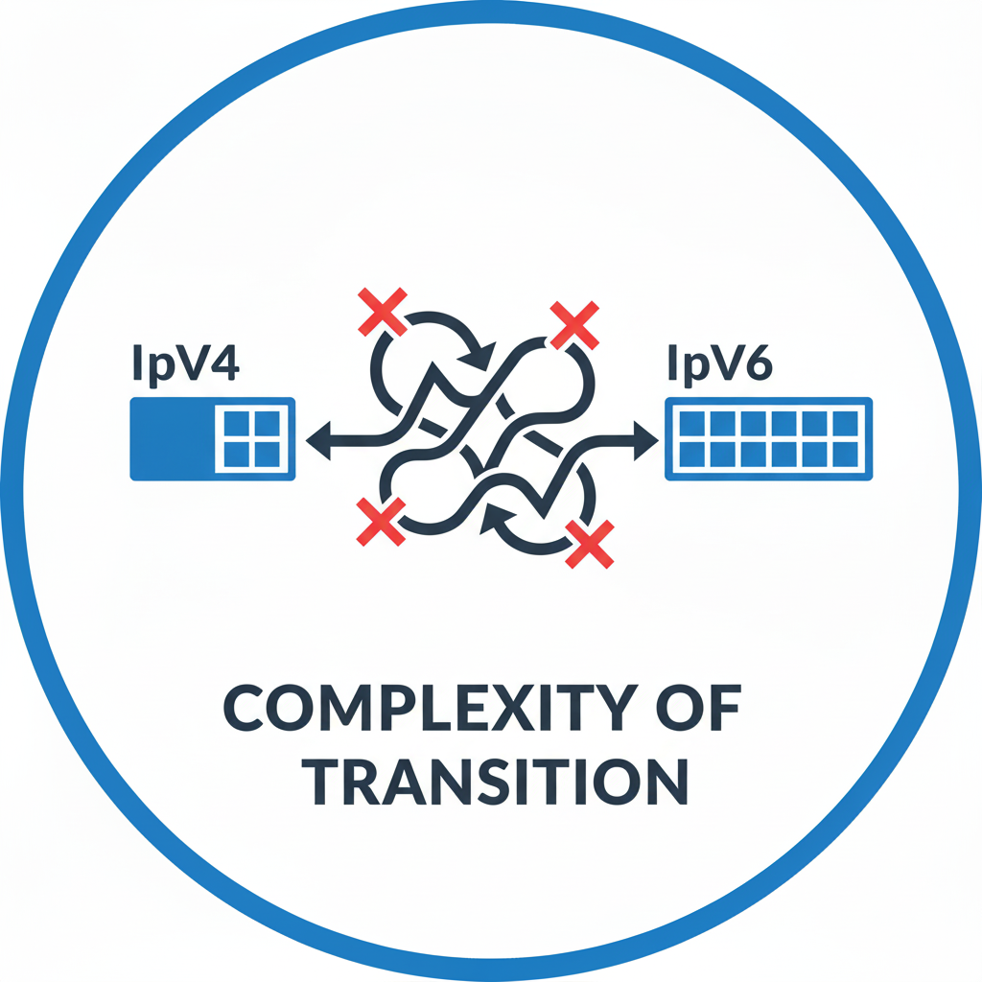
Key Challenges in IPv6 Adoption
Notes:
"So, why is this transformation so slow? Why the gap between capability and adoption? It comes down to three key hurdles that network operators face every single day:
The Technical Complexity: The transition forces a complex 'dual-stack' world, making managing connectivity and translation technically challenging for operational teams.

Slide 15
Key Challenges in IPv6 Adoption
Notes:
What if the first two challenges are not a concern, the organization have an executable plan to replace or upgrade the legacy systems and they have secured the necessary budget for implementation. At that point, your final and most complex challenge is purely The Technical Execution.
You’re left with the intensive work of navigating the messy 'dual-stack' world. You must ensure seamless, secure communication between IPv4 and IPv6 networks without sacrificing performance. This is where you need deep expertise, flawless planning, and the skills to conquer the operational complexity of a large-scale transition."

Slide 16
Where do we exactly start?
Notes:
The inevitable question ☺, Where do we exactly start?

Slide 17
Where do we exactly start?
1. Do we hire expensive IPv6 consultants?
2. Do we send teams for months of training?
3. Do we risk making architectural mistakes that haunt us for years?
Notes:
1. Do we hire expensive IPv6 consultants?
2. Do we send teams for months of training? Sacrificing critical day-to-day operational capacity now.
3. Do we risk making architectural mistakes that haunt us for years? Mistakes that demand far more time and money to fix later.

Slide 18
AI & LLMs
Your Network Design Co-Pilot
Notes:
"Now, imagine you could bypass that entire dilemma. Imagine a way to cut months off your timeline, reduce your budget, and virtually eliminate human error in the process.
That's exactly what AI and Large Language Models can do for you. Not in theory. Not someday. Right now.
Let me show you exactly what I mean. First, let's quickly understand what these tools actually are...

Slide 19

AI & LLMs
Notes:
Software that can reason, learn, and solve problems like humans.
It has memorized every RFC, RIPE policy, network devices along with their best practice. LLMs understand both human language AND technical documentation
This allows it to act as the perfect translator, instantly connecting your high-level goals with the precise technical language required for a flawless network build."

Slide 20
Why This Matters for IPv6

Slide 21

Why This Matters for IPv6
Notes:
Context: It AI's short-term and long-term memory. A traditional chatbot is 'stateless'—it forgets everything after each query.
It remembers it’s designated role and the specific scenario—such as Senior Network Architect and 'a regional ISP with three POPs.’
And It builds upon every previous output.

Slide 22
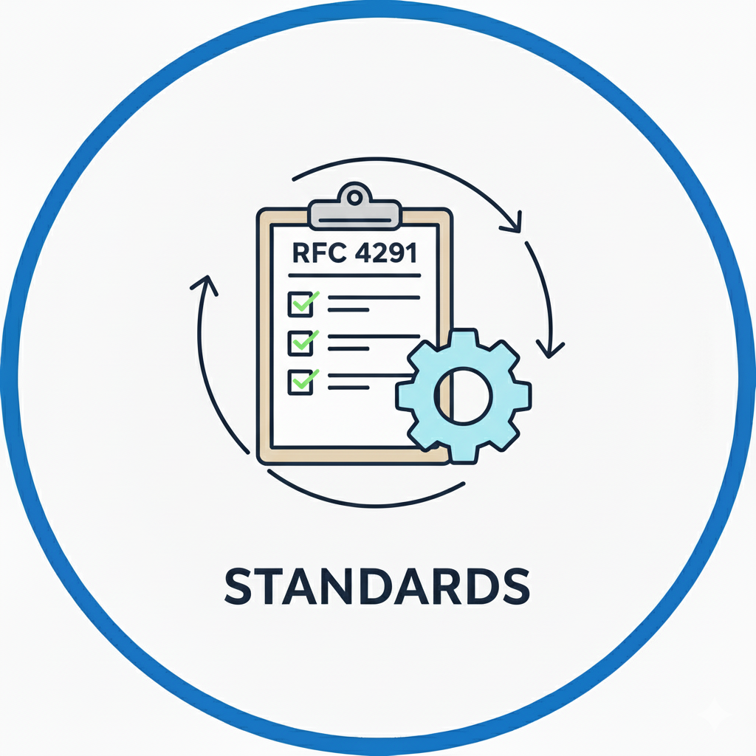
Why This Matters for IPv6
Notes:
"AI is trained on billions of text documents, meaning it has internalized every networking standard ever written.
More importantly, it understands the semantic relationship between these concepts.
When you ask about IPv6 routing, the AI doesn't just give you subnets—it automatically considers the BGP implications, the security policies, and the full operational procedures for your network.

Slide 23

Why This Matters for IPv6
Notes:
Speed: It compresses time. This AI takes what used to be a **multi-week project—**the calculations, the documentation, the cross-referencing—and converts the entire workflow into a matter of minutes, drastically shrinking your deployment calendar.

Slide 24
Why This Matters for IPv6
Notes:
"With these three principles, we define the strategic advantage of AI in networking. We are fundamentally transforming a slow, error-prone technical process into a fast, accurate, and fully integrated operational workflow.
The era of costly IPv6 delays is over; the era of AI-accelerated deployment starts now."

Slide 25
The Bridge:
From "AI Can Do This" to
"Here's How You Do It"
Notes:
AI is like having a brilliant senior architect on your team, but here's the thing about brilliant people—you need to ask them the right questions.
Ask vaguely, get vague answers. Ask precisely, get precise solutions.

Slide 26
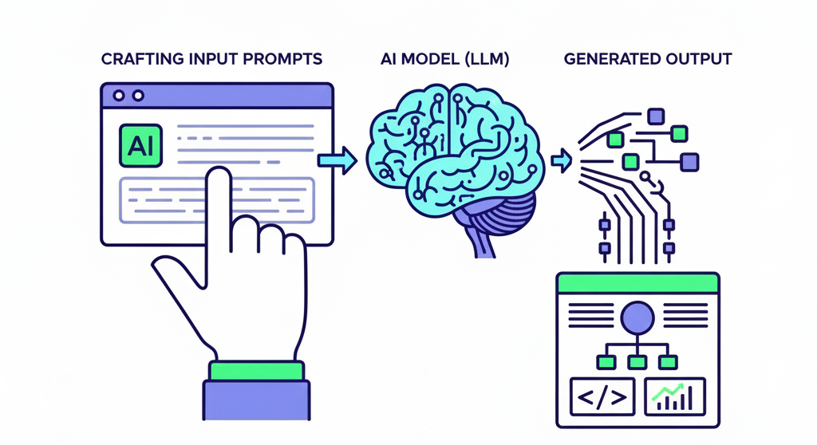
Prompt Engineering
Notes:
Which brings us to prompt engineering.
"Now, I know what some of you are thinking: [slight smile] 'This sounds amazing, but I've tried AI tools before and got generic, unusable results.’
And you're absolutely right to be skeptical. Because here's the truth that nobody talks about in AI presentations: The technology is only as good as how you communicate with it."

Slide 27
The Art of Asking AI Right
Notes:
The difference isn't the AI. It's not the complexity of the problem. It's not even the experience level of the engineer.
The difference is how the question is asked and The Art of Asking AI Right.

Slide 28
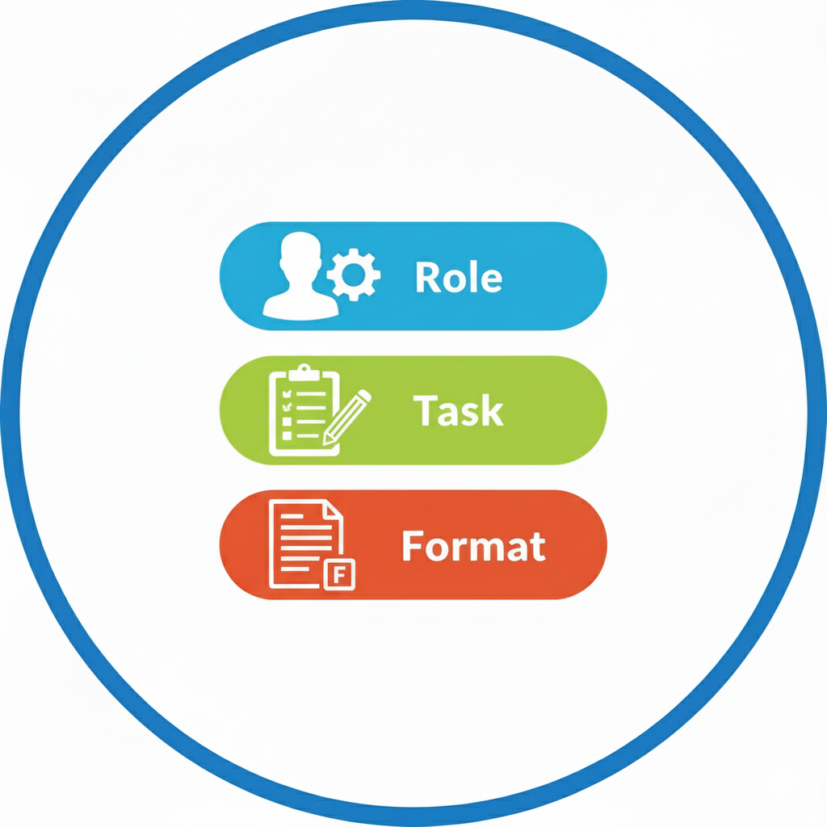
The Art of Asking AI Right
Prompt Element | Content to Give the AI
Role | Act as a friendly travel guide who is enthusiastic about modern history.
Task | Summarize the rapid growth and development of UAE since 1990’s, focusing on its transformation.
Format | Deliver a welcoming, conversational introduction followed by a list of three impactful facts using bold headlines.
RTF Framework
Notes:
The RTF framework is excellent for achieving high-precision, single-step outputs that are ready for immediate use.

Slide 29
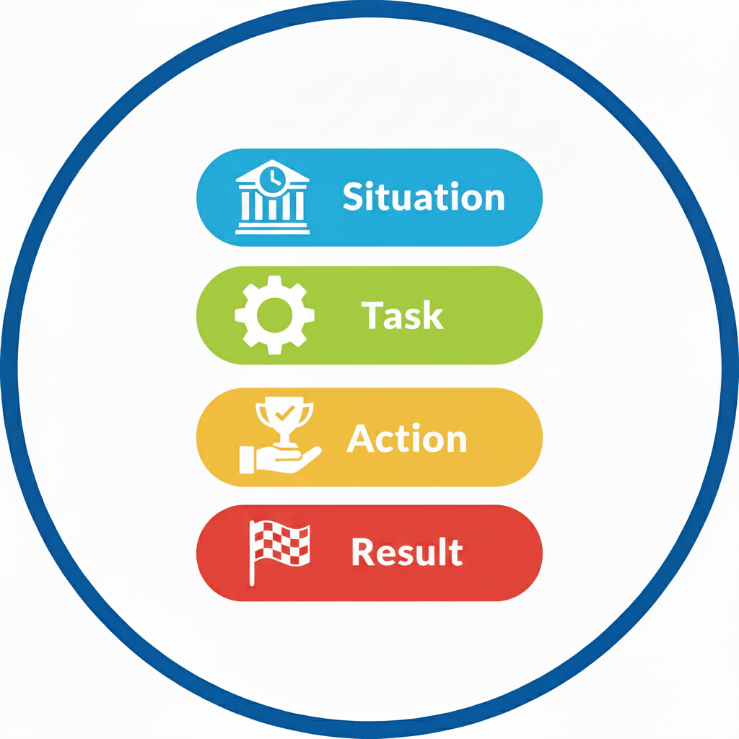
The Art of Asking AI Right
Prompt Element | Content to Give the AI
Situation | "My project requires transferring a very large archive file (50GB+) over a long-distance, high-latency network connection."
Task | "Compare the suitability of TCP vs. UDP for this specific file transfer task and justify which protocol is superior."
Action | "The analysis must focus only on reliability, overhead, and congestion control mechanisms inherent to each protocol."
Result | "Present the comparison as a table with columns: Feature, TCP Performance, and UDP Performance. Conclude with a single sentence stating the best choice."
STAR Framework
Notes:
The STAR framework is excellent for problem-solving because its structure forces the user (and the AI) to define the specific circumstances, required actions, and expected verifiable outcomes of the solution.

Slide 30
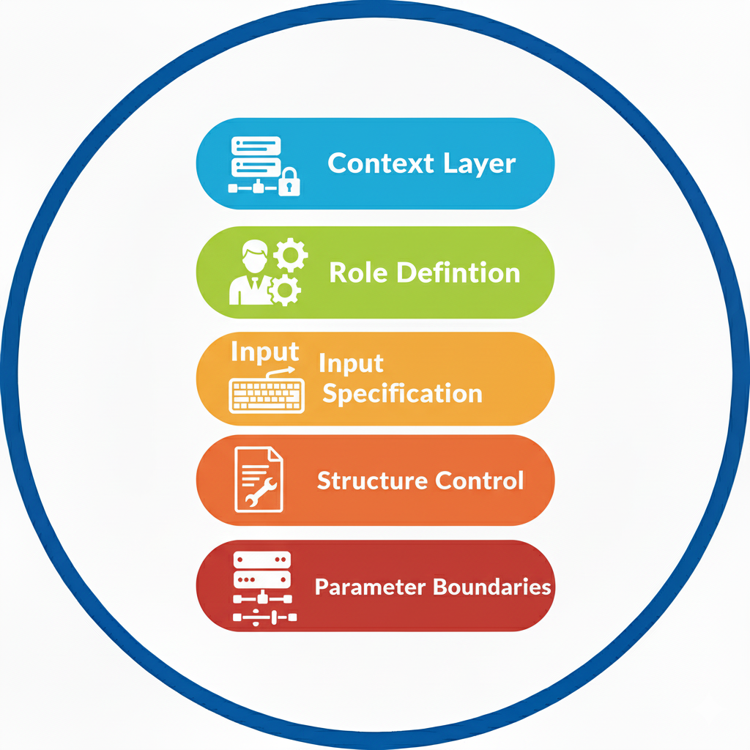
The Art of Asking AI Right
Prompt Element | Content to Give the AI
Context | A new office requires addressing for 500 hosts.
Role | Act as an IP Address Management (IPAM) Specialist.
Input | Supernet: 10.10.0.0/16. Requirement: Must support a minimum of 550 usable hosts.
Structure | Output four specific values: CIDR, Subnet Mask, Network Address, and Broadcast Address.
Parameters | Use the smallest possible CIDR mask that meets the host requirement.
CRISP Framework
Notes:
It is a structured adaptation rather than a widely-established standard framework.
The CRISP framework is excellent for complex infrastructure projects because its structure forces the user (and the AI) to define the contextual environment, technical constraints, quantifiable specifications, deliverable formats, and non-negotiable parameters of the design.

Slide 31
CRISP FRAMEWORK: DESIGN

Slide 32
CRISP FRAMEWORK: DESIGN
Context: ACME LIR has received /29 IPv6 allocation from RIPE. Network has 2 data centers (Main DC + DR site), serves multiple customer types with different addressing needs.
Role: Senior IPv6 network architect with hierarchical addressing expertise.
Input:
- Allocated: /29 IPv6 block from RIPE
- Infrastructure: Main DC + DR site (need /32 each)
- Customer segments:
* DIA customers: /48 per customer
* ADSL residential: /56 per customer
* IP Transit eBGP customers: /48 per customer

Slide 33
CRISP FRAMEWORK: DESIGN
Structure: Provide addressing hierarchy table showing:
1. DC allocations (/32 each)
2. Customer segment breakdowns
3. Infrastructure/interconnect subnets
4. Reserved space for growth
5. Output in Table format
Parameters: Follow RFC best practices, maintain clean aggregation.

Slide 34
2001:DB8::/29

Slide 35
2001:DB8::/29
1st /32
2nd /32
3rd …
Main DC
DR Site
..…
2001:DB8::/32
2001:DB9::/32

Slide 36
Infrastructure
2001:DB8:0000:0000::/36
DIA Customers
2001:DB8:0000:1000::/36
Main DC
2001:DB8::/32
IP Transit Customers
2001:DB8:0000:2000::/36
Broadband Customers
2001:DB8:0000:3000::/36

Slide 37
Infrastructure
4,096 × /48
2001:DB8:0000:0000::/36
DIA Customers
4,096 × /48
2001:DB8:0000:1000::/36
IP Transit Customers
4,096 × /48
2001:DB8:0000:2000::/36
Broadband Customers
4,096 × /48
256 × /56
2001:DB8:0000:3000::/36

Slide 38
CRISP FRAMEWORK: Config

Slide 39
CRISP FRAMEWORK: Config
Context: Generate IPv6 configurations for 6 Cisco routers implementing 6to4 transition design based on the addressing scheme above. The ISP is using Internet in a VRF design.
Role: Senior Cisco IPv6 network architect with IPv6 implementation expertise and 6PE (IPv6 Provider Edge)
Input:
- 6 Cisco routers requiring IPv6 configuration.
- Implement 6PE (IPv6 Provider Edge)tunneling mechanism.
- Use addressing hierarchy from previous design.
Router roles: 3x DC edge, 3x customer access.
ACME-INTERNET-VRF is used for the INTERNET
10.1.1.0/24 is used for IPv4 Loopbacks.
10.1.2.0/24 is used for IPv4 IGP.
AS65100

Slide 40
CRISP FRAMEWORK: Config
Structure: Generate for each router:
1. IPv6 interface configuration.
2. 6VPE setup between EDGE and Customer Access Router.
3. IGP & MPLS routing protocol config.
4. Customer-facing interface templates.
Parameters: Use Cisco IOS-XR syntax, include security basics, relevant descriptions, provide clear router identification, enable IPv6 routing protocols.

Slide 41
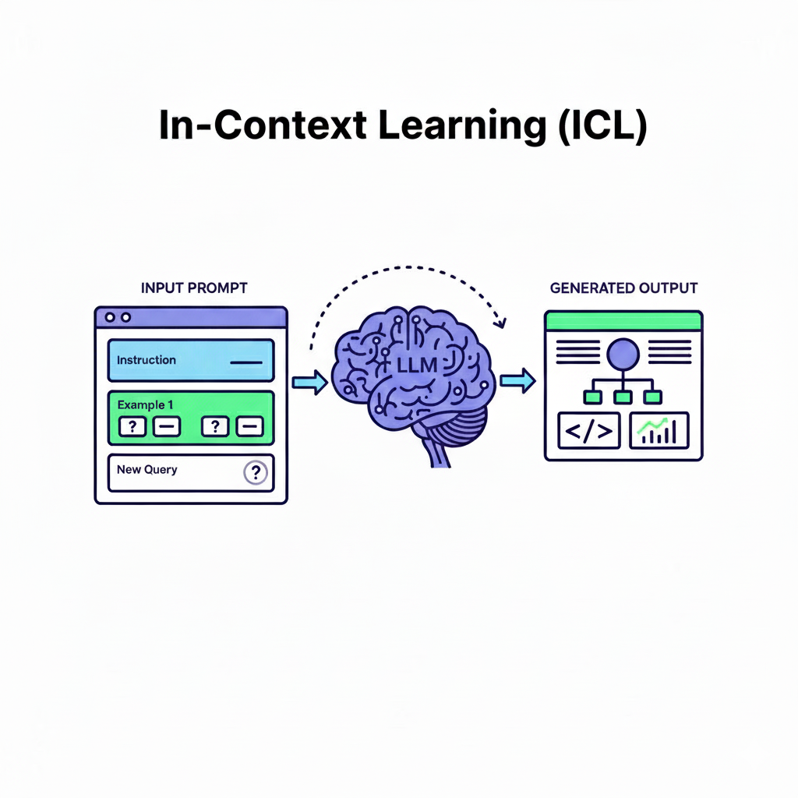
CRISP FRAMEWORK: Config

Slide 42
Cisco XR based Configuration
DC-EDGE-1: Interface Configuration
interface Loopback0
description IPv4 loopback for router-id / LDP transport
ipv4 address 10.1.1.11 255.255.255.255
!
interface GigabitEthernet0/0/0/0
description IGP link
ipv4 address 10.1.2.11 255.255.255.0
no shutdown
!
DC-EDGE-2: Interface Configuration
interface Loopback0
description IPv4 loopback for router-id / LDP transport
ipv4 address 10.1.1.12 255.255.255.255
!
interface GigabitEthernet0/0/0/0
description IGP link
ipv4 address 10.1.2.12 255.255.255.0
no shutdown
!

Slide 43
Cisco XR based Configuration
DC-EDGE-1: IGP/OSPF Configuration
router ospf 1
router-id 10.1.1.11
area 0.0.0.0
interface GigabitEthernet0/0/0/0
exit
!
mpls ldp
enabled
interface Loopback0
interface GigabitEthernet0/0/0/0
interface GigabitEthernet0/0/0/1
DC-EDGE-2: IGP/OSPF Configuration
router ospf 1
router-id 10.1.1.12
area 0.0.0.0
interface GigabitEthernet0/0/0/0
exit
!
mpls ldp
enabled
interface Loopback0
interface GigabitEthernet0/0/0/0
interface GigabitEthernet0/0/0/1

Slide 44
Cisco XR based Configuration
DC-EDGE-1: BGP Configuration
router bgp 65100
bgp router-id 10.1.1.11
!
address-family vpnv4 unicast
!
address-family vpnv6 unicast
!
neighbor 10.1.1.12
remote-as 65100
update-source Loopback0
address-family vpnv4 unicast
!
address-family vpnv6 unicast
!
DC-EDGE-2: BGP Configuration
router bgp 65100
bgp router-id 10.1.1.12
!
address-family vpnv4 unicast
!
address-family vpnv6 unicast
!
neighbor 10.1.1.11
remote-as 65100
update-source Loopback0
address-family vpnv4 unicast
!
address-family vpnv6 unicast
!

Slide 45
CRISP FRAMEWORK: RIPE OBJ

Slide 46
CRISP FRAMEWORK: RIPE OBJ
Context: Context: Create production-ready RIPE database objects for ACME's IPv6 allocation and routing announcements using the addressing design above.
Role: RIPE database administrator with object creation and submission expertise.
Input:
Organization: ACME-LIR
IPv6 blocks: [from design above]
AS Number: AS65100
Need inet6num and route6 objects
Maintainer: MNT-ACME-LIR
Inet6num status: Assigned
Technical contact: TC123-RIPE
notify:ripe-db@acme.com

Slide 47
CRISP FRAMEWORK: RIPE OBJ
Structure: Generate complete database objects:
inet6num object for main allocation
route6 object for BGP announcement
Required cross-references and attributes
Proper formatting for database submission
Parameters: Strict RIPE syntax compliance, include all mandatory fields, proper object relationships, ready for direct submission.

Slide 48
IPv6 Inet6num Objects
inet6num: 2001:DB8:0000:1000::/48
netname: ACME-DIA-1
descr: DIA customer prefix 1 for ACME-LIR
org: ORG-ACME1-RIPE
country: UAE
admin-c: ACME-RIPE-ADMIN
tech-c: TC123-RIPE
status: ASSIGNED
mnt-by: MNT-ACME-LIR
mnt-lower: MNT-ACME-LIR
source: RIPE
inet6num: 2001:DB8:0000:1001::/48
netname: ACME-DIA-2
descr: DIA customer prefix 2 for ACME-LIR
org: ORG-ACME1-RIPE
country: UAE
admin-c: ACME-RIPE-ADMIN
tech-c: TC123-RIPE
status: ASSIGNED PA
mnt-by: MNT-ACME-LIR
mnt-lower: MNT-ACME-LIR
source: RIPE

Slide 49
IPv6 Route6 Objects
route6: 2001:DB8:0000:1000::/48
descr: route for DIA customer 1
origin: AS65100
mnt-by: MNT-ACME-LIR
mnt-lower: MNT-ACME-LIR
created: 2025-09-21
last-modified: 2025-09-21
source: RIPE
route6: 2001:DB8:0000:1001::/48
descr: route for DIA customer 2
origin: AS65100
mnt-by: MNT-ACME-LIR
mnt-lower: MNT-ACME-LIR
created: 2025-09-21
last-modified: 2025-09-21
source: RIPE
Notes:
There it is. Production-ready RIPE database objects. Generated in under 2 minutes.

Slide 50
The Transformation Moment
Notes:
A complete IPv6 addressing hierarchy designed with AI assistance—work that typically takes days or weeks, done in minutes.

Slide 51
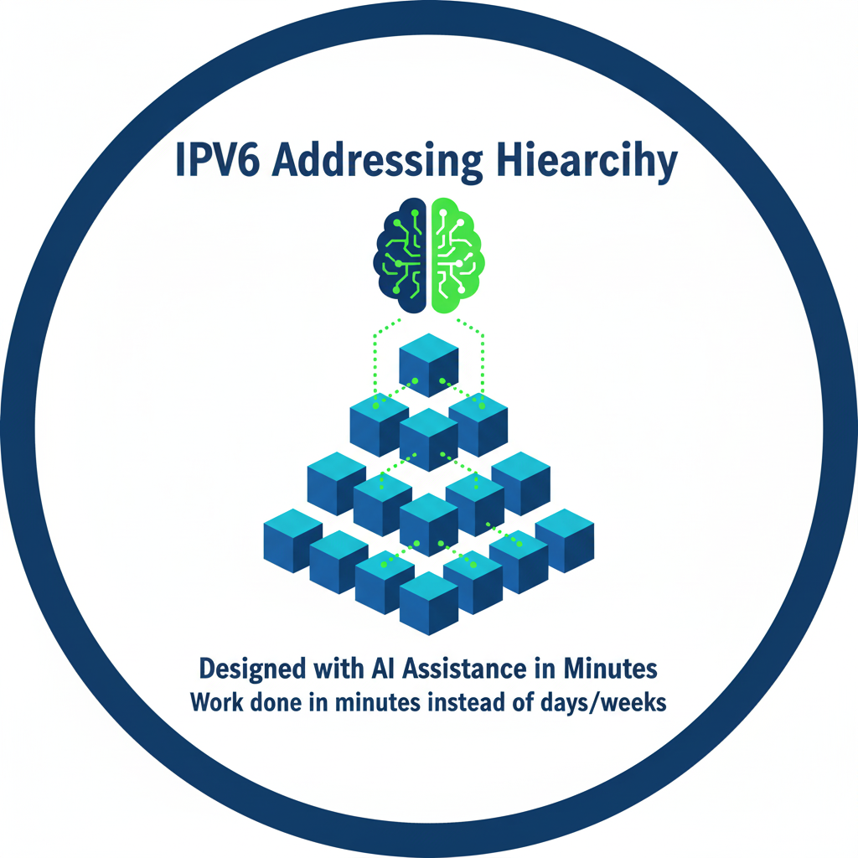
The Transformation Moment
Notes:
A complete IPv6 addressing hierarchy designed with AI assistance—work that typically takes days or weeks, done in minutes.

Slide 52
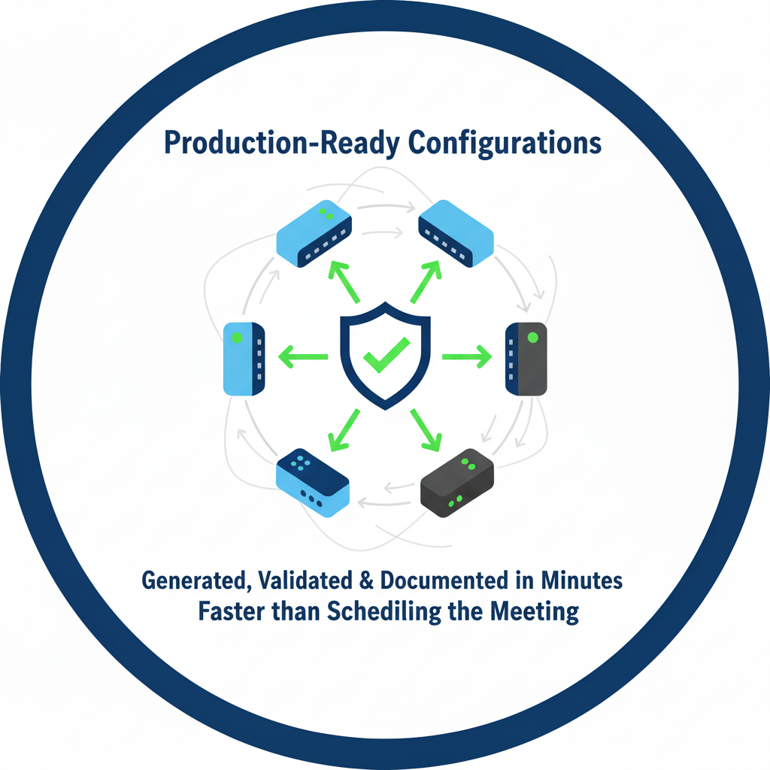
The Transformation Moment
Notes:
Production-ready configurations Generated configuration across multiple routers with complex IPv6 implementation.

Slide 53
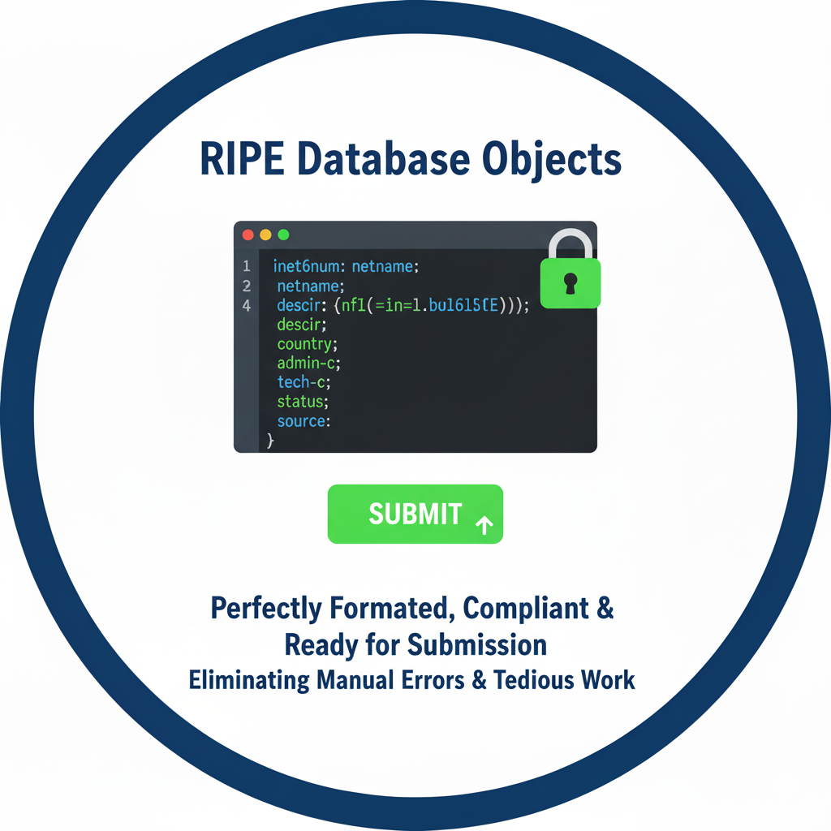
The Transformation Moment
Notes:
RIPE database objects perfectly formatted, compliant, ready for submission—eliminating the tedious manual work and error-prone syntax issues.
Extensive experience is not required. You don't need to initially hire expensive consultants. You don't need to send your entire team for six months of training.
Junior engineers with AI assistance can now design like seasoned architects. Small teams can accomplish what used to require entire departments.
This is the great equalizer for our industry."

Slide 54
THANK YOU

